Slide 1
MIFOS TRAINING SLIDES

Slide 2
SIGN IN
Your system administrator will provide you with your username, password, and the URL you need to access your financial institution's implementation of Mifos X. Once you have your username and password, you are ready to sign in to the Mifos X system.
Open a browser window (e.g., Firefox, Chrome, Internet Explorer).
Enter the URL in the address bar The Mifos X Sign In Page will display.
Enter your username in the username field.
Enter your password in the password field.
Click Sign In The Mifos Welcome Page will display.

Slide 3
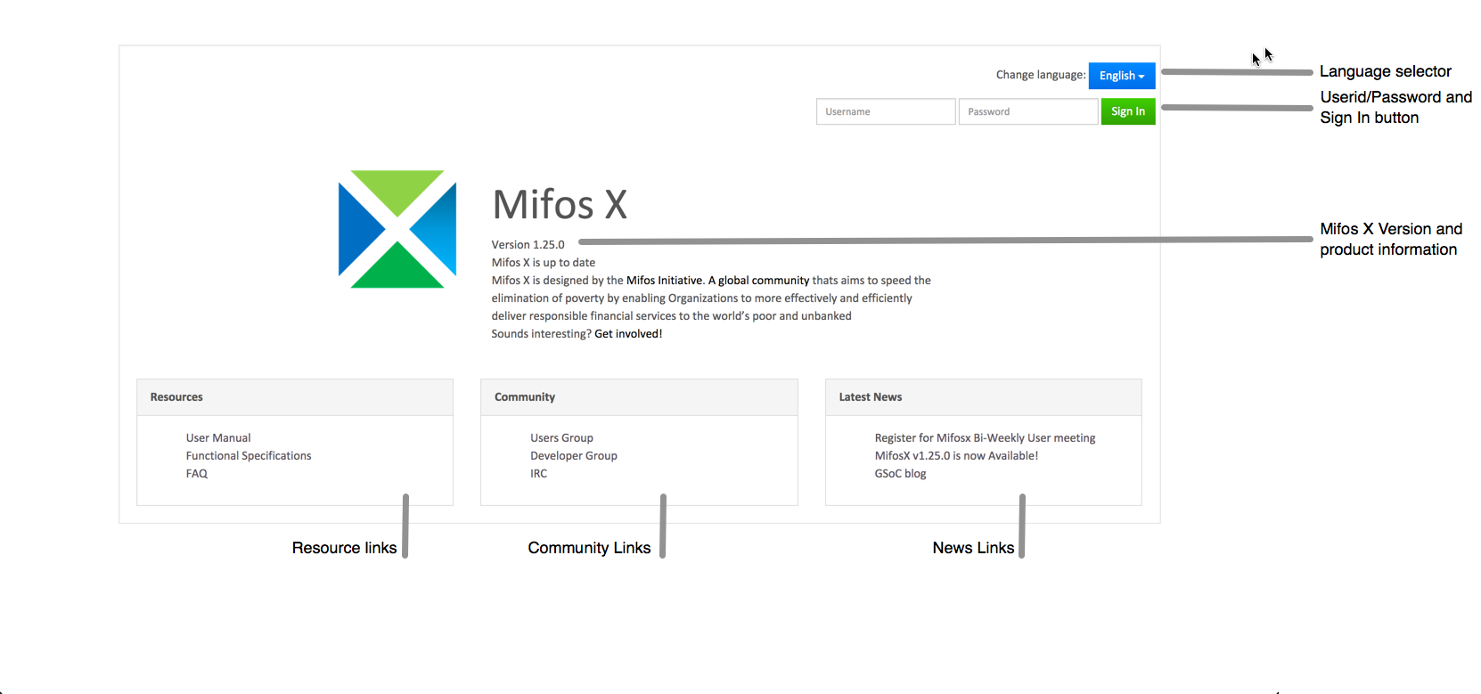

Slide 4
In addition, the Sign In page features:
Language selector menu
Mifos X version and product information
Resource links
Community links
News links
To change the language, click the blue drop down next to Change language, then click on the language you want.
To access a link in the Resource, Community, or Latest News box, click on it.

Slide 5
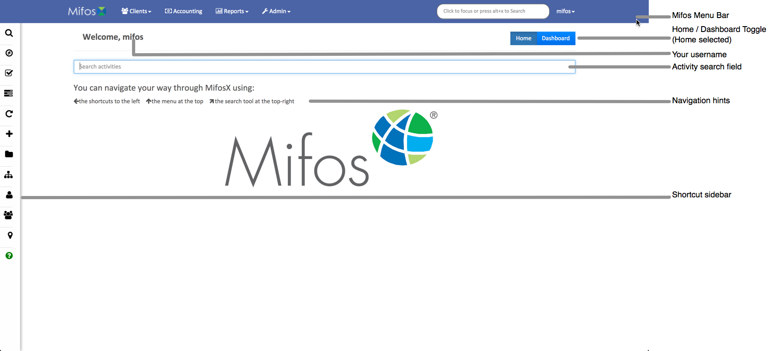
WELCOME PAGE
The Welcome page is displayed when you sign in to Mifos X.
5

Slide 6
The Blue Mifos Menu Bar displayed across the top of the Welcome page is displayed on every page in the Mifos X system. The menu bar includes:
Mifos Logo-Access the Welcome page from anywhere in the Mifos X system
Clients Menu
Access Clients
Groups
Centers
Accounting Menu
Access the accounting activities page
Reports Menu
Access reports
Admin Menu
Access administrator activities
Search Tool
Use the search tool to search for clients, groups, and centers
Mifos Menu -
Access to Help (Keyboard Shortcuts),
Profile (Your user Profile, including an activity to change your Password),
Settings (Language and Date Format),
Log Out (Sign Out of Mifos X)

Slide 7
The Activity Search tool is a quick method to find and navigate to activities / pages in the Mifos X system. For example, if you want to access an activity related to loans, type "loan" into the activity search field. Loan-related activities will be listed (i.e., create loan product, loan products, bulk loan reassignment). You can then click on the desired loan activity. Similarly, you can access activities related to clients, savings products, groups, and more.
The Navigation Hints point out navigation methods that are available to you wherever you are in Mifos X, including:
Shortcut Menu (Sidebar)
Mifos Menu Bar
Search Tool (Located on the Mifos Menu Bar)
The Shortcut Menu is a sidebar menu of favourite Mifos X activities. You can configure the Shortcut sidebar to suit the work you do and how you do it. The Shortcut sidebar will pop out when you hover the mouse over the menu area. The Shortcut sidebar is available on every page in the Mifos X system.

Slide 8
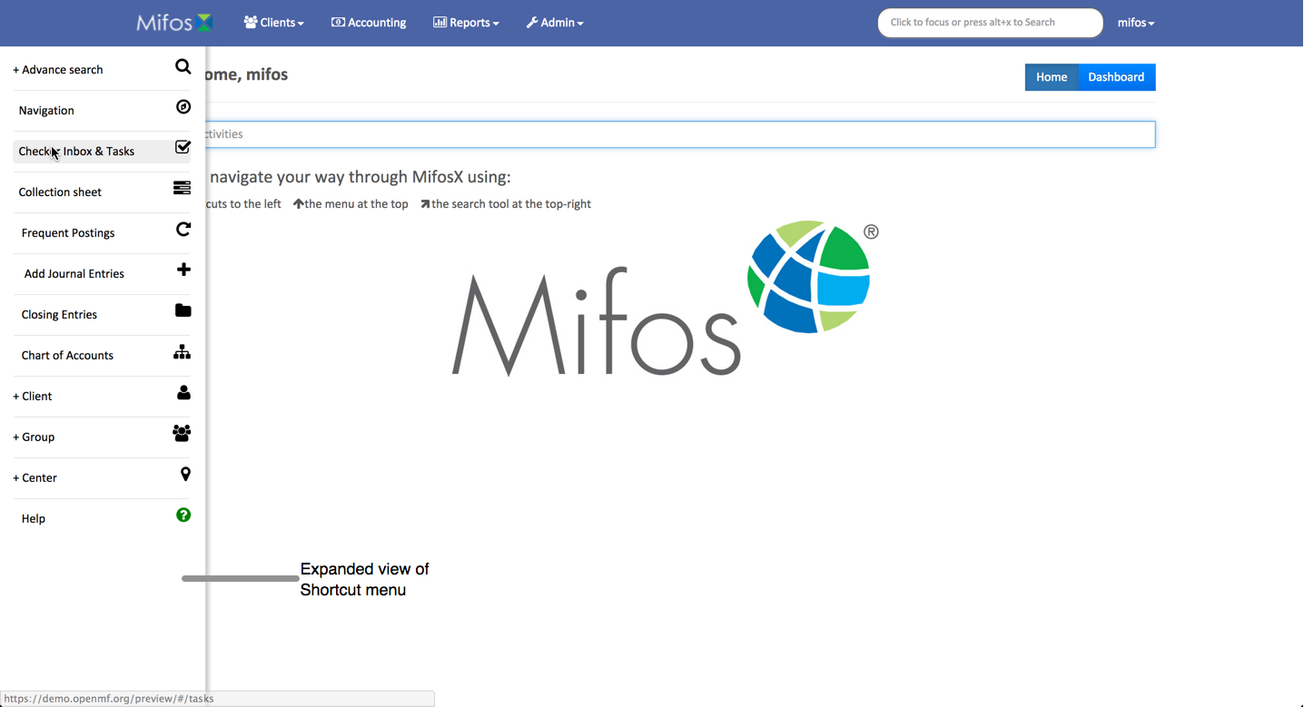
8

Slide 9
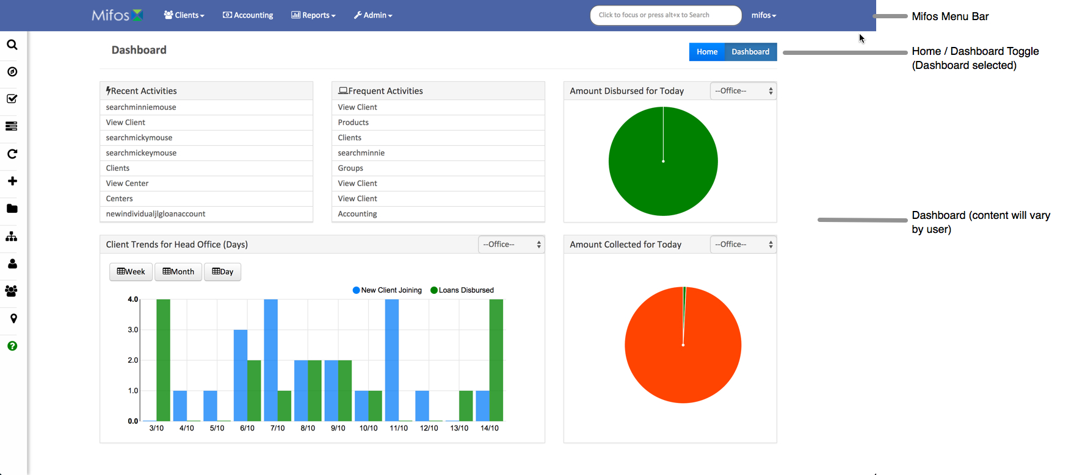
DASHBOARD
The Dashboard page is displayed when you click Dashboard on the Welcome page. The Dashboard contents will be unique to each user.
To launch an activity listed under Recent Activities and Frequent Activities, click on it.
9

Slide 10
LIST PAGE
The List page layout is used throughout Mifos X and is a method to view and access information.
The Mifos menu bar and the Shortcut sidebar menu are available on list pages.
The grey bar under the Mifos menu bar identifies the type of information presented in the list.
One or more bright blue Activity buttons may be present below the grey bar. The label on the button tells you the activity that will be launched when you click it.
The Filters allow you to narrow the listed information on the page. The text in the filter field informs you what fields will be filtered when you enter a filter.
Page navigation buttons (<–Prev, Next –>) at the bottom of the page are used to scroll forwards and backwards through the list.
To view the complete information for one of the rows displayed in the list, click on it.

Slide 11
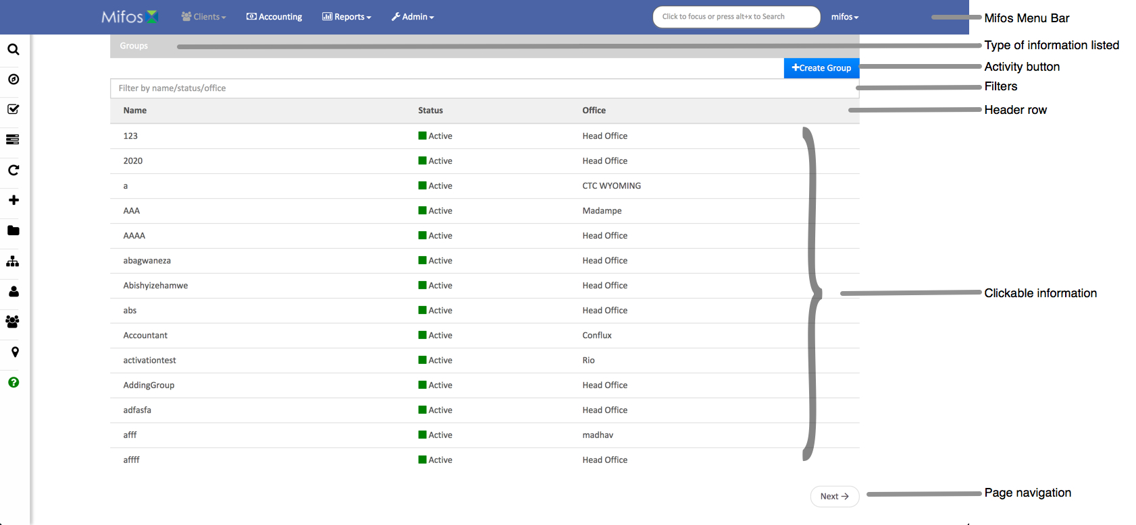
11

Slide 12
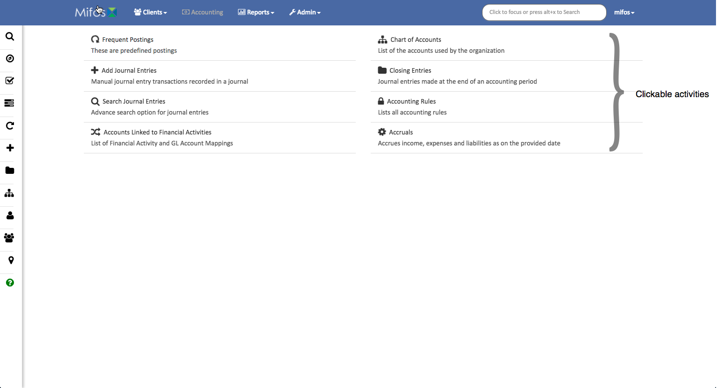
MENU PAGE
The Menu page layout displays two columns of activities with a description of what each activity does. To launch an activity, click on its name.
The Mifos menu bar and the Shortcut sidebar menu are available on menu pages.
12

Slide 13
CLIENTS-GROUPS-CENTERS NAVIGATION
If want see information related to Clients, Groups and Centers, click on 'Clients' tab to see following drop down menu which shows Clients, Groups and Centers sub-menu tabs

Slide 14
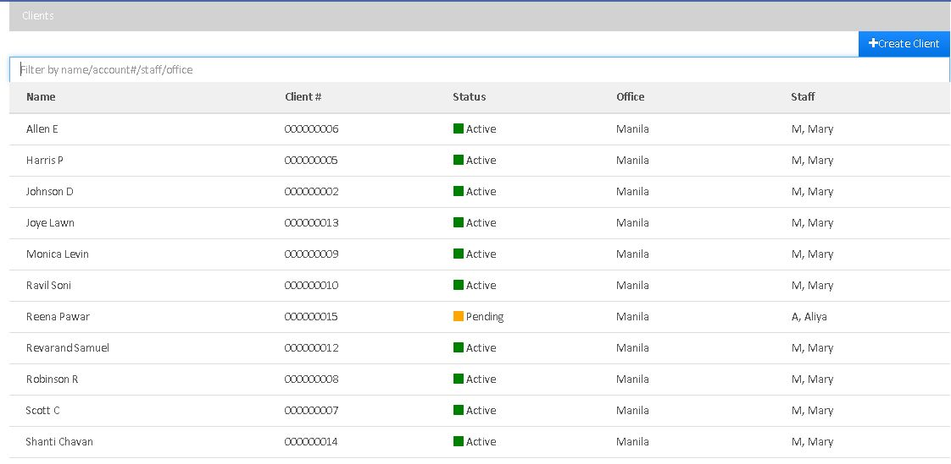
CLIENTS NAVIGATION
Click on Clients sub-menu tab to see the list of clients as shown below.

Slide 15
It shows list of clients with their name, account number(client #) , status, office and staff.
It is provided with search menu using which you can search the clients by typing their name.
You can create a new client by clicking on '+Create Client' button.
Client Status may be Active, Pending or Closed.
To see the information regarding any client – that is his/her personal profile, loan accounts and saving accounts, click on the client name and the following window will appear:
15

Slide 16
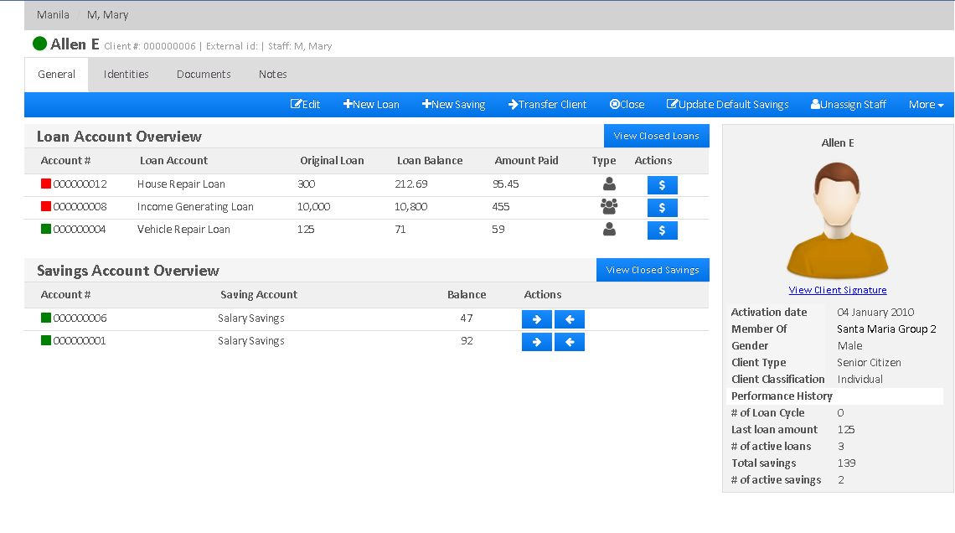
16

Slide 17
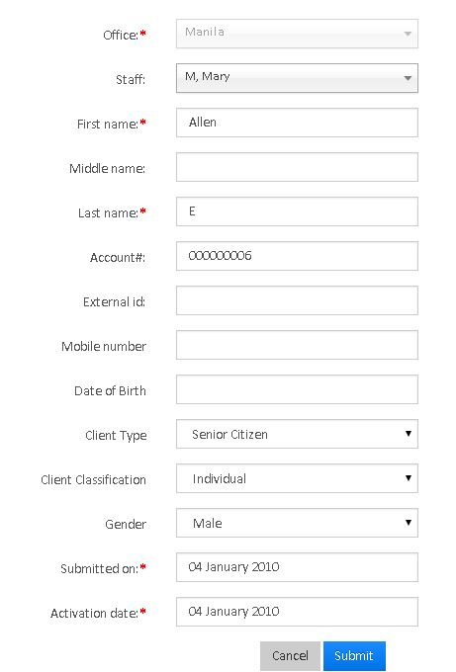
Create a Client
Click on "Clients" tab on top left, next to Mifos icon on home page. It opens the news page containing list of all the clients.
There is a "+Create Client" tab on top right corner, Click on it to see the following page

Slide 18
FIELD NAME | DESCRIPTION
Staff | Assign a staff for the client based on the office
Open Saving Account | Check this, to create the savings account for the client while client is being created. After checking this, one more field will appear, "select saving account", in order to select the savings product.
Office | Select the office to which Client belongs
Mobile Number | Enter the Client's Mobile Number
Last Name | Provide Client's Last Name (Mandatory Field)
Gender | Use the drop-down menu to select the gender of client.
First Name | Provide Client's First Name (Mandatory Field)
External ID | Give the unique ID which is useful for searching options and whenever client is transferred from one branch to another.
Date Of Birth | Enter the Client's Date of Birth using Date Picker
Client type | From the drop down, select the client type. This may be individual, business, child, senior citizen. Your organization creates Client Type during Initial Configuration
Client Classification | Here you can select indiviidual, married, widow. etc.
Active | Checking it , will enable one more field, Activation Date. If Client is already activated please provide activation date.
18

Slide 19
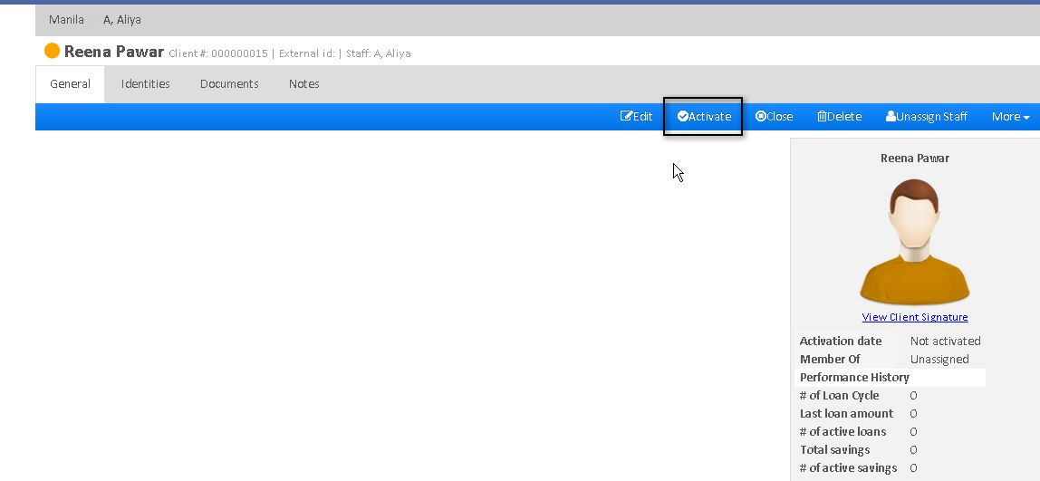
ACTIVATE A CLIENT
If Client is not activated, while creation then follow these steps:
1) In the list of Clients, select the client and click on Activate button as shown in the image.
19

Slide 20
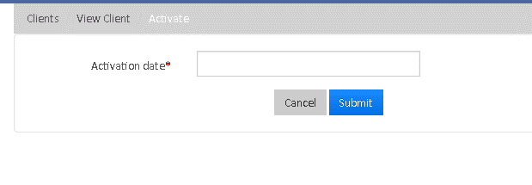
2) Refer the following image and enter the activation date and click on submit button to activate the client

Slide 21
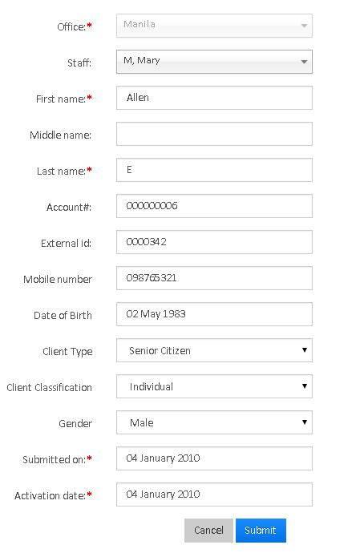
Edit an existing client
In order to edit the Client,
1) Click on Client to view the client
2) Then Click on Edit button to see the following window:
3)Enter the details and click on Submit button.

Slide 22
ASSIGN STAFF TO A CLIENT
To assign a staff for the client,
Click on Client to view the client
Then click on "Assign Staff" tab.
Select the staff from drop-down list
TRANSFER A CLIENT
1. Open the list of clients by clicking on "Clients" tab. 2. Click on the client to view his profile 3. Click on the "Transfer Client" tab

Slide 23
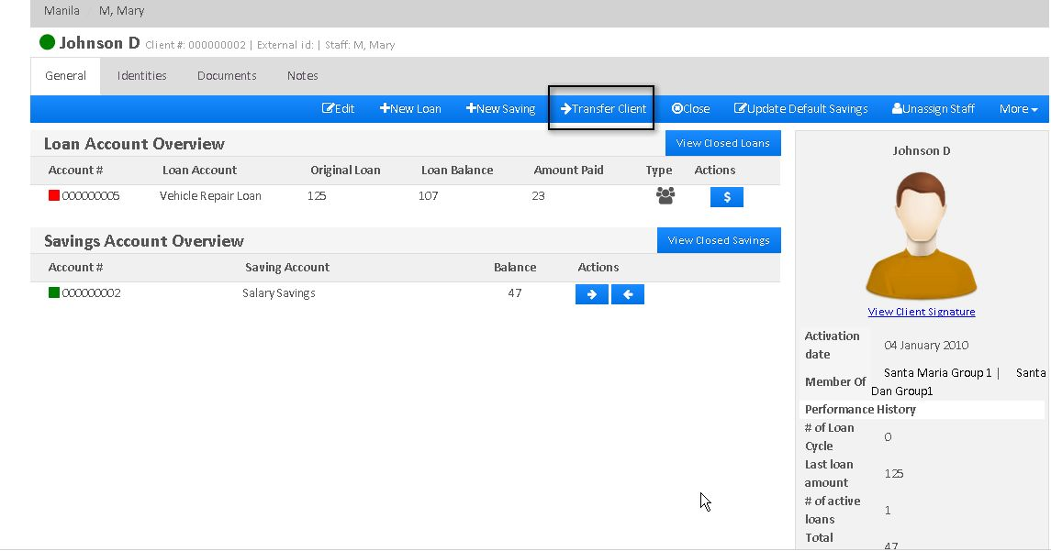

Slide 24
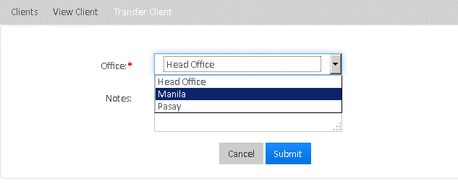
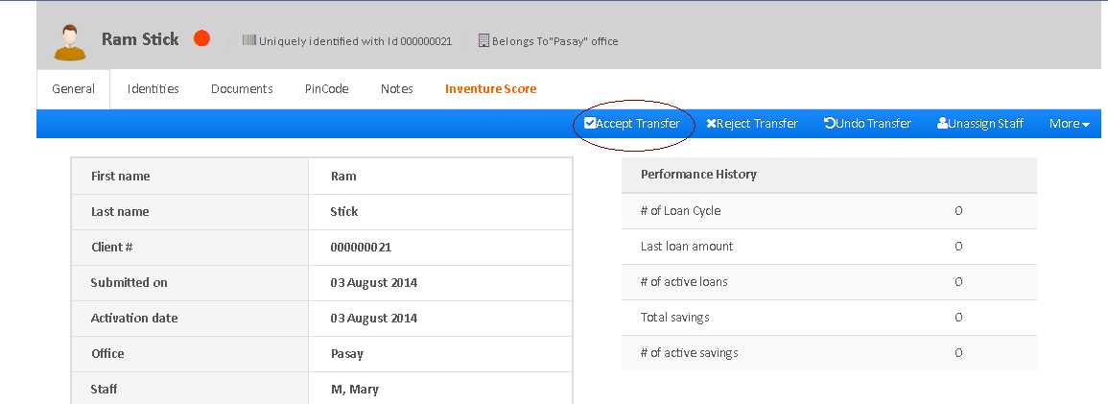
4) Select the office to where Client is transferred and then click on Submit button.
5) A new window will open where you have to click on "Accept Transfer" tab to finish the client transfer.
24

Slide 25
CLOSE A CLIENT
Follow these steps in order to Close a Client
Go to the Client's profile.
Click on "Close" tab
A new window will open. Provide "Closure Date" and "Closure Reason".
Click on "Submit" button to close the Client.

Slide 26
GROUPS NAVIGATION:
i) Click on Clients main menu and then click on 'Groups' sub-menu to see the list of groups as shown below.
ii) It shows list of groups with their name, group status and the office it belongs to.
Iii) Using Search menu, you can search the group by typing its name.
iv) To create a new group, click on '+Create Group' tab.
v) To see the information regarding any group, click on the name of the group.

Slide 27
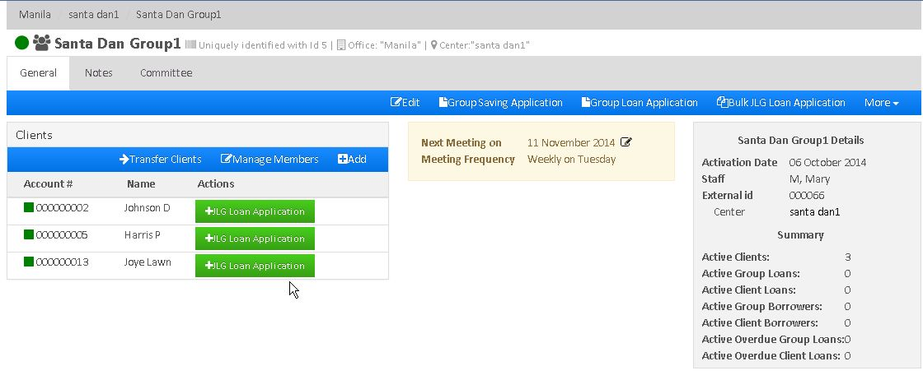
vi) It shows list of clients in the group, Group Meeting information and Group profile.
vii) You can create JLG (Joint Liability Group) Loan Application for each client by clicking on '+JLG Loan Application' or for multiple clients by clicking on 'Bulk JLG Loan Application'
viii) You can create 'Group Saving Application' and 'Group Loan Application' from this page.

Slide 28
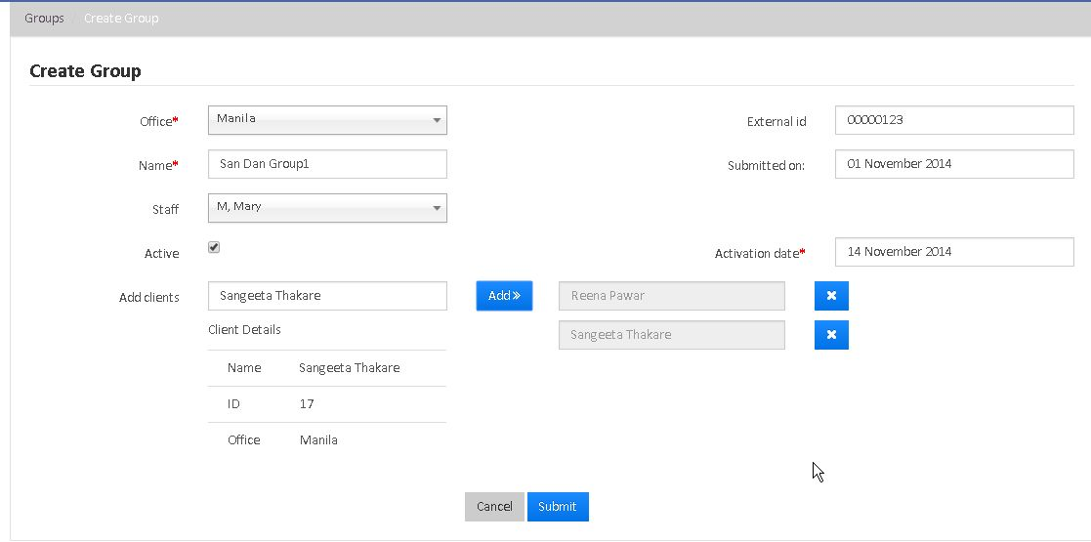
CREATE A NEW GROUP
From Mifos Home Page, there are three ways of creating a group: Search Activities box, Clients drop-down menu, or via the Navigation bar.
In Search Activities box, start typing the text create group. The field auto-populates. Press Enter. The Create Group page opens. Provide details in the following fields.
Click Clients drop-down box. Select Groups. Click on ”+CreateGroup” The Create Group page opens.
28

Slide 29
3) Once the Create Group page opens. Provide details in the following fields
FIELD NAME | DESCRIPTION
Office | From drop-down menu, select the office to which the clients belong to in order to create their group.
Name | Provide the name for the group (Mandatory Field)
Staff | From drop-down menu select the available staff belonging to the particular office.
Add Clients | Allows you to select from a list of available clients
Active | Allows you to activate the group for specific date.
Activation Date | Allows you to select a current or back date
External ID | Provide External Id for the group
Submitted ON | Provide the submission date to create group.
Once the group is Created, The next step is to assign the meeting date for the group. In order to assign meeting date, go to the group and click on 'More' tab and then click on "Assign Meeting Date to see the following window:

Slide 30
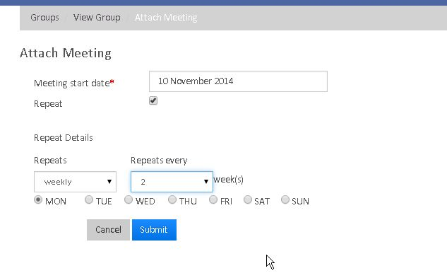
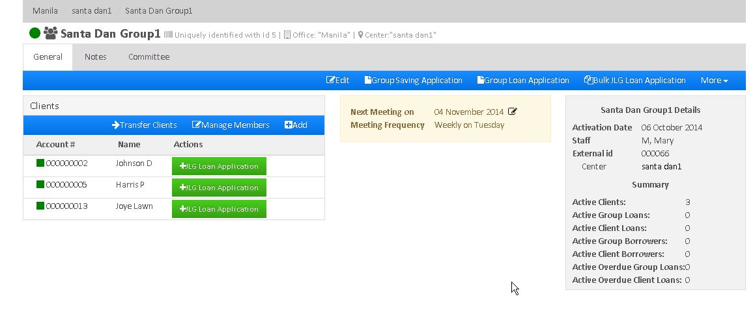
After that the window of a specific group looks like the below image:
30

Slide 31
As shown in the above image, the Group window displays: i) The list of Clients in the group ii) Group's next meeting date, meeting frequency and meeting day. iii) Group Activation Date, Staff and External Id iv) Number of Active Clients, Active Group loans, etc.
ASSIGN STAFF TO A GROUP
From the list of existing groups, navigate to the group you want to assign staff to.
From the More drop down menu, select Assign Staff. The Assign Staff page opens.
Select staff from the drop-down menu.
Click submit.
EDIT GROUP DETAILS
From the list of existing groups, navigate to the group you want to edit the details of.
From the Group page, click Edit button. The Edit Group page opens.
Edit the following details.

Slide 32
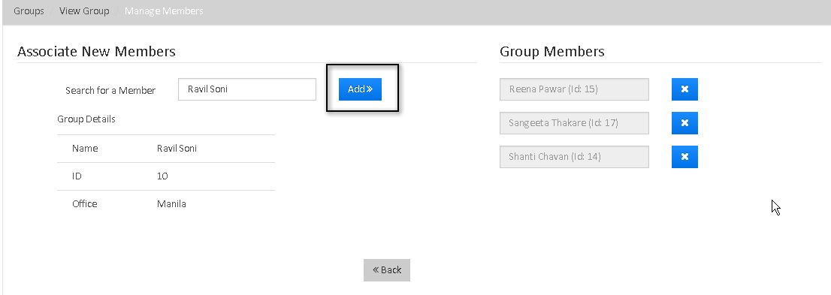
FIELD NAME | DESCRIPTION
Name | Mandatory Field
Staff | Provide the new staff name
External ID | Provide the external id for the group
Activation Date | Provide the activation date of the group
ASSOCIATE EXISTING CLIENTS/MEMBERS WITH A GROUP
1) From the list of existing groups, navigate to the group you want to associate members to.
2) In the Group page, click on Manage Members tab to see the following window.
32

Slide 33
Click Add button to associate the new existing member to the group. ASSIGN NEW MEMBERS TO AN EXISTING GROUP
From the list of existing groups, navigate to the group you want to add members to.
2) In the Group page, click Add tab to create a client .
3) Enter the details of the client and click submit button to add the client to the group.
4) Click Submit to create the client and associate him to the group.
TRANSFER CLIENTS BETWEEN GROUPS
From the list of existing groups, navigate to the group you want to transfer clients from.
2. In the Group page, click on Transfer Clients tab to see the following window:
3. Select the desired clients and click on ">>" button and select the destination group.
4. Click on submit button to transfer the clients to destination group.

Slide 34
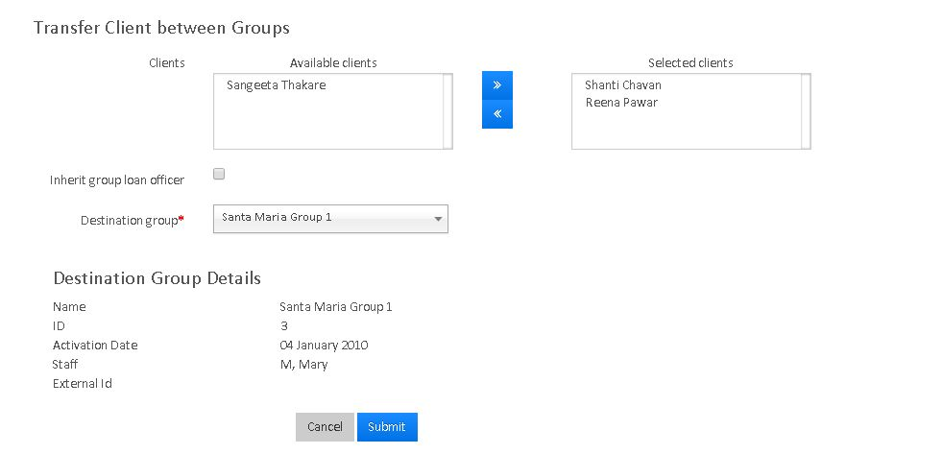

Slide 35
Saving Account can be created for whole group rather than single client. The Group Saving Account is shared between all the members of the Group. They can do all the transactions like Deposit and Withdraw.
TO CREATE GROUP SAVING ACCOUNT:
Go to the specific Group and click on 'Group Saving Application'.
2) On the next window, Select the saving product for the Group.
3) Fill up all the details and click on Submit button
4)Next, the Saving Account needs to be approved and activated with specified date so that each member of the group can make the transactions.
5) Once the Saving Account is created for the Group, the 'Saving Account Overview' is shown on the Group page, highlighting Saving Account Number, Saving Product and Balance.

Slide 36
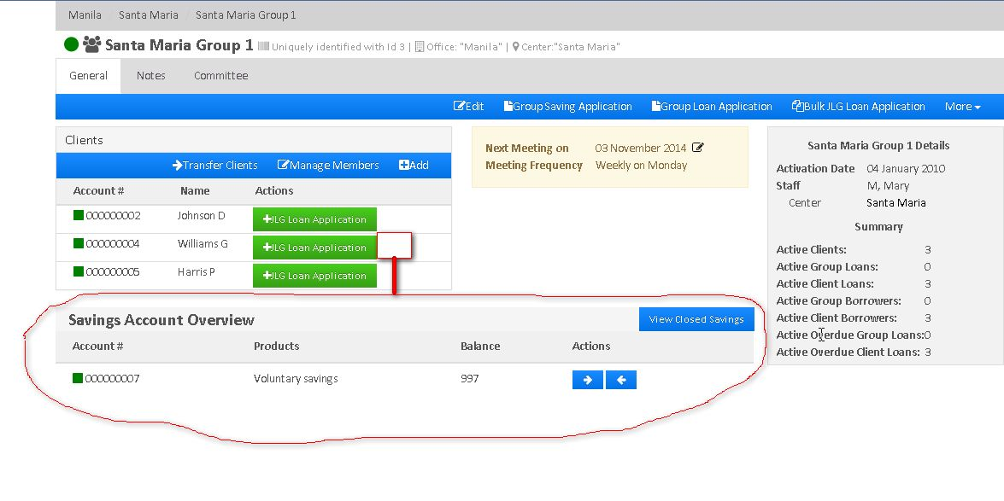
36

Slide 37
Loan Account can be created for whole group rather than single client. The Group Loan Account is shared between all the members of the Group.
TO CREATE GROUP LOAN ACCOUNT:
Go to the specific Group and click on 'Group Loan Application'.
2) On the next window, Select the loan product for the Group.
3) Fill up all the details and click on Submit button.
4)Next, the Loan Account needs to be approved and activated with specified date so that each member of the group can make the transactions.
5) Once the Loan Account is created for the Group, the 'Loan Account Overview' is shown on the Group page, highlighting Loan Account Number, Loan Product and Loan Type(Group, in this case)

Slide 38
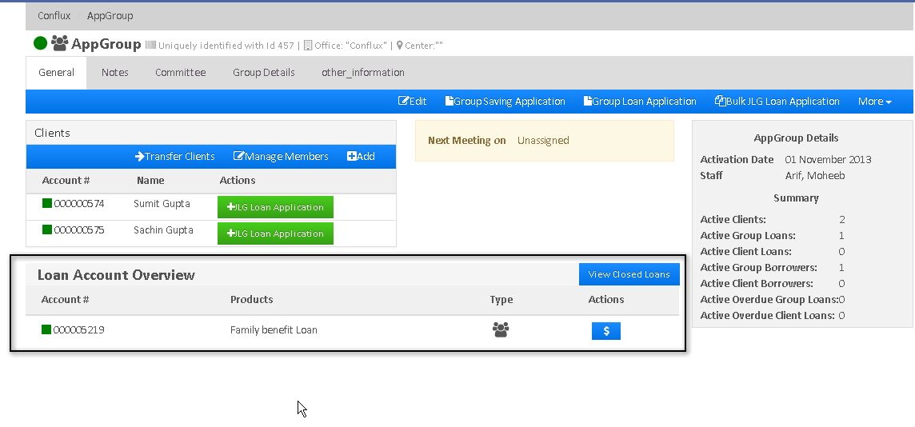
38

Slide 39
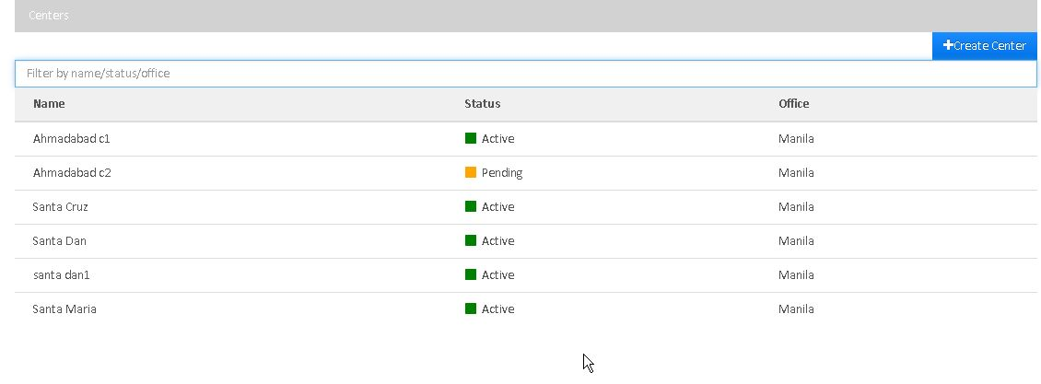
CENTERS NAVIGATION
i) Click on Clients main menu and then click on 'Centers' sub-menu to see the list of centers as shown below.
ii.) It shows list of centers with their name, center status and the office it belongs to. iii.) Using Search menu, you can search the center by typing its name. iv.) To create a new center, click on '+Create Center' v.) To see the information regarding any center, click on the name of the center.

Slide 40
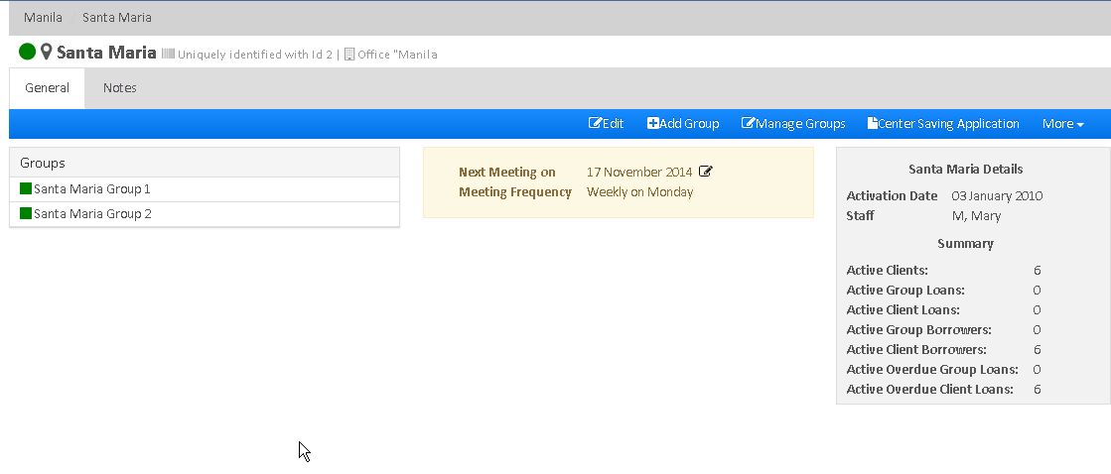
vi) It shows list of Groups in the Center, Center Meeting information and Center profile.
vii) To create a new Group under center, click on '+Add Group'.
viii) To add existing group to the center, click on 'Manage Groups'.

Slide 41
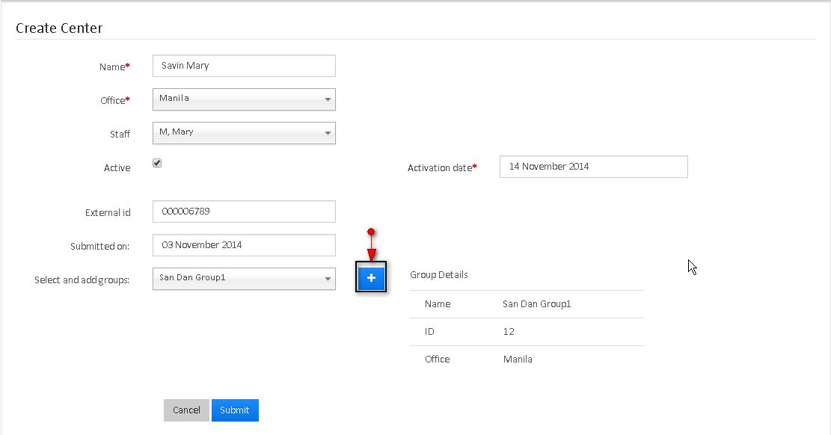
CREATE A CENTER
From Mifos Home page, you can create center in three different ways: Search Activities box, Clients drop-down menu, or via the Navigation bar.
In Search Activities box, start typing the text create center. The field auto-populates. Press Enter. The Create Center page opens. Provide details in the following fields.
Click Clients drop-down menu. Select Centers from the list. Click the +Create Center button on the right corner of the page. The Create Center page opens. Provide details in the following fields.
Point the cursor at the triangle at the left side of the screen. The navigation bar appears. Click on + Center in the navigation bar. The Create Center page opens. Provide details in the following fields.

Slide 42
FIELD NAME | DESCRIPTION
Activation date | A mandatory field that appears when you select Active. Enables you to activate your account for the current date or for a back date.
Active | Select this field to activate the center while creating it.
External ID | Provide some unique id (maybe alpha-numeric) which can be used as search parameter later.
Name | Provide the name for the center (Mandatory Field)
Office | Provide the office name to which the center is registered to. (Mandatory Field)
Select and add groups | From drop-down menu, select the existing groups and add them to the center by clicking '+' button.
Staff | Mention the staff name. ( You can select any one the employee of the office to which the center is registered)
Submitted on | Enables you to submit a center on a particular date.
4. Click on 'Submit' button to create the center.

Slide 43
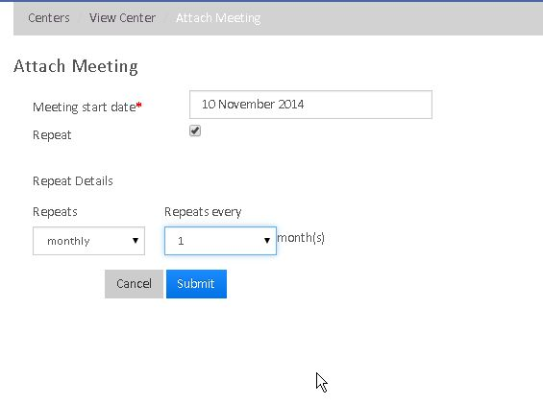
ATTACH MEETING DATE TO THE CENTER:
1) Go to the specific center and click on 'More' tab and then click on 'Attach Meeting Date' to see the following window:

Slide 44
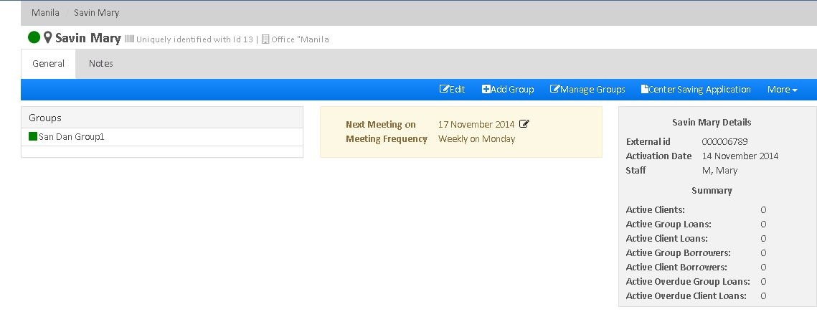
2) Enter Meeting Start Date, Frequency and the day and click on submit button to attach meeting date to the center. Once the center is created with attached meeting date , the Center window looks like this:
The Center window shows the list of Groups under that center, Meeting date, External Id of the center, Activation Date, Assigned staff, Active Clients, Active Group Loans, etc.

Slide 45
ACTIVATE A CENTER
You can activate a center while creating it or in future. The status of the centers that have not been activated appear as Pending.
Navigate to the center you want to activate.
Click Activate button.
Enter activation date. You may choose to activate on the current date or a back date.
You may also activate an existing center by choosing to edit it.
EDIT AN EXISTING CENTER
Navigate to the center you want to edit.
Click the Edit button available at the home page of that center.

Slide 46
You may edit the following fields:
FIELD NAME | DESCRIPTION
Name | Provide the new center name
Staff | Provide the new Staff name
External ID | Enter the new External ID
Activation Date | Enter the Activation Date

Slide 47
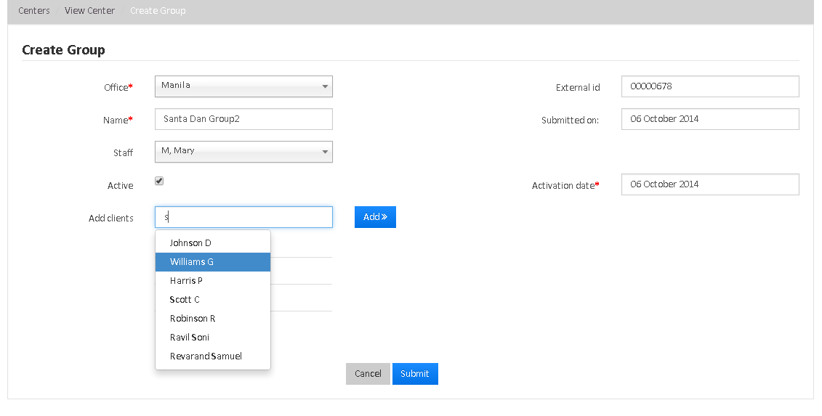
CREATE A NEW GROUP AND ADD TO THE CENTER:
1) Go to the Specific Group and click on 'Add Group' tab to see the following window:
47

Slide 48
2) As shown above, enter the Group details and add the clients
3) Click on Submit button to create the group and add it to the center.
ADD AN EXISTING GROUP TO THE CENTER:
1) Go to the specific Group and click on 'Manage Groups' tab to see the following window:
2) Search the existing Group and add it to the center.

Slide 49
CENTER SAVING APPLICATION
Go the Specific Center and click on 'Center Saving Application' tab to open the saving Application.
2) Select the existing Savings Product and furnish the remaining details.
3) Click on 'Submit' button to create saving application for the center.
4) Finally Approve and Activate the Saving Account.
CLOSE A CENTER
Navigate to the center you want to close.
From the home page of that center, click More.
Select Close from the drop-down menu . The Confirm page opens.
Enter details for the following fields:
FIELD NAME | DESCRIPTION
Closure Date | Mandatory field that allows you to close center on the current or back date
Closure reason | Mandatory field that allows you to choose from the values defined in the Manage Code section.
49

Slide 50
CASH TRANSACTION PROCESSING
In Mifos, Generally cash transactions happen in the following situations:
When loans are disbursed.
When loan repayments are made on client loan accounts.
When loan repayments are made on group loan accounts.
When loan is prepaid on client/group loan account.
When deposits and withdrawals are made on Client's/Group's saving accounts.

Slide 51
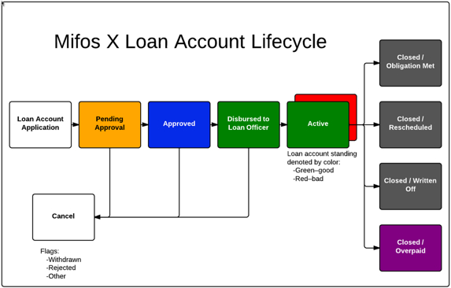
ABOUT LOAN ACCOUNTS
A loan account is an instance of a loan product. A loan account has a unique account number, a specified interest rate, and it is owned by one, and only one, client or group.
A loan account can be created for an active client or group based on a loan product that is active on the submitted date. When a loan account is created, it inherits the rules and defaults from the loan product. Your financial institution may allow some of the inherited information to be modified for a loan account, depending on how the loan product is defined.
A client may have more than one active loan account as defined by a financial institution's policies, configured in the Product Mix.
The loan account lifecycle is illustrated in the Mifos X Loan Account Lifecycle diagram. Loan account statuses are visually indicated in Mifos X using the color scheme illustrated in the Mifos X Loan Account Lifecycle diagram.
51

Slide 52
HOW TO MAKE REPAYMENTS ON A CLIENT LOAN ACCOUNT
This section describes the steps to record a client repayment on a loan account that is not a group loan account or a JLG loan account. The following methods are available:
repayment via cash or similar payment type
one time transfer from saving account
standing instruction transfer from saving account
TO MAKE A REPAYMENT USING CASH OR SIMILAR PAYMENT TYPE
Locate the loan account by navigating to it through the client who holds the loan account.
Select Make Repayment from the action bar.
Accept the default Transaction date or select a different date from the calendar pop-up.
Accept the default Transaction amount or type a different repayment amount.
Select Payment type from the list.
Click + to add payment details (optional).

Slide 53
Account#
Check#
Routing code
Receipt#
Bank#
6.Type relevant notes.
7.Click Submit.
The loan account repayment will be recorded and the repayment schedule and loan summary will be updated with the payment information.
TO MAKE LOAN REPAYMENTS FROM A SAVING ACCOUNT (ONE TIME TRANSFER)
Locate the saving account from which the loan repayment will be made (the originating account).
Click the saving account name in the list to view the saving account information.
Click More and Transfer Funds from the action bar.
Select the group and account (the destination loan account to be repaid) to transfer funds to:
Office: Select the office where the destination loan account is located.
Client: Select the client who holds the destination loan account.
Account type: Select the loan product type upon which the destination loan account is based.
Account: Select the destination loan account.
Amount: Type the transfer amount.
Select the Transaction date from the calendar pop-up.
Type any notes in Description
Click Submit.

Slide 54
HOW TO MAKE REPAYMENTS ON A GROUP LOAN ACCOUNT
This section describes the steps to record a repayment on a loan account that is is held by a group. The following methods are available:
Collection sheet
Repayment via cash or similar payment type
TO MAKE A REPAYMENT USING CASH OR SIMILAR PAYMENT TYPE
Locate the loan account by navigating to it through the group that holds the loan account.
Select Make Repayment from the action bar.
Accept the default Transaction date or select a different date from the calendar pop-up.
Accept the default Transaction amount or type a different repayment amount.
Select Payment type from the list.
Click + to add payment details (optional).
Account#
Check#
Routing code
Receipt#
Bank#
Type relevant notes.
Click Submit.

Slide 55
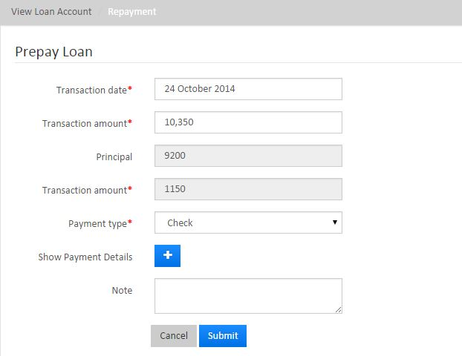
HOW TO PREPAY A LOAN ACCOUNT
TO PREPAY THE LOAN FOR A CLIENT:
To prepay a loan for a client, select the client. Click the General tab.
Click the loan account for which the client wants to prepay the balance.
Click Prepay Loan from the Action Bar to see the following screen with the payoff amount pre-populated summing up the total amount of principal and interest to pay of the loan as of that date.
Enter the Transaction Date, Transaction Amount, Payment Type, (mandatory fields) and Note (optional).
Click Submit. This loan status will now be Closed, paying off the amount due for principal and interest.

Slide 56
THANK YOU FOR ATTENTION

