Slide 1
Withdraw a loan account application

Slide 2
How to Withdraw a Loan Account Application?
This guide will show you how to Withdraw a Loan Account Application with Mifos X System

Slide 3
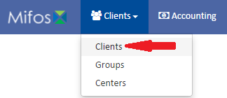
Go to Clients
Click on Clients in the Clients’ tab.

Slide 4
Select a Client
Select a client by clicking on him

Slide 5
Selecting a Loan
Select a Loan by clicking on it, but keep in mind that the square must be orange

Slide 6
Selection Option
Click on button, which is situated within the More section in the blue action bar

Slide 7
Rejecting Loan Account
Choose Withdrawn on Date from the calendar pop-up, this is a mandatory field
Put some useful notes in the Note box, like why this Loan is withdrawn
Click button

