Slide 1
Initial SYSTEM SETUP

Slide 2
Before proceeding, make sure that…
The Mifos Community App has been successfully downloaded and installed
The Pre-Configuration Plan has been completed

Slide 3
1. Login for the first time
Enter username: mifos
Enter password: password
Click “Sign In”
The initial username and password will be changed later
If you need help downloading and/or installing the Mifos Community App, see the “Mifos X Windows Installation” guide

Slide 4
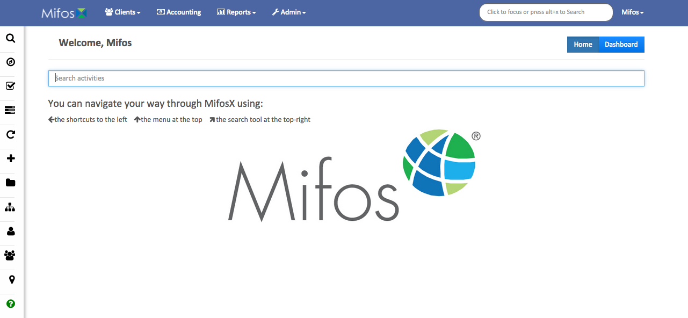
2a. Get to know the home screen
Clicking on the “Mifos” logo on the top-left will return you to the Home Page from any other page

Slide 5
2b. Get to know the home screen
Clicking on the “Clients” drop down will allow access to individual accounts, groups, and centers

Slide 6
2c. Get to know the home screen
Clicking on the “Accounting” drop down will allow you to access the system tools required by the accounting departments

Slide 7
2d. Get to know the home screen
Clicking on the “Reports” drop down will allow you to access all areas of system reports including the default reports provided by Mifos and custom reports developed by individual organizations

Slide 8
2e. Get to know the home screen
Clicking on the “Admins” drop down will allow you to set up users, organizations, products, and templates

Slide 9
2f. Get to know the home screen
The “Search” field will allow you to quickly navigate the system

Slide 10
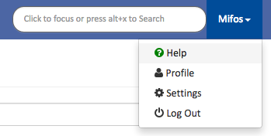
2g. Get to know the home screen
Clicking on the “Mifos” name on the far right and selecting “Help” will bring up a list of keyboard shortcuts
The shortcuts page can be included in staff system training after the system configuration is complete

Slide 11
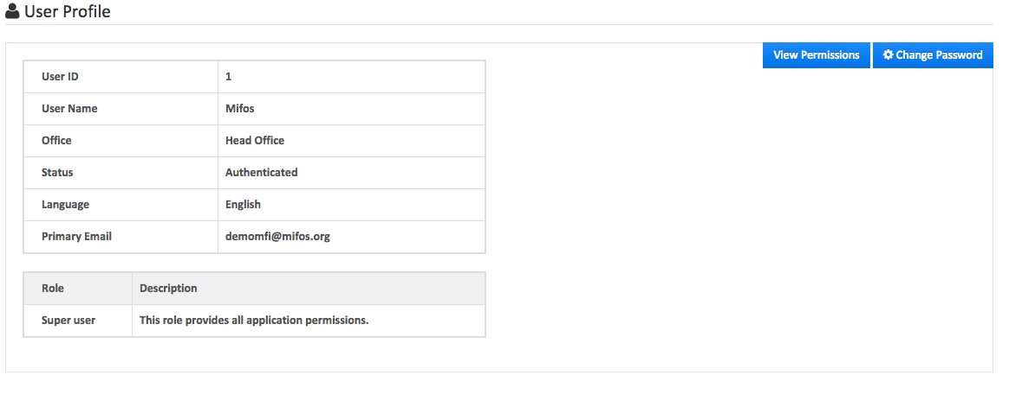
2h. Get to know the home screen
Clicking on the “Profile” option will show the individual user’s profile
For initial setup, the username will be “Mifos” and the role will be “Super user”

Slide 12
3. Modify your user settings
Click on the “Settings” option
Select your language from the drop-down menu (default is English)
Select your Date Format from the drop-down menu

Slide 13
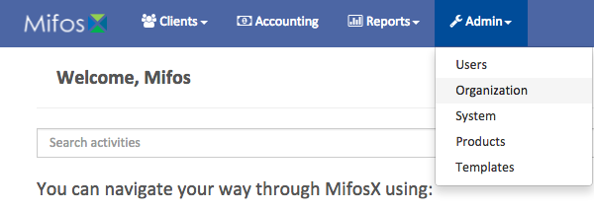
4. Set up your organization
Click on the “Admin” tab and select “Organization”
Using the information from the Pre Configuration Plan, create the Main Office of your organization
You may use a building name, road name, or other name that describes your organization
In the “Office” field, enter your main office name
In the “Parent Office” field, do not enter a name
In the “Opened on” field, enter the date your organization opened this office
In the “External ID” field, enter a number that will be used to identify your offices (this field is optional)
Review the information to make sure it is correct and hit “Submit”

Slide 14
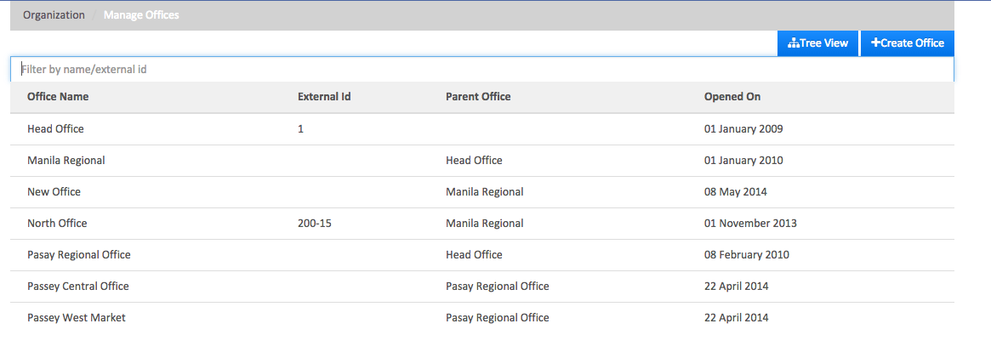
5a. Creating additional offices
Click on the “Admin” tab and select “Organization”
Select “Manage Offices”
Click on the “Create Office” button

Slide 15
5b. Creating additional offices
In the “Office” field, enter your additional office name
In the “Parent Office” field, select the office the newly created office falls under (the default is the Head Office)
In the “Opened on” field, enter the date your organization opened this office
In the “External ID” field, enter a number that will be used to identify your offices (this field is optional)
Review the information to make sure it is correct and hit “Submit”
It is recommended that you create your head office first, then your regional office(s), and then your individual branch office(s) to allow for the correct linking between your offices

Slide 16
6a. View your offices
Click on the “Admin” tab and select “Organization”
Select “Manage Offices”
You will be able to see all the offices that you have set up

Slide 17
6b. View your offices
Click on the “Tree View” button to view the list in a tree format

Slide 18
7. Configure your currency
Click on the “Admin” tab and select “Organization”
Select “Currency Configuration” and select the blue “Add/Edit” button
Enter your local currency and hit “Submit”

Slide 19
8a. Manage your holidays
Click on the “Admin” tab and select “Organization”
Select “Manage Holidays”
If the holiday affects your entire organization, select “Head Office” and select “Create Holiday”
If the holiday affects only one office, select that office name and select “Create Holiday”

Slide 20
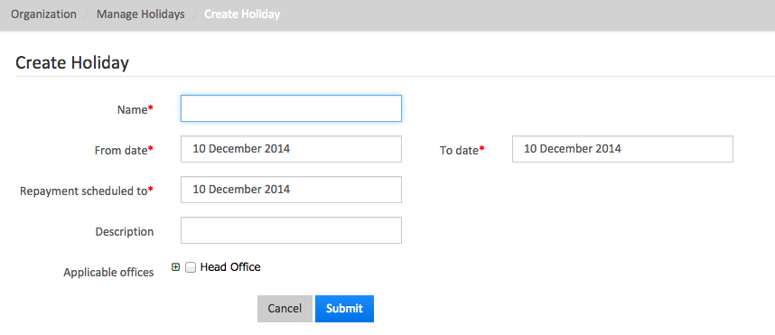
8b. Manage your holidays
In the “Name” field, enter the name of the holiday
In the “From Date” field, enter the start date of the holiday
In the “To Date” field, enter the end date of the holiday
In the “Repayment scheduled” field, enter the first business day after the holiday
This will allow loan payments to stay current if the due date falls on the holiday
In the “Description” field, enter the description of the holiday
Expand the box next to “Applicable office” and select each office affected by the holiday
Make sure everything is accurate, then hit “Submit”
The holiday will enter a “Pending for activation” status until it is reviewed by an authorized user and activated

Slide 21
9. Managing your funds
Click on the “Admin” tab and select “Organization”
Select “Manage Funds”
If your organization has funds for specific lending purposes, the names will be defined here
Loans made to customers in one of the created funds will be linked to allow for proper monitoring and to provide reports
Enter the name of the fund in the “New Fund” field
Click on the “+” to add the fund

Slide 22
10. Other sections to be used later
Click on the “Admin” tab and select “Organization”
“Manage Employees” will be used to add employees to the system and to edit employee information
User roles and permissions should be set up before creating employees
“Bulk Loan Reassignment” allows an organization to reassign all loans from one loan officer to another and will be used in day-to-day operations
No initial set up is required
“Standing Instruction History” will be used to track and search for any standing transaction history

Slide 23
11a. Manage data tables
Mifos X data-table allows users to add custom fields in addition to the built-in fields to a…
Client Profile
Loan/Saving Account
Group
Center
Office
The custom field supports 6 data types (String, Number, Decimal, Date, Text, and Drop Down)
Review the system-provided data tables and then, using your Pre-Configuration Guide, you may create additional fields

Slide 24
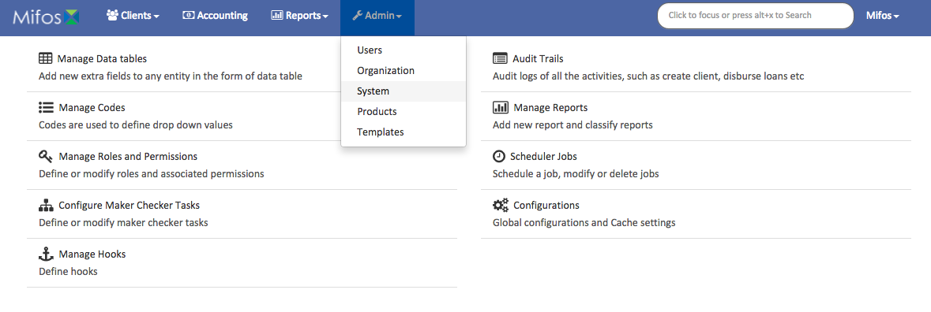
11b. Manage data tables
Click on the “Admin” tab and select “System”
Select “Manage Data Tables”
Select “Create Data Table”

Slide 25
11c. Manage data tables
In the “Data table name” field, enter the name for your new table
In the “Application table name” field, select the system function that the data table will affect
For instance, select “Client” if your additional fields will apply to the Client
Select “Multi row” if you need multiple rows to collect additional detail from the client

Slide 26
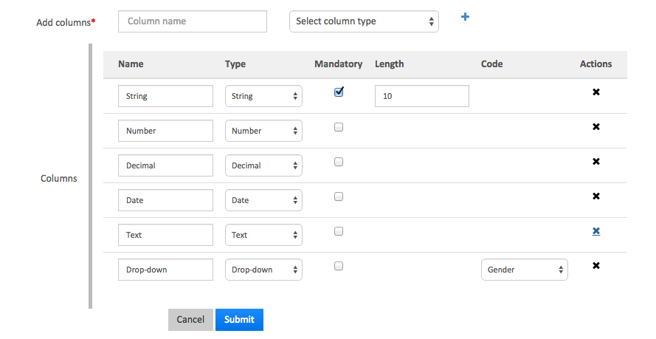
11d. Manage data tables
In the “Add columns” field, type what you would like to name the column
Then, select the column type (String, Number, Decimal, Date, Text, and Drop-Down)
Check the “Mandatory” box if you would like to make a field required
The “Length” of a String-type field can be adjusted by entering a number into the “Length” field
In the “Code” dropdown, select the code that best fits your drop-down value(s)
Under “Actions”, click the “X” to delete a column
Hit “Submit” when you’re done

Slide 27
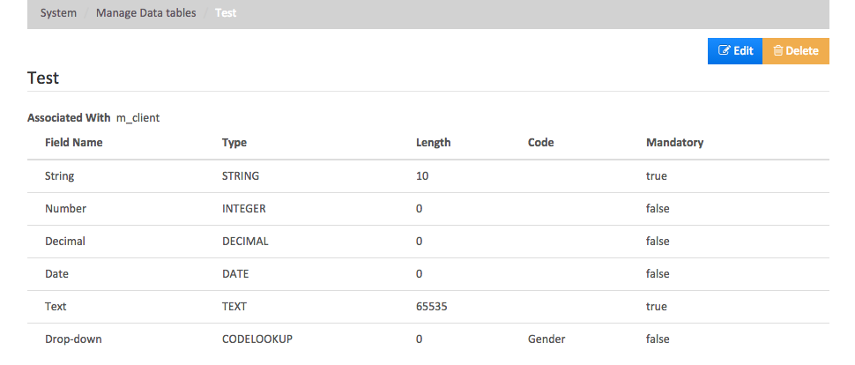
11e. Manage data tables
After submitting the data table, you will be brought to an overview page of the data table you have just created
Selecting “Edit” will allow you to edit the data table
Selecting “Delete” will allow you to delete the data table
A confirmation message will pop up to confirm that you would like to delete the data table

Slide 28
12. What is a code?
A code is a system-defined value that will be used in items such as drop-downs
The code itself cannot be modified but the code values (like “Customer Identifier”) can be modified
Even though the Customer Identifier code value defaults to “Passport,” it can also be used for “Drivers License” or “National ID” or another ID acceptable to your organization

Slide 29
13. Manage codes
Click on the “Admin” tab and select “System”
Select “Manage Codes”
You will be able to see the list of system-defined codes
To add your own code, select “Add Code”
For more information on how to add and/or edit codes, visit the "Manage Codes (Drop-Downs)” guide

Slide 30
14a. Manage roles and permissions
Click on the “Admin” tab and select “System”
Select “Manage Roles and Permissions”
You can now see the list of roles

Slide 31
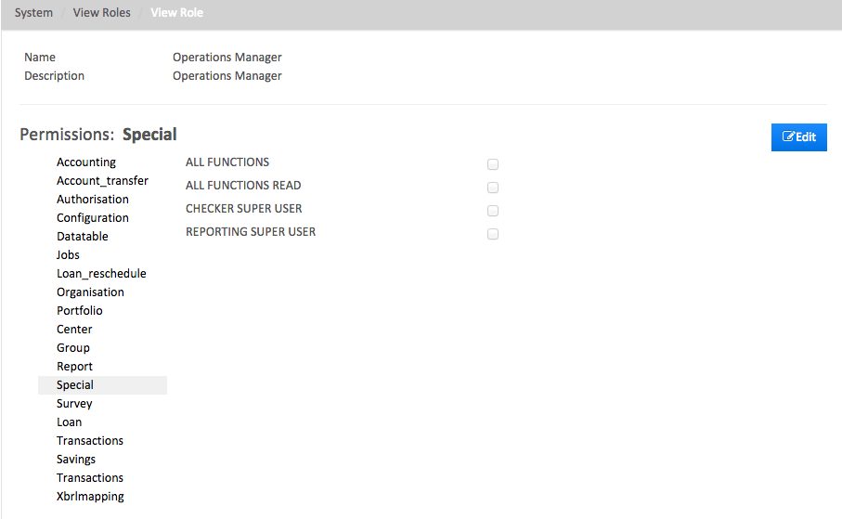
14b. Manage roles and permissions
Use your Pre-Configuration Guide and select each role and choose the system privileges given to each position by checking the appropriate boxes
Remember to hit “Edit” to allow you to modify the permissions
Hit “Submit” when you are done

Slide 32
14c. Manage roles and permissions
If you would like to add your own custom roles…
Select “Add Role”
Enter the “Name” of the role
Enter a short “Description” of the new role
Hit “Submit” when you are satisfied
Visit the “Manage Roles and Permissions” guide for more on the management of roles and permissions

Slide 33
15. What is a maker checker task?
The maker checker is a functionality that allows a financial institution to define transactions as having a maker and a checker phase
The “maker” is the user who enters, deletes, or changes data
The “checker” is the user who has rights to inspect and approve the data changes
The “Maker Checker” option is, at a global level, disabled by default
Visit the “Update Global Configuration” guide to enable/disable the Maker Checker functionality
The “Maker Checker” option is, at an individual transaction (permission) level, disabled by default
Visit the “Enable/Disable Permissions for Maker Checker” guide to enable/disable Maker Checker on a transaction (permission) level
To give checking rights to a user (through a role associated with the user), visit the “Update a Role’s Permissions” guide

Slide 34
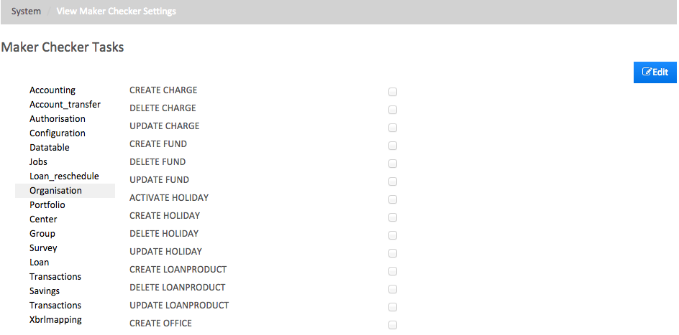
16. Configure maker checker tasks
Click on the “Admin” tab and select “System”
Select “Configure Maker Checker Tasks”
Select “Edit” to make changes
For a more detailed guide on Maker Checker, visit the “Maker-Checker” guide

Slide 35
17. Manage reports
Click on the “Admin” tab and select “System”
Select “Manage Reports”
You will see a list of reports pre-installed into the Mifos system for your organization
Existing reports can be customized to fit your needs by clicking on the report and selecting “Edit”
Select “Create Report” to create a new report
For more information about report generation, visit the “Manage Reports” guide

Slide 36
18. Scheduler jobs
The “Scheduler Jobs” option allows you to schedule one or more batch jobs to run at a certain time
A batch job (or cron job on Unix-based systems) is a back-end job executed on a computer at a particular time defined in the job’s cron expression
A batch job can be manually executed at any point of time
A list of batch jobs scheduled to run along with other details specific to each job can be viewed at any point of time
The scheduler status can be either “Active” or “Standby”
An “active” status indicates that the all batch jobs are running or will run as specified in the schedule
A “standby” status will stop all batch runs

Slide 37
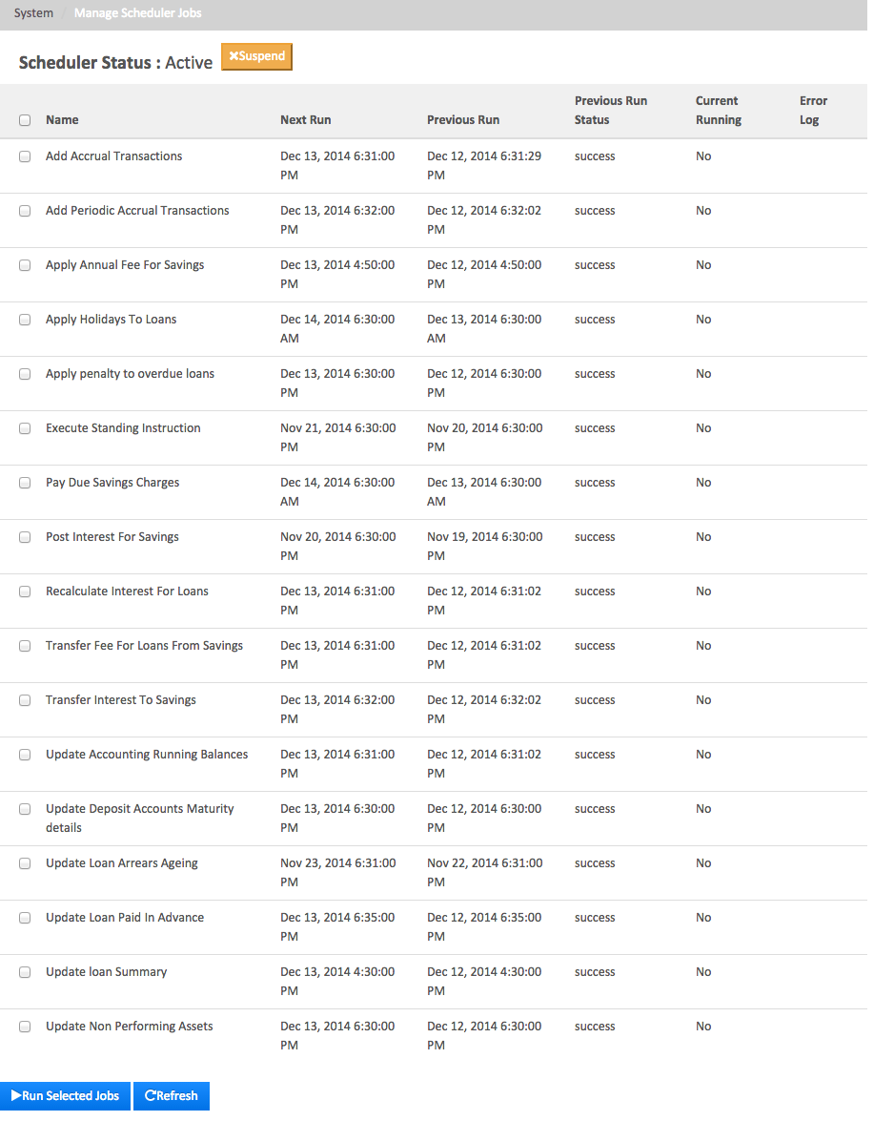
19. Manage scheduler jobs
To access the batch jobs, click on the “Admin” tab and select “System”
Select “Scheduler Jobs”
You will see a list of scheduler jobs
Jobs can be modified by clicking on them and selecting “Edit”
You can also view the run history of a job by clicking on the job and selecting “View History”
For more information about managing scheduler jobs, visit the “Manage Scheduler Jobs” guide

Slide 38
20a. Configurations
Click on the “Admin” tab and select “System”
Select “Configurations”
You will see a list of global configurations that can be enabled and disabled
“maker-checker” defaults to false; if it is true, the maker-checker functionality will be turned on
“reschedule-future-payments” defaults to false; if it is true, it will reschedule repayments which fall on a non-working day to the defined repayment scheduling rule
“allow-transactions-on-non_workingday” defaults to false; if it is true, it will allow transactions to occur on non-working days
“reschedule-repayments-on-holidays” defaults to false; if it is true, it will reschedule repayments that fall on non-working days based on the defined reschedule date
“allow-transactions-on-holiday” defaults to false; if it is true, it will allow transactions to occur on holidays

Slide 39
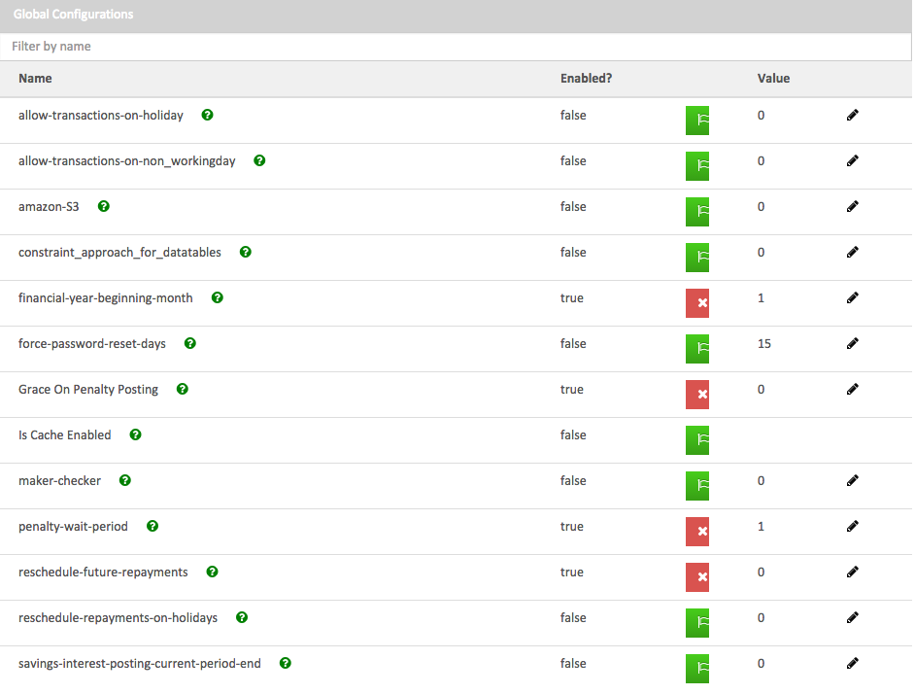
20b. Configurations
The above image is a quick view of what the “Global Configurations” list may look like
For more information about global configurations, visit the “Global Configuration” guide

Slide 40
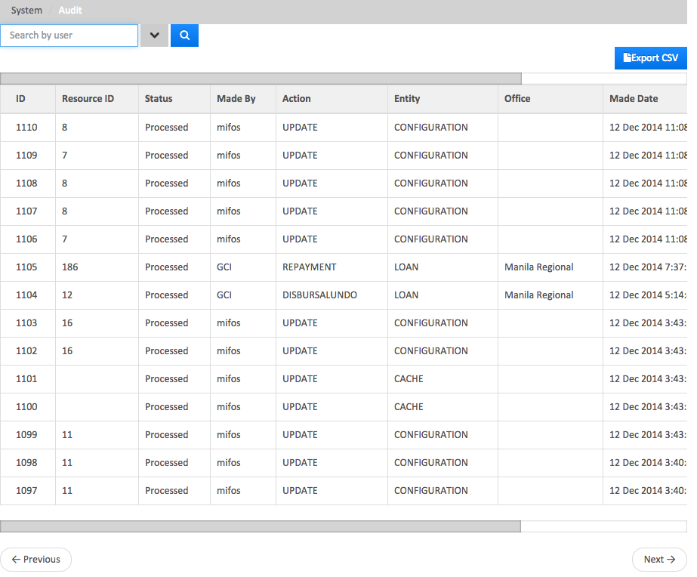
21. Audit trails
Click on the “Admin” tab and select “System”
Select “Audit Trails”
The area will be used for internal auditing after the system is fully setup
For more information about audit trails, visit the “Audit Trails” guide

Slide 41
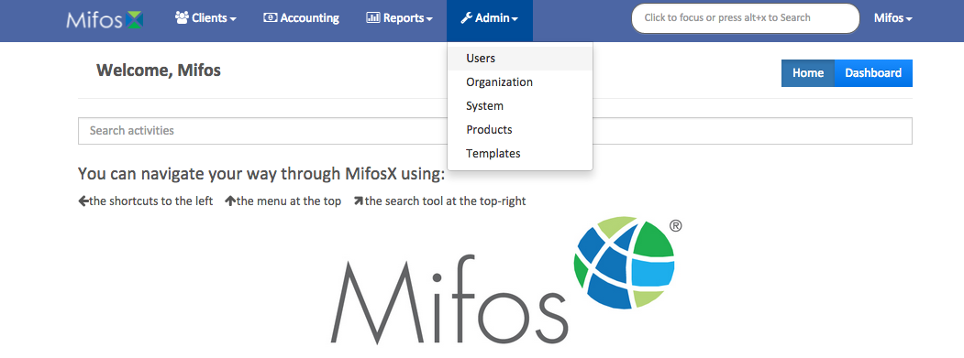
22. Set up system users
Click on the “Admin” tab and select “Users”
Refer to the Pre-Configuration Guide and set up the system users by clicking “Create user”
For more information about setting up system users, visit the “User Setup” guide

Slide 42
23a. Set up chart of accounts
Click on the “Accounting” tab and select “Chart of Accounts”
Select the “Add Account” button
Before setting up the products (later on), you MUST set up the General Ledger Chart of Accounts first
For more information about the general ledger chart of accounts, visit the “Chart of Accounts and General Ledger Setup” guide

Slide 43
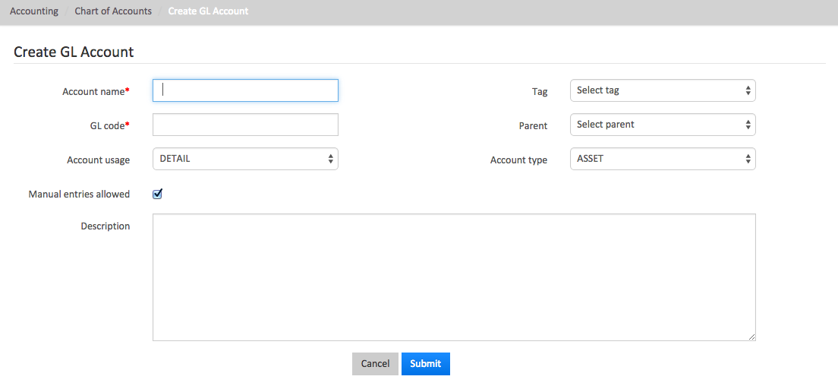
23b. Set up chart of accounts
Using your organization’s existing Chart of Accounts…
Enter the “Account name,” which is the name used in your organization
Enter the “GL code,” which is the general ledger account number
Select the “Account type,” which can be an asset, liability, equity, income, or expense
Select a “Tag,” which can be set up by an organization
Select the type of “Account usage,” which can either be a header or a detail
A header is the title of a grouping like “Operation Expense”
A detail is a category (or categories), such as “rent, stationery, and supplies”

Slide 44
23c. Set up chart of accounts
Using your organization’s existing Chart of Accounts, proceed to also…
Select the appropriate “Parent” of the account being created
Check the box “Manual entries allowed,” which will allow manual entries into the account being set up
Enter the “Description,” which is a short summary of the account
Include any general information here that may be helpful to staff members reviewing the chart of accounts
Hit “Submit” when everything has been completed

Slide 45
23d. Set up chart of accounts
If you view the “Chart of Accounts” page, you will see a list of accounts in list view
If you click on “Tree View,” you will be able to see the list of accounts in a tree format

Slide 46
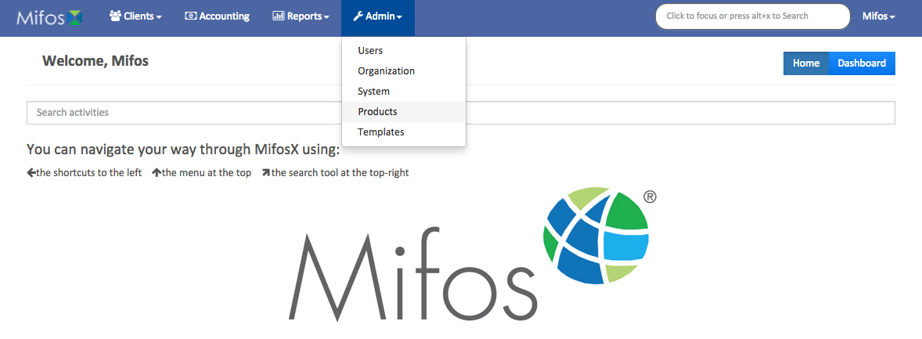
24. Enter the products
Click on the “Admin” tab and select “Products”
Enter your organization’s product(s) as defined in the Pre Configuration Plan
For more information about setting up and configuring products, visit the “Setting up and Configuring New Products” guide

Slide 47
Congratulations!
You have now completed the initial system set up!

