Slide 1
Overview of Molly
Screenshots of Molly Accounting Functionality

Slide 2
What is Molly?
Sophisticated interface between MIS and accounting package, providing both a seamless integration point with an existing accounting package or functionality to serve as stand-alone accounting package.
Designed for accountant separating accounting functions from MIS
For Large MFIs
Provides a highly flexible and easy to use interface to map financial transactions, offering high customization over the chart of accounts and transaction mapping.
For Small MFIs
Robust enough to work as stand-alone double-entry accounting package with full support for importing portfolio transactions and the entry of non-portfolio general ledger entries.
Molly has been developed by Mostfit Team at Intellecap and will be integrated with Mifos

Slide 3
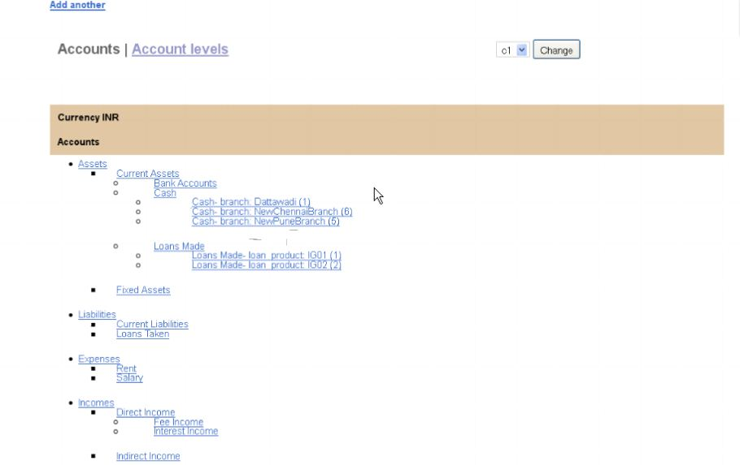
Chart of Accounts
Sample view of a chart of accounts in Molly, showing various account levels.

Slide 4
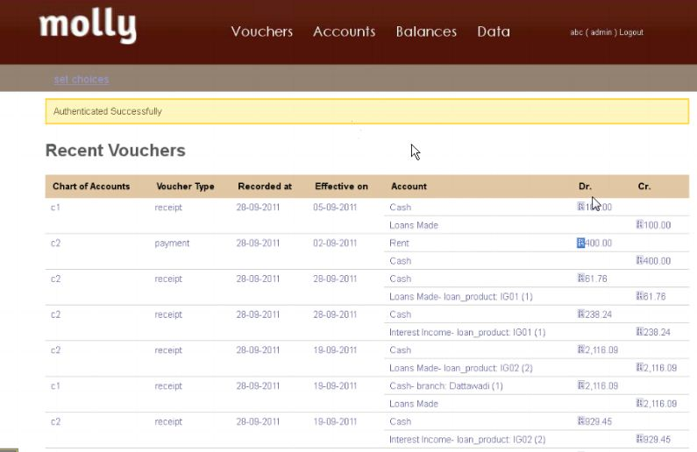
View of Recent Entries

Slide 5
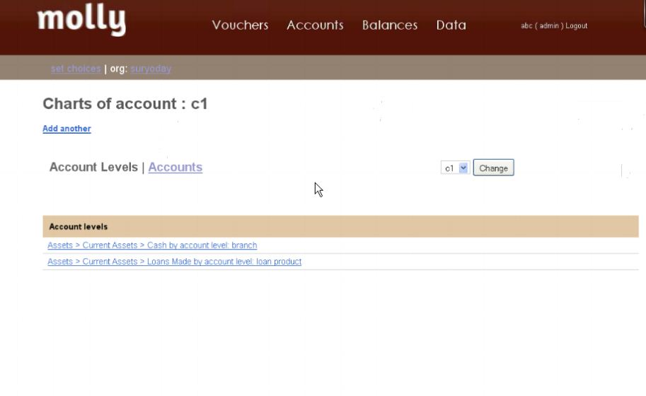
Chart of Account Levels
Each parent-level chart of accounts can be specialized by account level. This offers endless options to customize your chart of accounts. For example, each time a new branch is created, a new account level for that specific branch is created under the main Cash account.

Slide 6
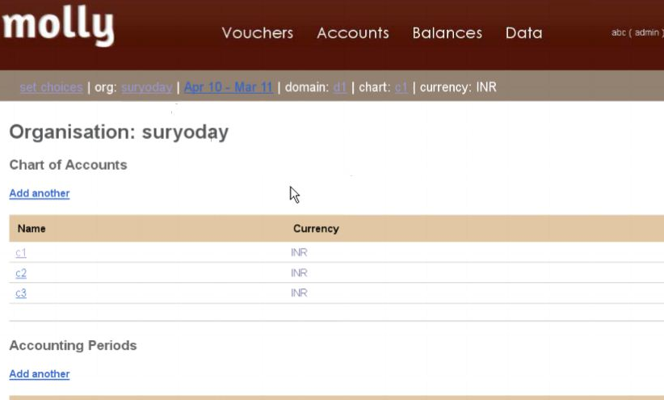
Support for Multiple Charts of Accounts
Molly supports the configuration of multiple chart of accounts. So if your organization needs to report according to different account set of standards you can maintain this in one interface.

Slide 7
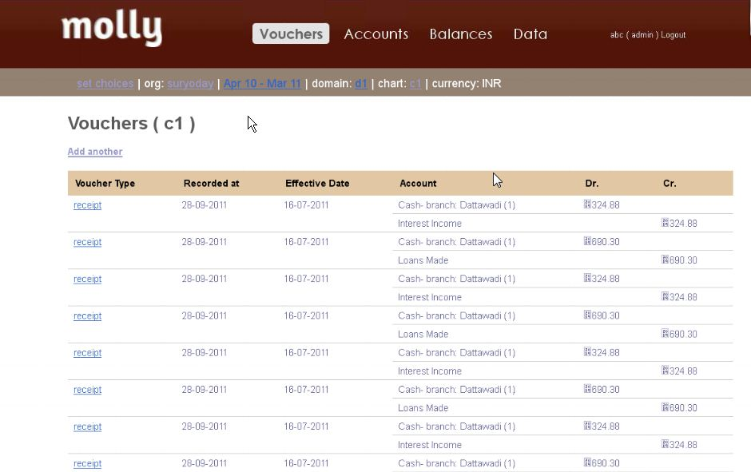
General Ledger Entries (Vouchers)
This shows the general ledger entries that have either been imported in or manually entered.

Slide 8
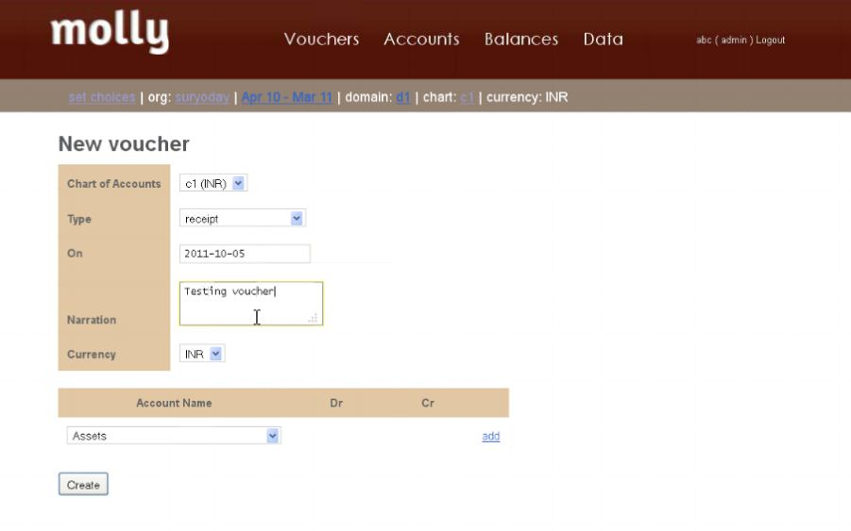
Posting a journal entry (voucher)
For those MFIs without a separate accounting package, Molly can serve as your basic accounting software. It supports the ability to input various transactions (i.e. posting branch-level expenses)

Slide 9
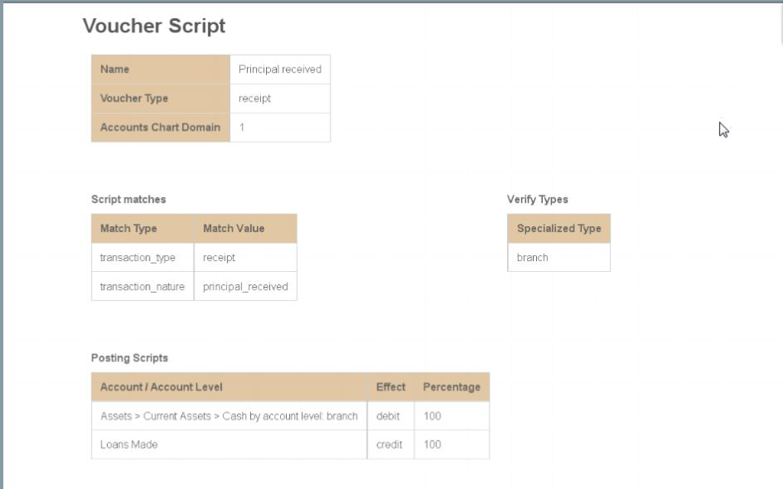
Flexible Transaction Mapping
Where Molly really excels is its flexibility in mapping transactions to the various general ledger accounts. Through a simple graphical user interface, the accountant can map transactions based on various parameters proportionally across pre-defined general ledger accounts.

Slide 10
Flexible Transaction Mapping
The same transaction in Mifos could be accounted for in two completely different ways in Molly. Every transaction mapped over is logged with time and effective date with duplicate and similar transactions being flagged.

Slide 11
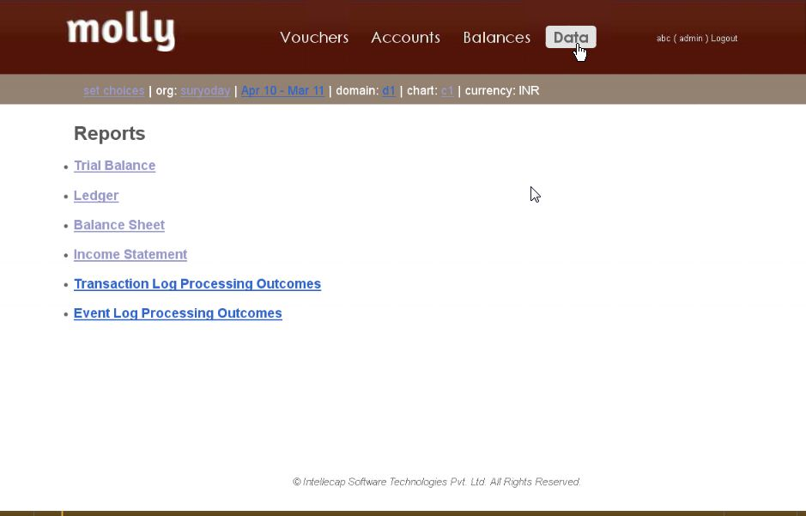
Financial Reports in Molly
Directly in Molly, you can generate your standard financial reports, including trial balance, balance sheet, income statement, transaction logs, etc.

Slide 12
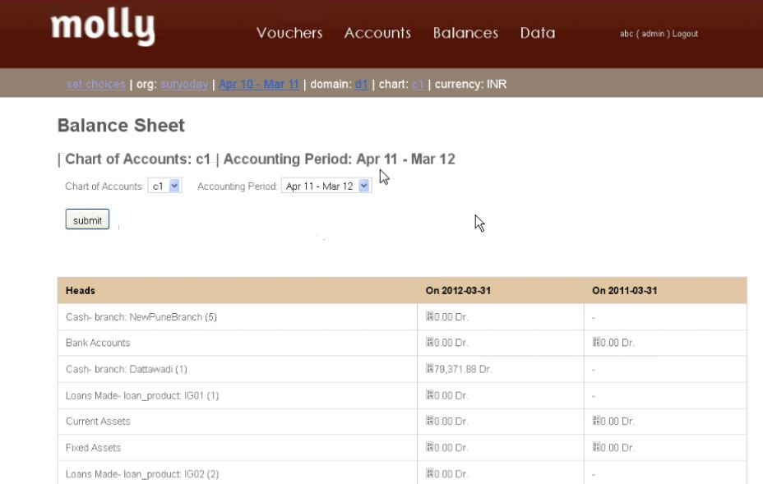
Balance Sheet in Molly

Slide 13
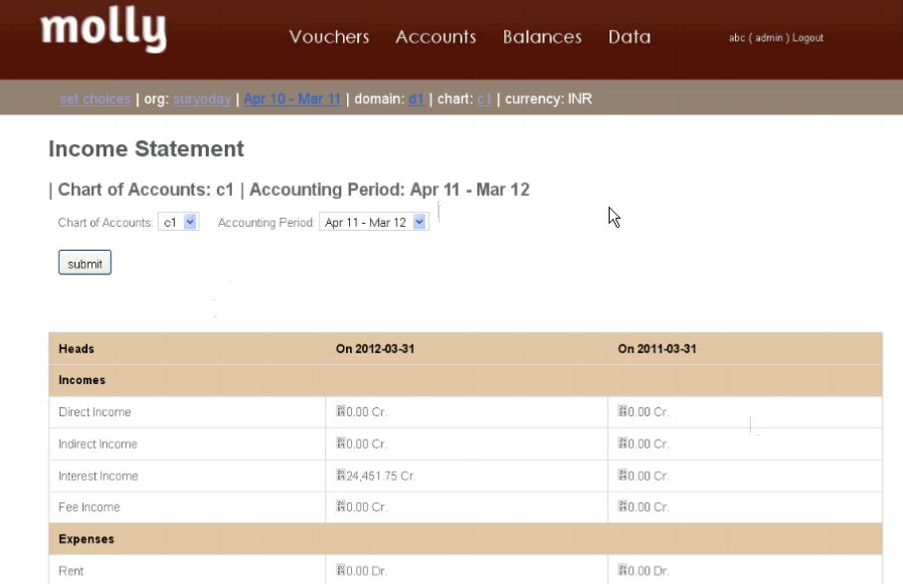
Income Statement in Molly

