Slide 1

Progress out of Poverty Index® (PPI®)
Mifos Summit
Gaurav Singh

Slide 2
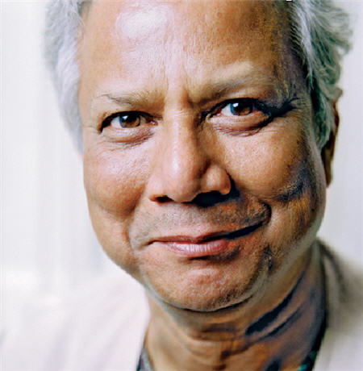
Our heritage
To me poor people are like
bonsai trees.
When you plant the best seed of the tallest tree
in a flower-pot, you get a replica of the tallest tree,
only inches tall. …the soil-base is
too inadequate.
Poor people are bonsai people. Simply, society
never gave them the base to grow on. All it needs
to get the poor people out of poverty is for us to
create an enabling environment for them.
Once the poor can unleash their
energy and creativity, poverty will
disappear very quickly.

Slide 3


Our Global Relationships
Global
India
Wholly-owned subsidiary of GF
Established in 2010 as a social business
Provides non-financial services
JV with GF, Citibank and IFMR
Established in 2008 as a social business
Provides financial advisory services
3

Slide 4
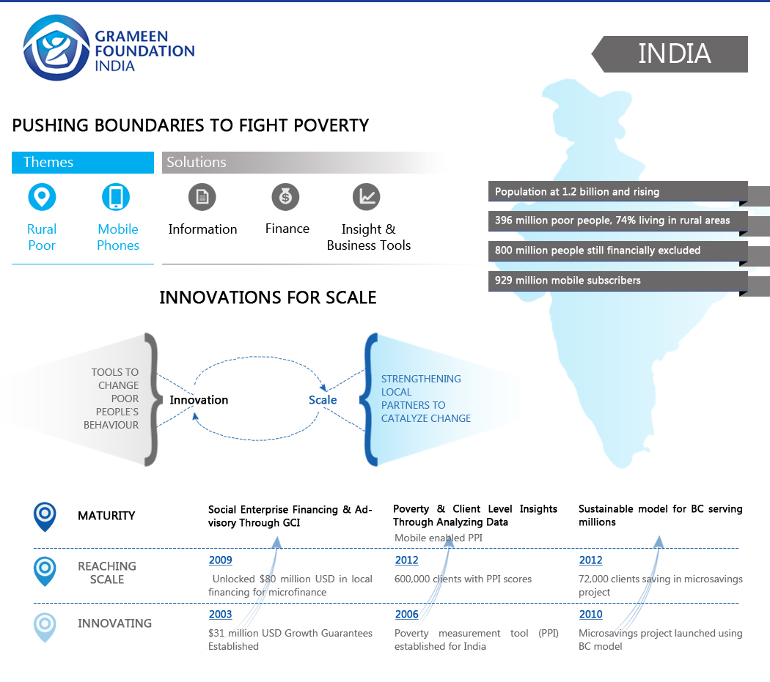
Addressing these problems
Insufficient & inconsistent income
Inability to tolerate shocks and manage risks
Lack of essential, actionable information
Needs are not understood and sub-optimal services are delivered
Solution Areas
Information Services
Financial Services
Poverty Tools and Insights

Slide 5
Overall Objectives of this Session
To understand the context of social performance management.
To understand why SPM is important for any social business
To understand what is the PPI and how to use it

Slide 6
Introduction to
Social Performance Management
Notes:
Cris leads discussion

Slide 7
What is ‘Social Performance’?
The effective translation of an institution’s mission into practice in line with accepted social goals
Commonly Accepted Social Goals
Serving increasing numbers of poor and more excluded people sustainably
Improving the quality & appropriateness of services through assessment of clients’ needs
Increasing clients’ social capital, assets, income, and access to services
Reducing clients’ vulnerability
Improving social responsibility of the organization toward clients, employees, and communities
Notes:
Now I would like to share with you the definition of social performance, as set and defined by the Social Performance Task Force.
Social performance is the effective translation of an institution’s mission into practice in line with accepted social goals. These commonly accepted social goals are:
serving increasing numbers of poor and excluded people sustainably
Improving the quality and appropriateness of financial services available to target clients through systematic assessment of their specific needs
Creating benefits for clients of microfinance, their families, and communities relating to social capital and social links, assets, reduction in vulnerability, increase of income, improved access to services and fulfillment of basic needs
Improving the social responsibility of our own organizations and the partners we support. This includes consumer protection and gender equity, as well as responsibility to staff, environment and the community.
Protecting clients is fundamental to Social Performance. Microfinance has great potential to help clients, but it also has the potential to harm them, especially through over-indebtedness.
OPTIONAL:
Example—If your mission is to increase the economic well-being of your clients, then strong social performance means that you carefully design and implement programs that ultimately meet their needs for financial products and services, and help them improve their economic situation, and you are able to demonstrate these improvements with client data you’ve collected.
__________________________________________________________________
Talking points:

Slide 8
The Double Bottom Line Principle
What is social performance¹?
  The effective translation of an institution's social mission into practice in line with accepted social values
What is Social Performance Management (SPM)?
  Taking the steps to deliberately manage and achieve desired results
    Define desired performance
    Measure and monitor against desired performance
Mission
Social Performance
Financial Performance

Slide 9
Social Performance Management
The process of translating mission into practice includes three components:
Intent and design
    Setting clear goals and objectives
    Designing of strategy to achieve goals & objectives
Information system
    Monitoring and understanding progress towards goals
Management systems
    Using of information to improve operations
    Decision making
    Aligning institutional systems & culture

Slide 10
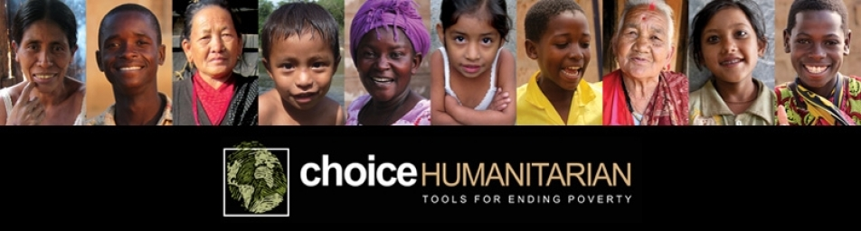

CHOICE’s Mission Statement
  CHOICE Humanitarian’s mission is to build the capacity of rural villagers to cultivate and act on sustainable solutions to poverty by fostering village self-determination and international community building.
  What? To build capacity.
  What results? Sustainable solutions to poverty alleviation.
  How? By fostering village self-determination and international community building.

Slide 11
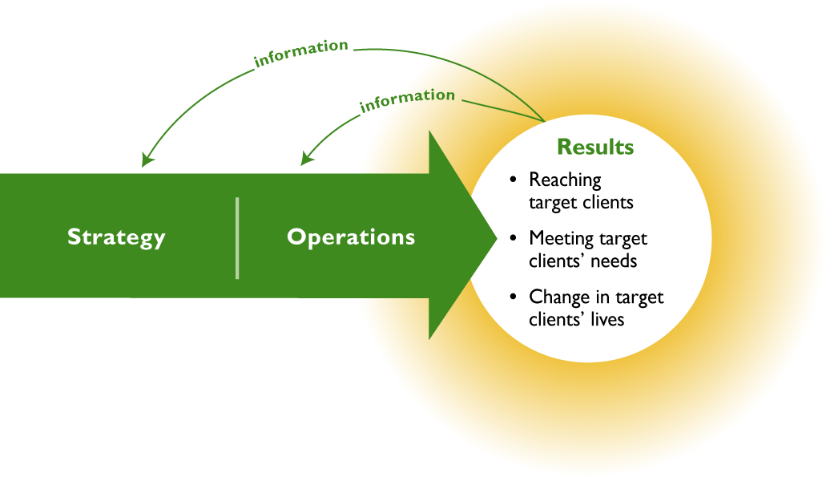
Mission to Practice Pathway
*
Goals
Objectives
Range of services
System use
Service delivery
Human resources
*Graphic from Imp-Act SPM Training
Notes:
Social Performance is defined in terms of both processes and results
Translating mission into practice is a deliberate and intentional process
Desired change in the lives of clients is the goal of this process and is not automatic

Slide 12
Mission to Practice Pathway
*
PPI
Goals
Objectives
Range of services
System use
Service delivery
Human resources
*Graphic from Imp-Act SPM Training
Notes:
Social Performance is defined in terms of both processes and results
Translating mission into practice is a deliberate and intentional process
Desired change in the lives of clients is the goal of this process and is not automatic

Slide 13
The PPI
(Progress Out of Poverty Index)

Slide 14
What is poverty?
Poverty can be defined in many ways. Here are a few examples:
  Insufficient access to basic services.
  Inability to consume a minimum number of calories per day.
A household’s poverty status is usually defined by whether the household expenditure is under the daily amount set by a given poverty line.

Slide 15
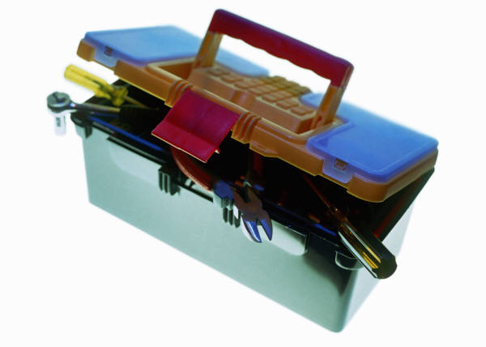
Social Performance Toolbox

Slide 16
What is the PPI?
A country specific, objective client poverty assessment and targeting tool, which:
  Provides client poverty level estimates
  Enables MFIs to manage social performance
An inexpensive and efficient 10 question scorecard
  Derived from the national household income and expenditure surveys
  Comprised of simple, non-financial indicators
  Has categorical indicators: family, house, and ownership of consumer durables
  Indicators tend to be verifiable, liable to change over time, and easy to answer

Slide 17
PPI in the SPM Framework
Managing social performance is based on
  1) setting clear social goals and objectives
  2) collecting information to monitor progress towards these objectives
  3) using information to improve operational and strategic decision-making.
By tracking poverty levels against other client data, an MFI can make key decisions about its mission and how to carry it out
PPI should therefore be thought of as a powerful tool that helps advance an organization’s mission within a larger social performance management system.

Slide 18
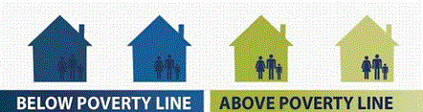

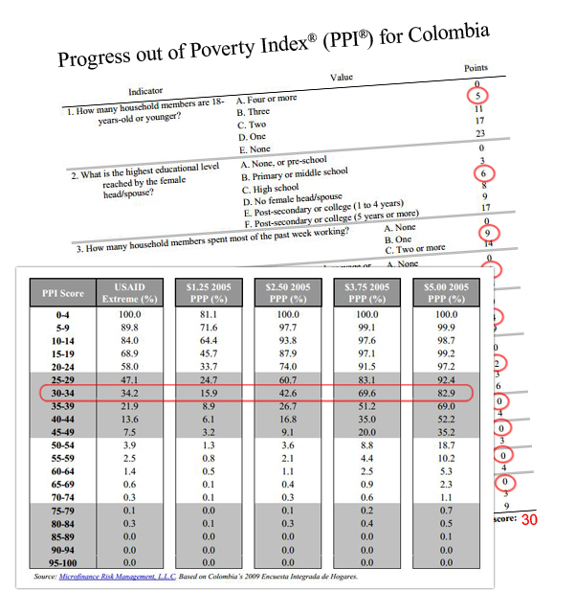
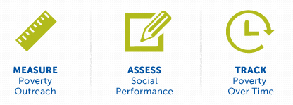

Progress out of Poverty Index® (PPI®)
What is the PPI?
A poverty measurement tool for organizations with a mission to serve the poor
10 easy-to-answer questions and a scoring system
Why use the PPI?
With the PPI, your organization can:

Slide 19
Construction of the PPI ®
All indicators on the national household survey are ranked according to how strongly they predict poverty levels.
Hundreds of indicators are narrowed to the 50 most powerful ones.
National Survey
100 indicators
Using both statistics and expert judgment, a 10 indicator scorecard is constructed.
10 indicators
PPI
Each possible response is assigned point value based on the original national survey responses. The total score (from 0 to 100) is linked to the probabilities of falling above or below each poverty line.
Notes:
First step, uncertainty coeficient.
Logit regression to build the scorecard.
After all indicators are tested, each indicator is selected based on several factors. The factors that contribute to the indicator selection include the: (used when conducting expert judgment process)
- Ability to improve accuracy
- Likelihood of acceptance by users (determined by simplicity, cost of collection, and “face validity” in terms of experience, theory, and common sense)
- Ability to change values as poverty status changes over time
Capacity to contribute to question variety (in comparison with other indicators already in the PPI)
- Ease of observation/verification

Slide 20
How does the PPI work?
Each Country-Specific PPI is comprised of a 10 question survey developed from national data
Client’s answers to each question are added up for a total PPI score
The PPI scores of all clients surveyed are compiled to estimate the poverty rate of all clients
Progress out of Poverty Index® by Grameen Foundation
20

Slide 21
The PPI: More information
Inexpensive and easy to collect.
PPI data is objective and comparable because the tool is derived from representative national household income and expenditure surveys.
Comprised of simple, non-financial indicators; easily verifiable; takes about ten minutes for field staff to collect.
  Allows pro-poor organizations to benchmark poverty distributions to national & international poverty levels
Notes:
An inexpensive and easy to collect scorecard
Derived from the most recent representative national household income/expenditure surveys
Comprised of simple, non-financial indicators.
Household and housing characteristics (such as cooking fuel and type of floor)
Individual characteristics (such as age and highest grade completed)
Household durable goods (such as electric fans and telephones)
Strongly Correlated with Poverty
Likely to Change over time with change in poverty status
An objective client poverty assessment and targeting tool, which can be used to measure client poverty levels and influence management decisions
- Provides social performance data
Likelihood an individual or portfolio falls above or below poverty lines ($1/day/PPP, $2/day/PPP and/or the national poverty line)
- Enables MFIs to manage performance
by understanding their clients’ poverty status

Slide 22
How Organizations use the PPI
Poverty outreach
Program evaluation
Product development
Monitoring
  Client profiles and behaviors
  Organization and program performance
  Tracking over time
Targeting and screening
Tracking poverty movement
Client insights

Slide 23
Very Good Poverty Outreach
75.2% of MFI-A new clients are below
$1.25 PPP line
Compares with
All India distribution of
42.6% below $1.25 PPP line
Sample Report – 1:
Organization Poverty Outreach
All-India, poverty lines and poverty rates, by round and by urban/rural
Round |  |  | Poverty line (nominal Rs/person/day) and poverty rate (%)
 |  |  | International purchase-power-parity lines
 | Line/rate |  | National | $1.25/day | $2/day
62 | Line |  | 14.25 | 19.22 | 30.75
Same report could be generated at various level of analysis
Rural/Urban
States/Region
District

Slide 24
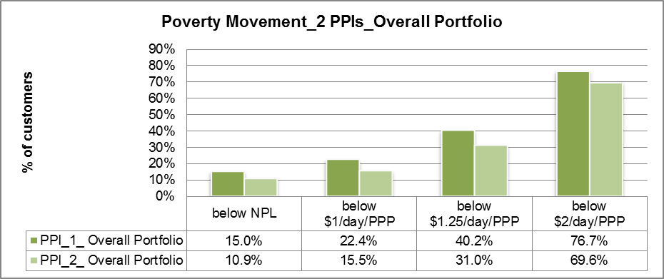
Sample Report – 2:
Tracking Over Time Analysis
National poverty rates | 17.0% | 25.4% | 42.6% | 74.9%
The poverty rates when clients join are on par with national poverty rates. 2nd PPI score shows a decrease in poverty incidence – could be due to improvements but may be because of dropouts.
A 9% reduction in poverty incidence in terms of the commonly referred to “extreme’ poverty line of $1.25/day/PPP can be seen here.

Slide 25
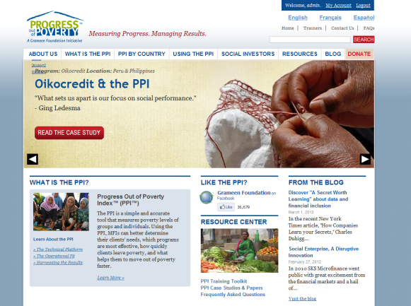
Website
www.progressoutofpoverty.org
info@grameenfoundation.org
Primary features and functions:
Free and easily downloadable country-specific PPI toolkits and educational resources.
Warehouse for industry-wide thought leadership and learning around social performance via blog posts and announcements
New website to include:
+ Easier navigation
+ Community portal
+ Rich media
+ User accounts w/ advanced support features

Slide 26
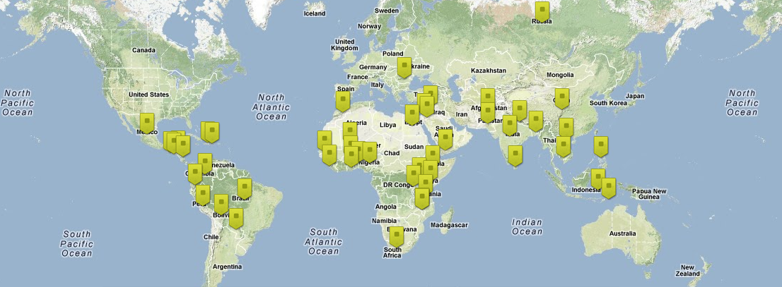
The PPI is a Public Good
PPIs are available for roughly 89% of the world’s poor, free of charge.

Slide 27
48 Country-specific PPIs
Afghanistan
Bangladesh
Benin
Bolivia
Brazil
Burkina Faso
Cambodia
China*
Colombia
Dominican Republic
Ecuador
Egypt
El Salvador
Ethiopia
Ghana
Guatemala
Haiti
Honduras
India
Indonesia
Jordan
Kenya
Malawi
Mali
Mexico
Morocco
Nepal
Nicaragua
Nigeria
Pakistan
Palestine
Paraguay
Peru
Philippines
Romania
Russia
Rwanda
Senegal
Sierra Leone
South Africa
Sri Lanka
Syria
Tanzania
Timor-Leste
Uganda
Vietnam
Yemen
Zambia
Coming soon
Tunisia
*China has an expert-based poverty scorecard in place of a PPI.
Progress out of Poverty Index® by Grameen Foundation
27

Slide 28
Who uses the PPI?
Microfinance Institutions
Social Businesses
Social investors
Impact Investors
National and/or regional associations
International NGOs
Governments

Slide 29










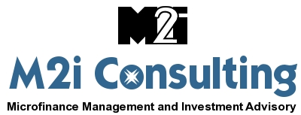
Who uses the PPI?
Over 200 development organizations are currently using the PPI
Social audits and ratings incorporate the PPI into their social ratings

Slide 30
PPI Users in India
More than 19 MFIs are using PPI ® & many more are piloting
  Grameen Foundation Direct Engagements:
    Cashpor MicroCredit
    Grameen Koota
    Sonata Finance Pvt. Limited
    ESAF Microfinance & Investment Pvt. Limited
Social investors : Dia-Vikas, Manaveeya Holdings and Michael and Susan Dell foundation (MSDF) have integrated PPI in Social Performance Monitoring Tool
Technical Service Provider:
  EDA Rural Systems
  M2i Consulting
  MicroSave
Leading publication and discussions on social performance management - Ex. Sa-Dhan SPM report

Slide 31
Who is involved?
The PPI is managed by Grameen Foundation's Progress out of Poverty Initiative and is developed by Mark Schreiner of Microfinance Risk Management, L.L.C. with input from Grameen Foundation and partners in the field.
Notes:
Creating a PPI
Read slide.
The Progress out of Poverty Index® (PPI®) is a simple, accurate and affordable methodology that pro-poor organizations can use to estimate and track the poverty rates of those they serve.
The PPI is developed for each country through the collaboration of
Grameen Foundation;
Mark Schreiner of Microfinance Risk Management, L.L.C.; and
Partners in the field, such as microfinance institutions or local initatives, that provide valuable feedback on each indicator.

Slide 32

H₂O
Construction of the PPI
Little Change, Big Effect
Progress out of Poverty Index® by Grameen Foundation
32

Slide 33
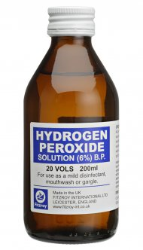
H₂O₂
Construction of the PPI
Little Change, Big Effect
Progress out of Poverty Index® by Grameen Foundation
33

Slide 34
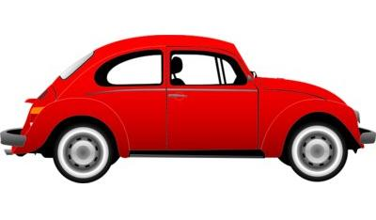
Viewing the PPI as a Whole
Observation: PPI users struggle with viewing the PPI as 10 questions linked together
Progress out of Poverty Index® by Grameen Foundation
34
Notes:
The parts of the car are just that parts of a car – a door, a window, a wheel. Together these components are put together to create a car. We take the parts to create a whole – we see the whole picture – the car.

Slide 35
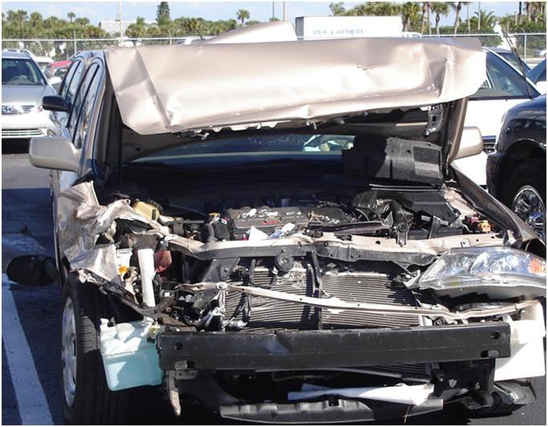
What happens…
If a PPI is changed?
If a score on the PPI is changed?
It brEAKS DOWN
Because everything is statistically linked and the link has been severed!
Progress out of Poverty Index® by Grameen Foundation
35
Notes:
Looks like a car, but it’s no longer functional
Resembles a PPI but it’s no longer a PPI. The chain that linked it to the national household survey is broken.

Slide 36
Progress out of Poverty Index
Question and Answer

