Slide 1
AIM
We are here with the commitment that we will give a good product to the user community
DIGAMBER | FINANCE

Slide 2
Question ?
To the community
Is Mifos X will be a more than a database application ?
Yes
”I appreciatre this. Definetly it will be more than this”
But How?
DIGAMBER | FINANCE

Slide 3
Agenda |
Field’s problems, Technical Solution
1
Is Mifos X is capable for accounting ?
✓
2
Can we have a dashboard ?
✓
3
Can I manage my database properly?
✓
4
Can we have a good reports?
✓
5
Is this application is available on cloud?
✓
DIGAMBER | FINANCE

Slide 4
Agenda |
Field’s problems, Technical Solution
1
If any how all my branch staff has been changed then how the new one come to know where the center meeting/center is located.
2
In case of default how can my branch manager identify the client even she is front of him.
3
How Can I confirm that the same amount has been deposited by my Field officer , equals to the amount he collects from the center meetings.
4
How can I know that my field officer done his center meetings on time .
5
How can I know that my Branch Manager has done his physical verification of clients honestly
6
How can I know that my Branch Manager visits the center meeting regularly.
7
How can I send the same letter to many or prints an agreement
DIGAMBER | FINANCE

Slide 5
Agenda |
Field’s problems, Technical Solution
Words and things are in your everyday life
Mobile
These are very common words and also USE in everyday life.
Can we merge all these with Mifos X to find out the solution of my agenda?
Face Book/ Picasa/Instagarm
Google Map
SMS
Mail Merge
GPS
DIGAMBER | FINANCE

Slide 6
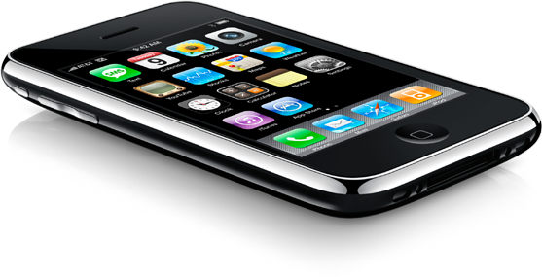
Agenda |
Field’s problems, Technical Solution
Mobile
Face book/ Picasa/ Instagram
1
We can use mobile devices as the solution of all.
We all knows that you are working on that.
2
Just like a face book you can upload a photo of a client after GRT or you can upload the center inspection photo too upto some extend.
At the time of identifying the client this tool can be more powerful.
DIGAMBER | FINANCE

Slide 7
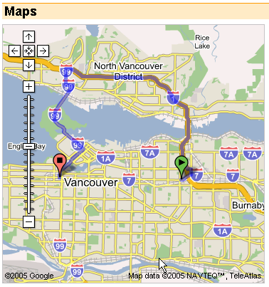
Agenda |
Field’s problems, Technical Solution
Google Map
Short Message Service (SMS)
3
At the time of physical verification vsit of a center even a client, the BM can draw a MAP with the help of google map and save it for future use.
With the help of saved map anyone can go to the center place directly.
This can be a very revolutionary step towards the go green initiative.
-Generating of e-receipts instead of paper .
-Client can get the actual amount receipt if he pays more and get the receipt of less , the staff fraud can easily traceable.
-It gives you a direct interaction with the client in the field.
An advance feature we may put in Mifos further.
4
DIGAMBER | FINANCE

Slide 8
Agenda |
Field’s problems, Technical Solution
Mail Merge
Global positioning system (GPS)
5
We can use a mail merge facility to generate a letters in own language.
Also we may put the data field into any template like an agreement etc and get a print out of the same, saves time and a cost too.
It increase the scalability of any institution.
6
This is a very common feature now a days with the help of this :-
We can check the actual position at the time of repayment received.
When they upload photo a stamp can tells the actual location.
DIGAMBER | FINANCE

Slide 9
Questions …
DIGAMBER | FINANCE

Slide 10
THANK YOU!
DIGAMBER | FINANCE

