Slide 1
2013 Mifos Year in Review
Edward Cable, Craig Chelius, Vishwas Babu
October 22, 2013

Slide 2
Organizational Developments
Received 501(c)3 non-profit status
Ownership of Mifos brand
Achieved full funding for 2013
New board members

Slide 3
Same Mifos Brand. Brand New Position.
Technology for Financial Inclusion
To speed the elimination of poverty by coordinating a global community that builds, supports, and uses Mifos, a free and open source platform that enables financial service providers to more effectively and efficiently deliver responsible financial services to the world’s 2.5 billion poor and unbanked.

Slide 4
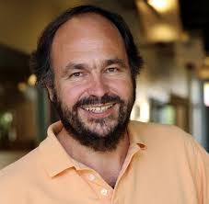
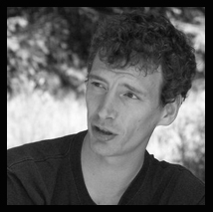
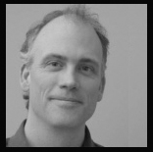
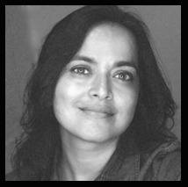
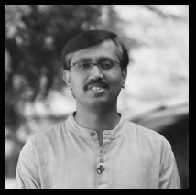
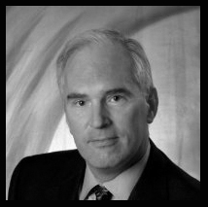
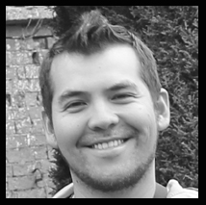
Board of Directors
Paul Maritz (Chairman)
Paul, lead funder of Mifos since its inception, has been the sole source of support for theCOSM transition and launch of Mifos X. As CEO of Pivotal, his engineering brilliance & vision for technology will guide our platform.
Dave Neary
Dave is Community Gardner at Red Hat and an expert on the dynamics of free software communities. He helps us navigate OS licensing while smoothly growing our technical community.
James Dailey
James is the original visionary who founded Mifoswhile at GTC. He’s the currently CTO of MicroEnergy Credits and helps keep us on the cusp of technology-enabled financial inclusion.
Zaheda Bhorat
Zaheda leads our efforts to grow our community of implementers and users. To surmount this challenge, She brings us two decades of community-building experience at Google, Sun, & Apple.
Suresh Krishna
As Managing Director of Grameen Koota, Suresh provides us the domain expertise and strategic vision from one of the premiere microfinance institutions in the world.
Craig Chelius
Edward Cable

Slide 5
Community Development
Setting the stage for growth
Opening up the Community
Partnering to strengthen our core
Growing Participation
Setting up Infrastructure
Building Awareness

Slide 6
Thoughtworks - HSP

Slide 7
Social Coding 4 Good
Helping connect us with corporate volunteers
Take 3 Program with Vmware
Brand New UI Design with Deanna McCusker

Slide 8
Social Coding 4 Good

Slide 9
Corporate Partnerships

Slide 10
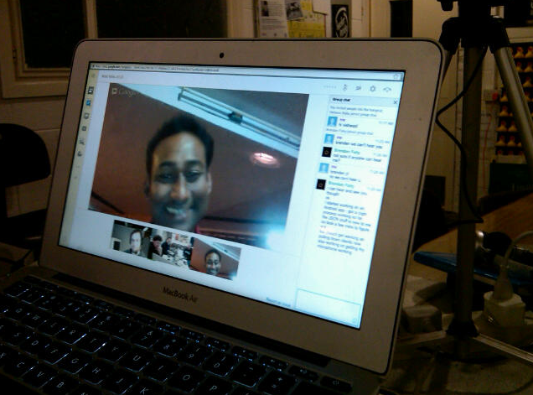
Random Hacks of Kindness

Slide 11
WalMart Hackathon

Slide 12
Google Summer of Code
4 amazing interns.
4 awesome mentors.
4 valuable projects.
1 incredible summer.

Slide 13
OSCON 2013

Slide 14
Financial Inclusion 2020

Slide 15
Vibrant & Collaborative User Base
New opportunities for Specialists
New opportunities for users
Large and small

Slide 16
Growing User Base
Now more than 1.2M clients reached by 50 institutions using Mifos 2.x
Including a dozen users in China
20 institutions piloting Mifos X
5000 MFIs in our database of leads

Slide 17
Maturing Ecosystem
New Specialists have joined us from Uganda, Burundi, Ghana, the Ivory Coast, Nigeria, and Cambodia
Large-scale deployments for Mifos X in the pipeline in Nigeria, Ivory Coast, Rwanda
Partnerships in the works with WOCCU, Desjardins International Development and others

Slide 18
First Movers on the Platform
Musoni
Launch of mLite
Quipu
Qmobile & Qloud Inclusión
Grameen Koota
Migration from Mifos 2.x and GK Maarg
InVenture
Integration with mobile credit scoring
Elevate Africa & Heaven’s Family
First live users on Mifos X

Slide 19
Technical Developments
First Major Release of the Mifos X Platform
12 regular bi weekly point releases
90% feature parity with Mifos X
Onboarding of technical partners
Infrastructure Improvements
Brand new user interface on AngularJS

