Slide 1
Assigning loan Officer

Slide 2
How to assign Loan Officer?
This guide will show you how to assign Loan Officer with Mifos X System

Slide 3
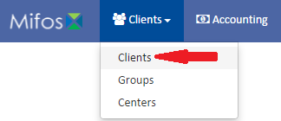
Go to Clients
Click on Clients in the Clients’ tab.

Slide 4
Select a Client
Select a client by clicking on him

Slide 5
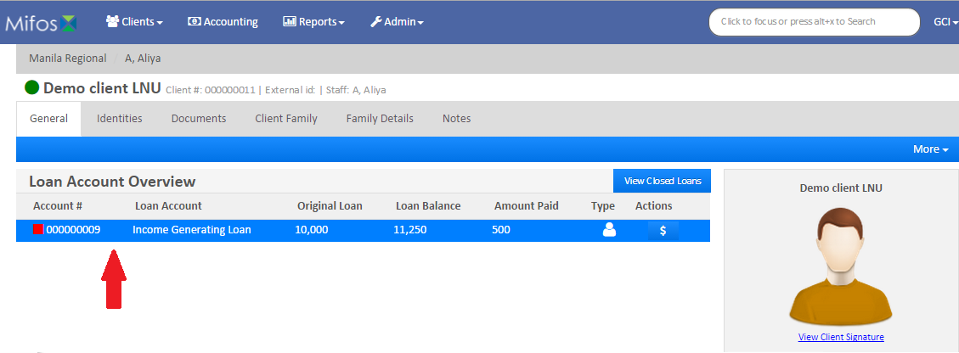
Selecting a Loan
Select a Loan by clicking on it

Slide 6
Selecting Option
Click on Assign Loan Officer which is situated within the blue action bar

Slide 7
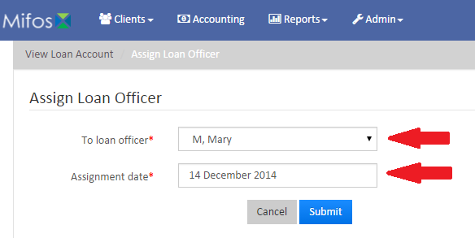
Assigning the Loan Officer
Choose a Loan Officer from the drop-down menu
Pick Assignment Date.
Click button.

