Slide 1
Closing a loan account

Slide 2
This guide will show you how to close a loan account using the Mifos X system.
To close a loan account, the loan account's outstanding balance must be zero or within the specified tolerance amount.

Slide 3
Step 1
Launch Mifos X and click Clients. If you want to close a client loan account, click Clients, and if you want to close a group loan account, click Groups.

Slide 4
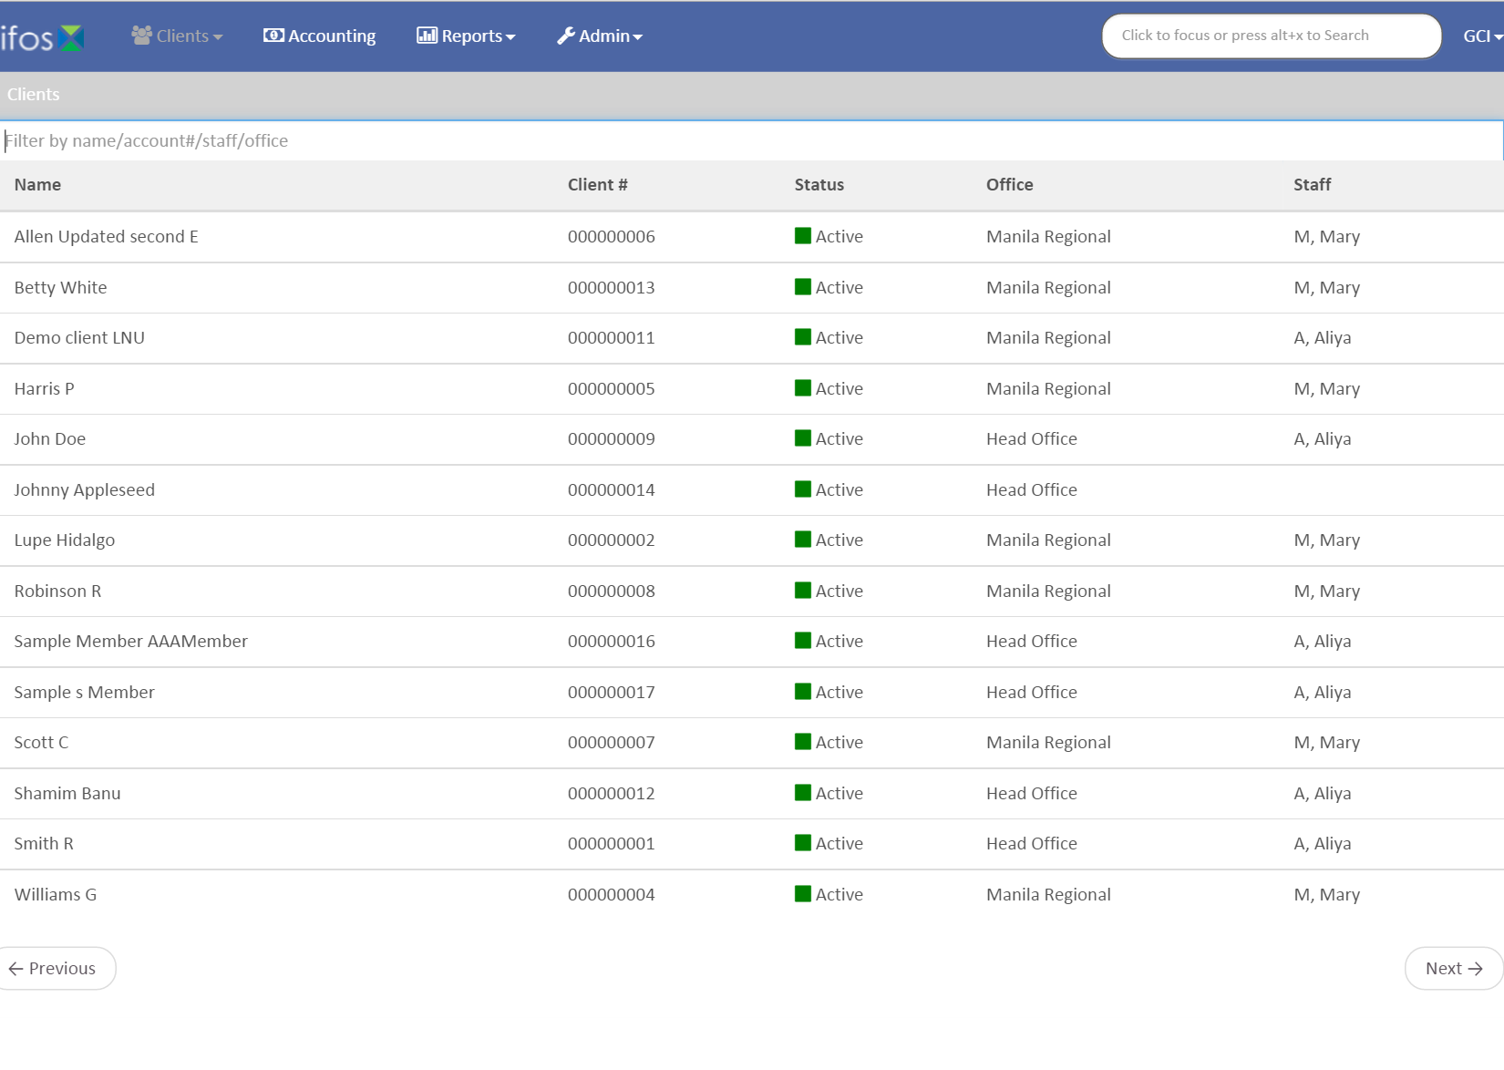
Step 2
Click on the client or group.

Slide 5
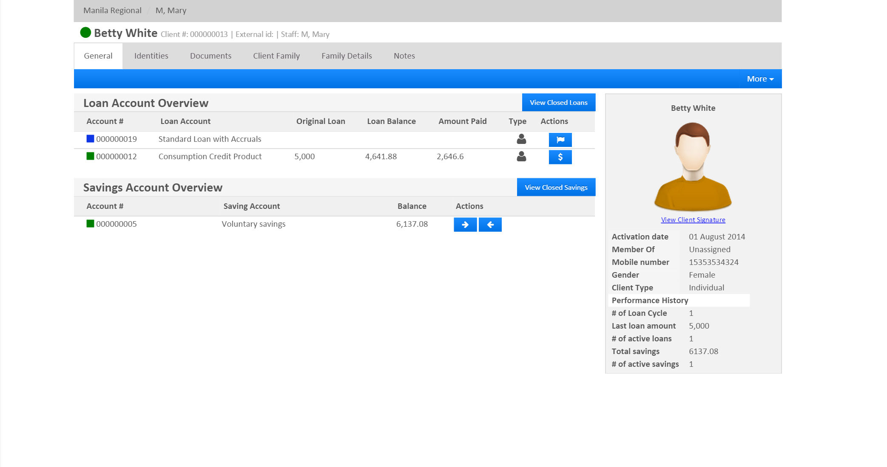
Step 3
Select the loan account to be deleted.

Slide 6
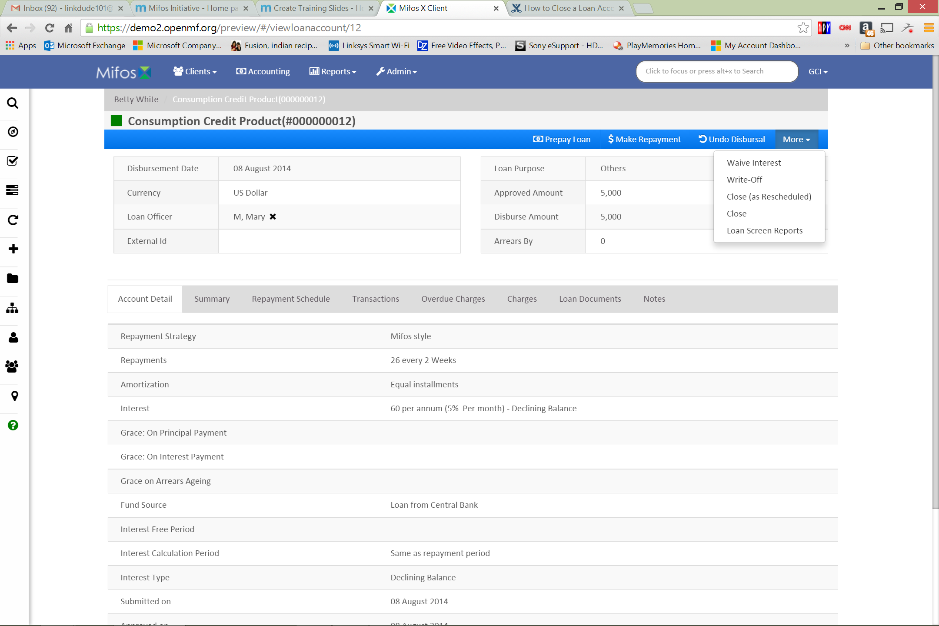
Step 4
Click More, and then click Close.

Slide 7
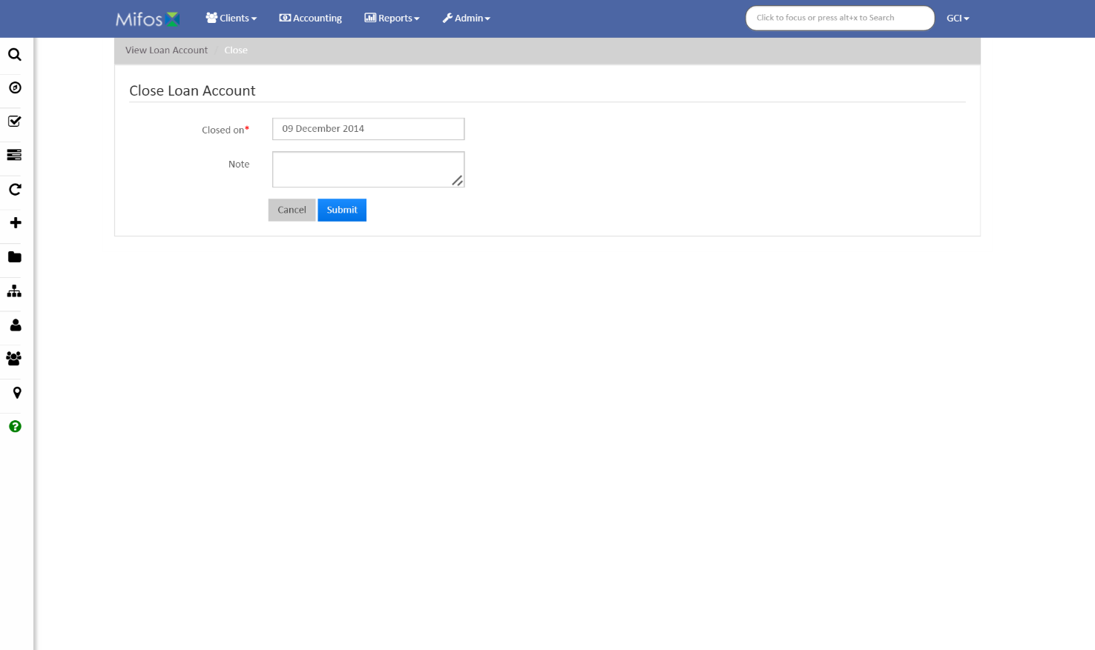
Step 5
Pick a date for Closed on, and enter a Note (optional). Click Submit.

Slide 8
Thanks for your attention, and good luck!

