Slide 1
Creating a general ledger account

Slide 2
This guide will show you how to organize your different accounts within Mifos X.
Five types may be created: Asset, Equity, Expense, Income, and Liability.

Slide 3
Step 1 – Chart of Accounts
Launch Mifos X and click on Accounting.
Click on Chart of Accounts.

Slide 4
Step 2 – Chart of Accounts
You will see a list of all the accounts currently in use by your organization.
You can filter the results with the Filter by Account/GL Code/Account Type field, or view the chart in a Tree View.

Slide 5
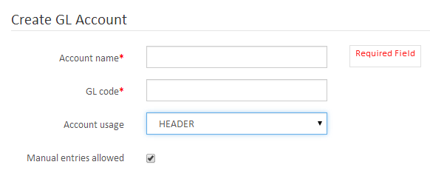
Step 3 – Creating Header Accounts
Click Add Account and enter the Account Name and GL Code.
Click on Account Usage and select Header. Select whether Manual Entries are allowed.

Slide 6
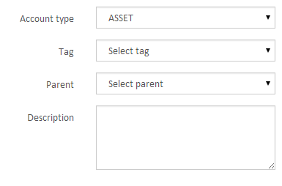
Step 4 – Creating Header Accounts
The information on the right is optional.
You can select the Account Type, Tag, and Parent, and type a Description. Then click Submit.

Slide 7
Step 5 – Creating Detail Accounts
Click Add Account and enter the Account Name and GL Code.
Click on Account Usage and select Detail. Select whether Manual Entries are allowed.

Slide 8
Step 6 – Creating Detail Accounts
The information on the right is optional.
You can select the Account Type, Tag, and Parent, and type a Description. Then click Submit.

Slide 9
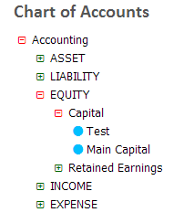
Step 7 – Tree View
If you want to view your accounts in a tree format, click on Tree View.
Click +.

Slide 10
Step 8 – Editing/Disabling/Deleting an Account
Return to the Chart of Accounts screen and click on the account you would like to edit.
From here, you can Edit, Disable, or Delete the account. After disabling an account, you can re-enable it by clicking the button again. Deleting an account will require confirmation.

Slide 11
Step 9 – Editing an Account
Clicking Edit will allow you to make any necessary changes. When finished, click Submit.

Slide 12
Thanks for your attention, and good luck!

