Slide 1
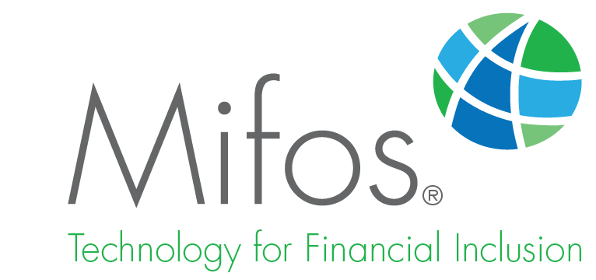
Easy Access to Your
Mifos X Account
Notes:
Thank you. It is a pleasure to join for my first board meeting. Mifos X is an open technology platform for financial inclusion that provides the core functionality needed to deliver financial services to the world’s 2.5 billion unbanked. It solves the challenge of core banking systems that are too expensive, too complicated or that have no local support. The Mifos X user interface is renowned for its simplicity and ease of use. Mifos X can be deployed in any environment: cloud or on-premise, on or offline, mobile or PC.

Slide 2
Easy Access to Your Mifos X Account
How do I log onto and log out of my Mifos X Account?
Notes:
Logging onto and out of your Mifos X account is simple and easy.

Slide 3
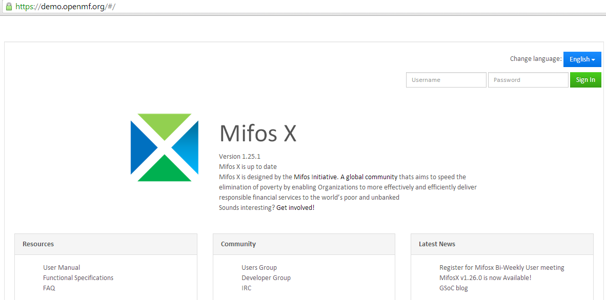
Open an Internet browser window and enter the URL in the address bar.
On the Mifos X Sign In Page, enter your Username and Password and click Sign in.
The Mifos X Welcome Page will be displayed.
Notes:
Your system administrator will provide you with your username, password, and the URL needed to access your financial institution's implementation of Mifos X. Once you have your username and password, you are ready to sign in to the Mifos X system. In addition, the Mifos X Sign In page features a Language selector menu, Mifos X version and product information, Resource links, Community links and News links.

Slide 4
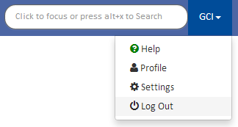
Click your Username on the menu bar.
Click Log Out.
You are logged out when the Mifos X Sign in page is displayed.
Notes:
It is important to log out of your Mifos X account when not in use to ensure the safety of your data.

Slide 5
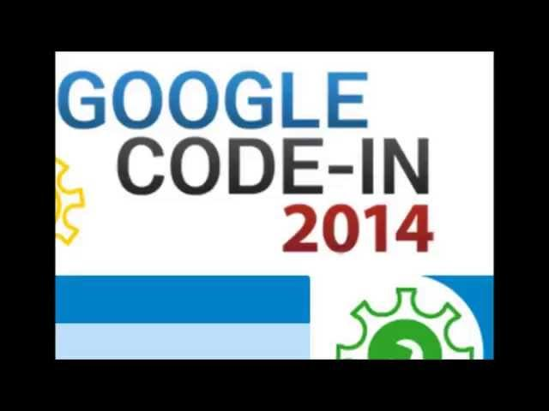
Demonstration Video
Notes:
Video. Click play to watch.

