Slide 1
Managing loan account disbursement

Slide 2
This guide will show you how to manage loan account disbursement using Mifos X.
Loan account applications that have been approved can be disbursed to a negotiable payment type (e.g., Cash, Check, M-Pesa) or to a saving account linked to the loan application. When a loan account is disbursed, its status changes from Approved to Active.
A disbursement made in error can be undone. When a disbursement is undone, the loan account status changes from Active to Approved.

Slide 3
Disbursing a loan account to a negotiable payment type
Launch Mifos X and click Clients. If you want to disburse a client loan account, click Clients, and if you want to disburse a group loan account, click Groups.

Slide 4
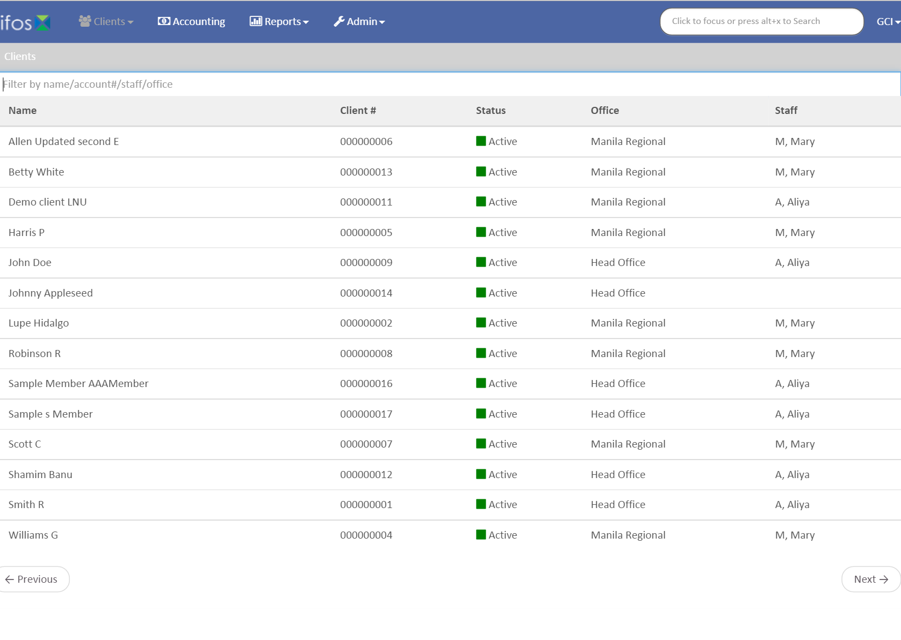
Step 2
Click on the client or group.

Slide 5
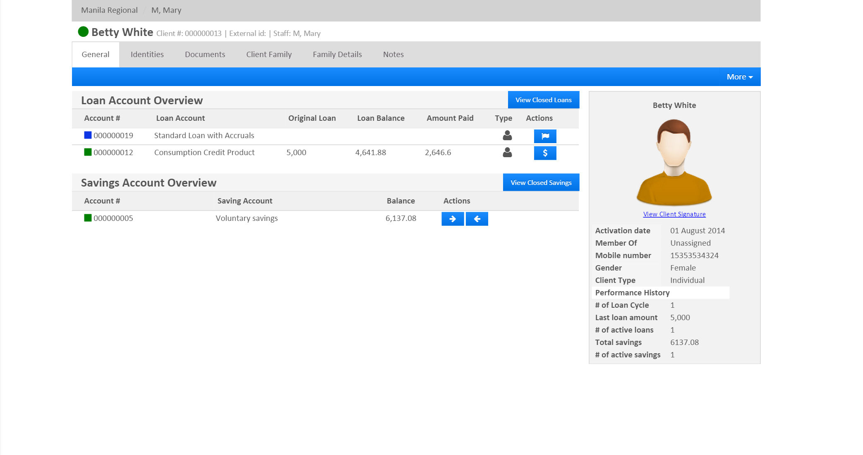
Step 3
Select the loan account to be disbursed.

Slide 6
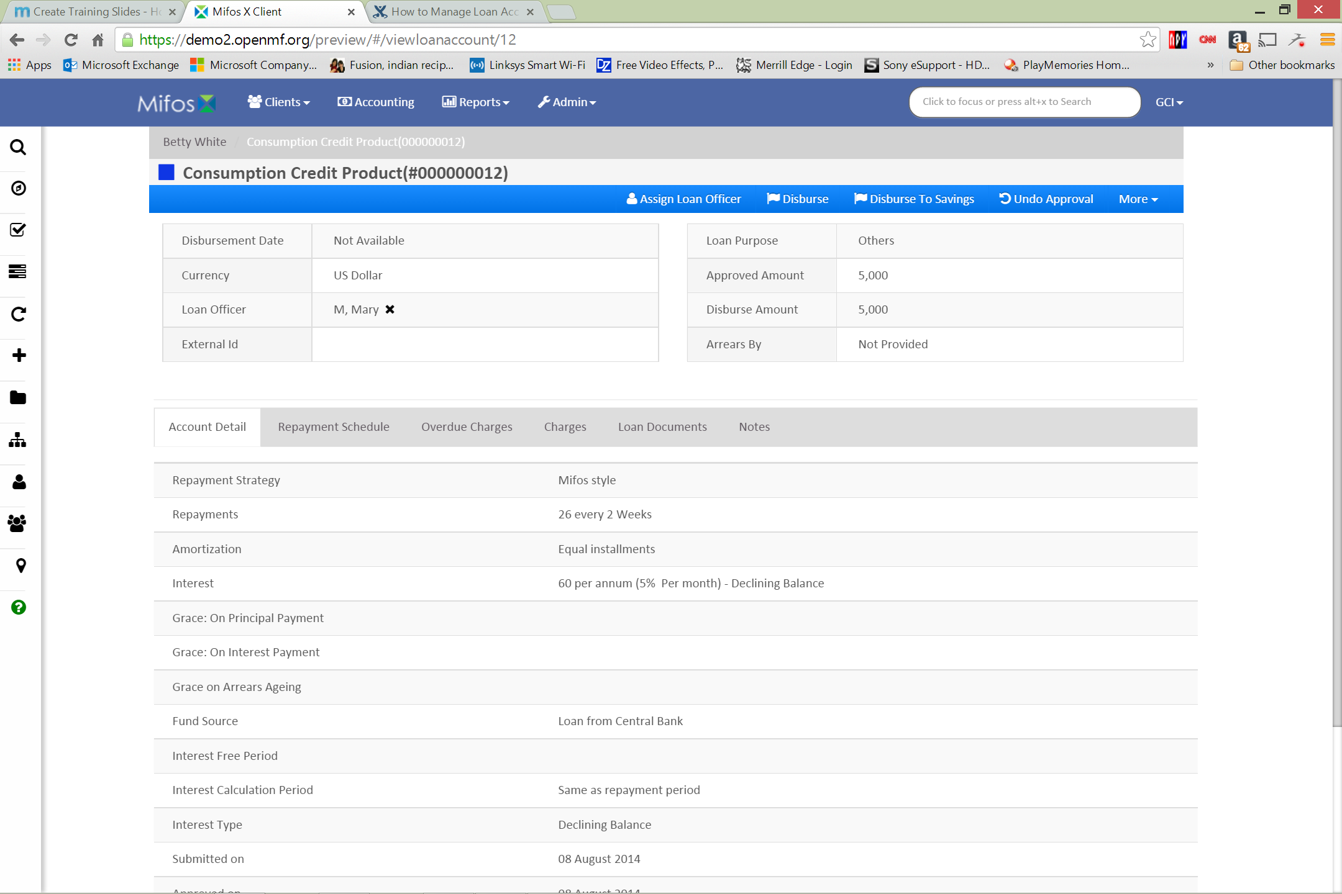
Step 4
Select Disburse from the blue action bar.

Slide 7
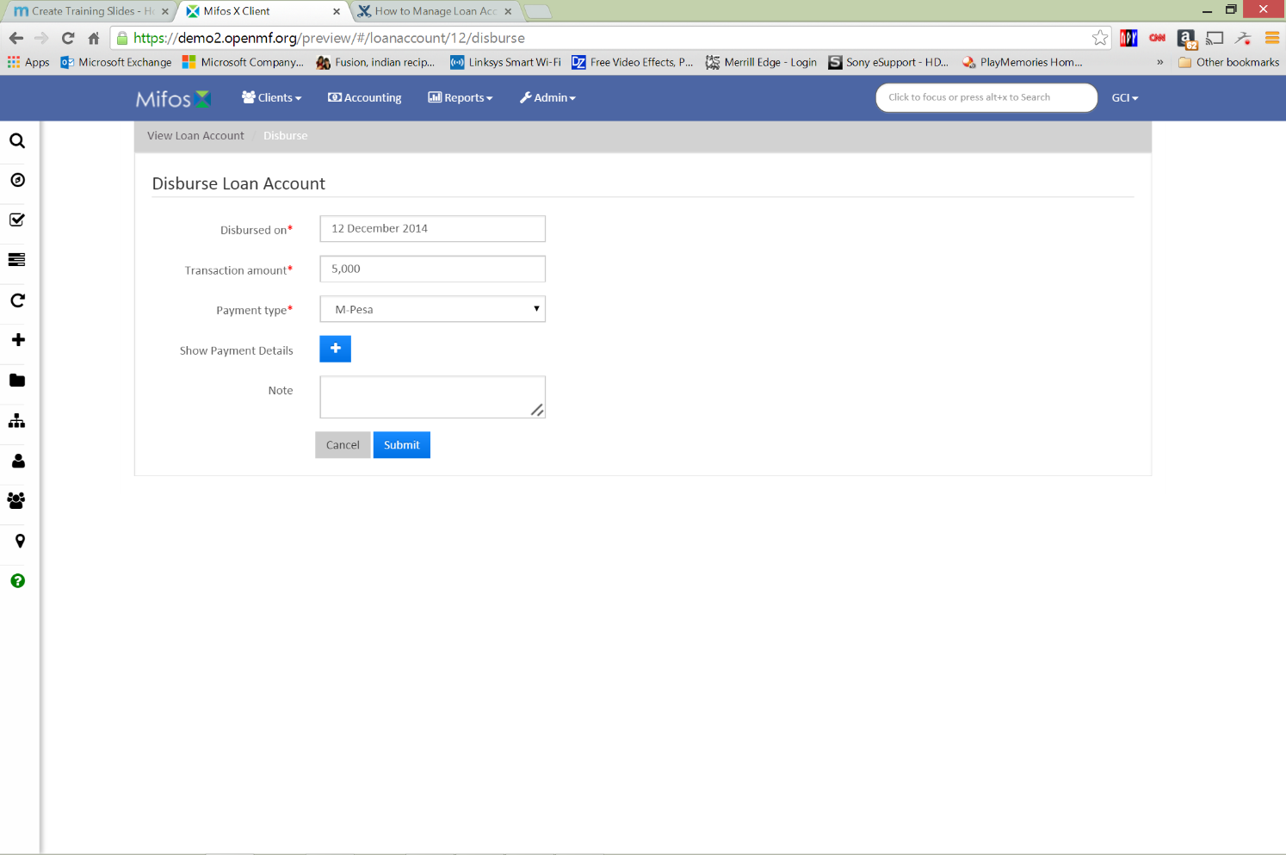
Step 5
Enter the Disbursed on date, the Transaction amount, the Payment type, Payment details (press +), and an optional Note. Click Submit.

Slide 8
Disbursing a loan account to a savings account
Launch Mifos X and click Clients. If you want to disburse a client loan account, click Clients, and if you want to disburse a group loan account, click Groups.

Slide 9
Step 2
Click on the client or group.

Slide 10
Step 3
Select the loan account to be disbursed.

Slide 11
Step 4
Select Disburse to Savings from the blue action bar.

Slide 12
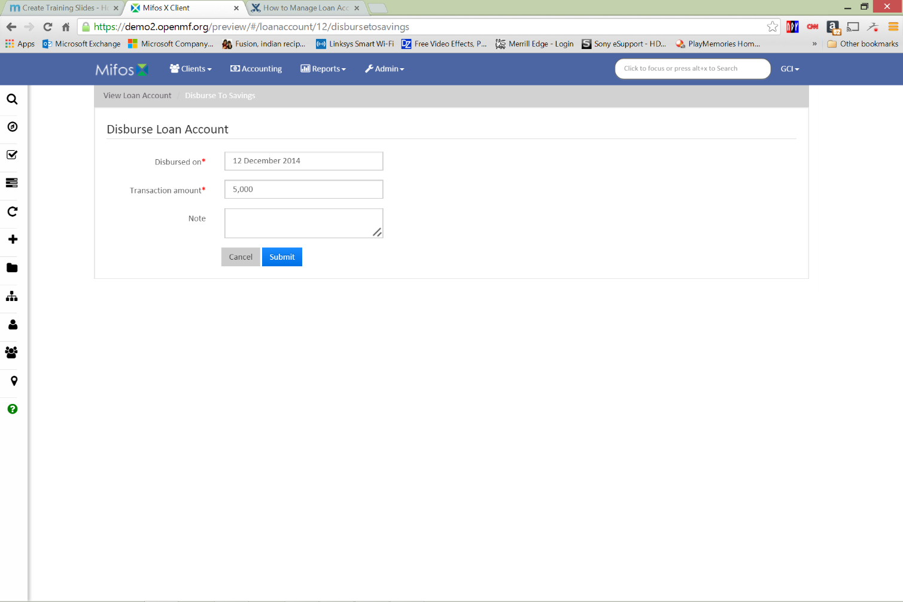
Step 5
Enter the Disbursed on date, the Transaction amount, and an optional Note. Click Submit.

Slide 13
Undoing a loan account disbursement
Launch Mifos X and click Clients. If you want to undo a client loan account disbursement, click Clients, and if you want to undo a group loan account disbursement, click Groups.

Slide 14
Step 2
Click on the client or group.

Slide 15
Step 3
Select the loan account.

Slide 16
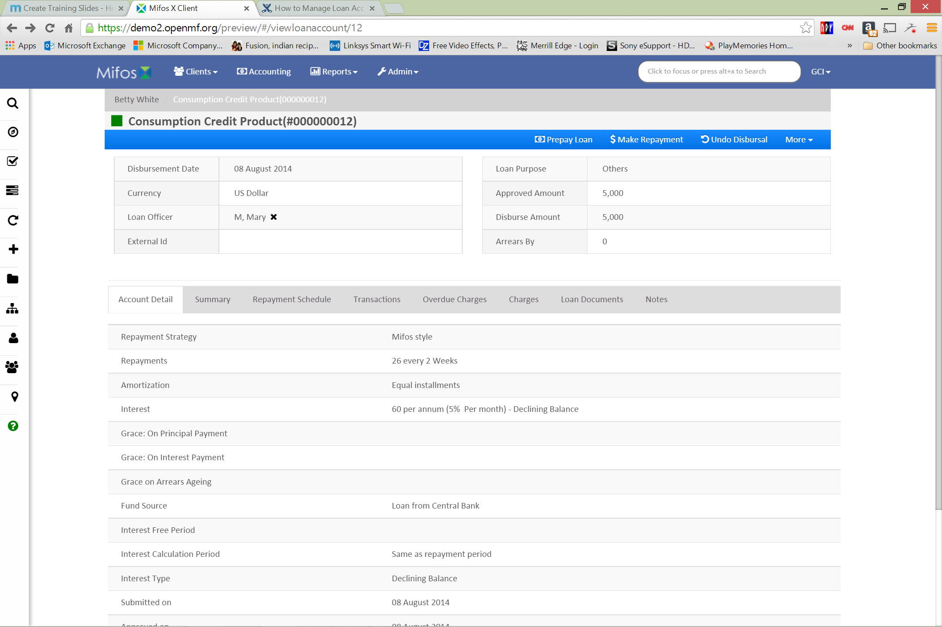
Step 4
Select Undo Disbursal from the blue action bar.

Slide 17
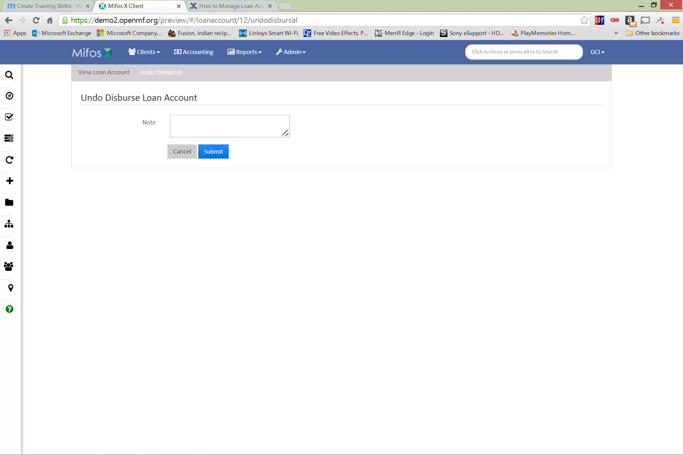
Step 5
Enter a Note. Click Submit.

Slide 18
Thanks for your attention, and good luck!

