Slide 1
Creating a Savings Account

Slide 2
Before proceeding, make sure that…
The client is approved
The client account is created in the system

Slide 3
1. Find the client account
Select “Clients” and choose the “Clients” dropdown option or use the search bar to type in a client
Select the client you would like to create the savings account in

Slide 4
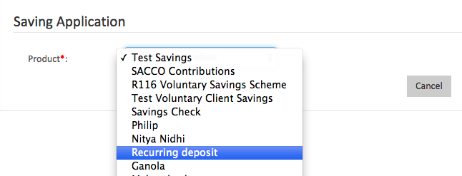
2. Choose the type of account
Make sure you are on the “General” tab
Select “+New Saving”
Select the type of account being opened

Slide 5
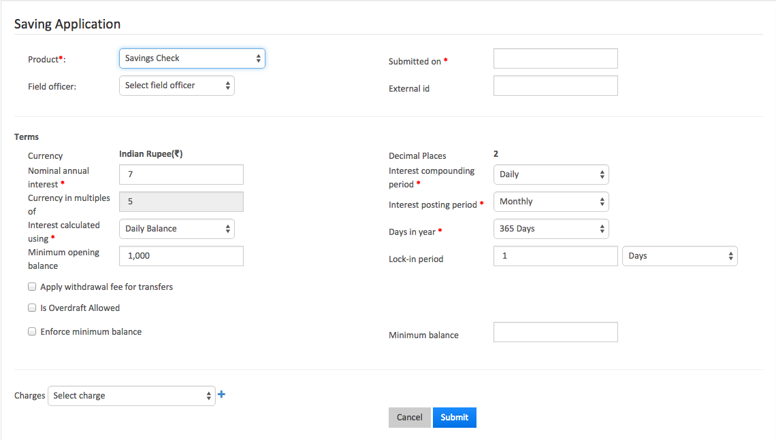
3. Fill out the details
Complete the required fields (many of them will already be pre-filled)
Hit the blue “Submit” when done

Slide 6
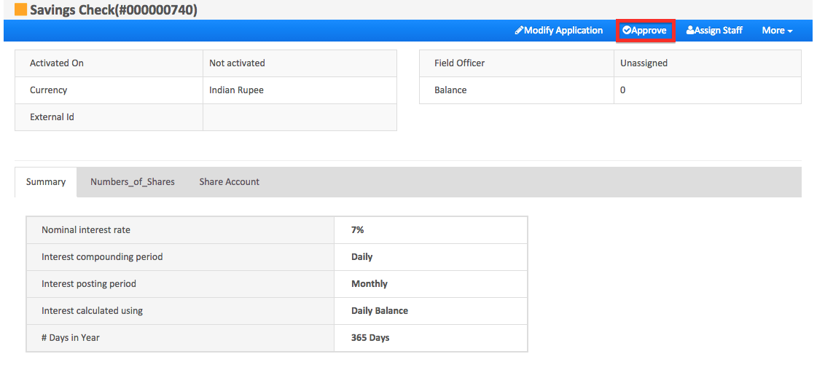
4. Approve the details
Review the information presented
If everything is correct, select “Approve” from the blue navigation bar

Slide 7
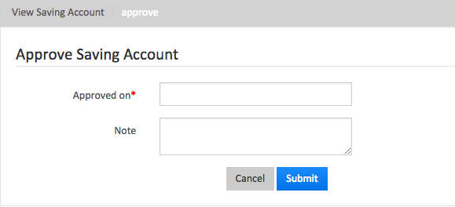
5. Fill out the approval details
Enter the “Approved On” date
It is usually the same date, but in some cases, it is earlier so make sure you verify that it is correct
Enter any notes for the account in the “Note” field
Review the information on screen, then press “Submit” when you have made sure everything is correct
You will be taken back to the “General” screen

Slide 8
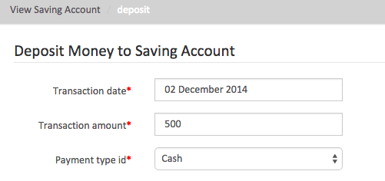
6. Make a deposit
Click on the account OR click on the blue arrow in “Actions”
Enter the transaction date and transaction amount and select the payment type from the dropdown menu

Slide 9
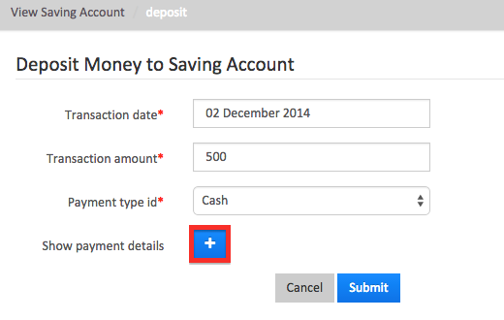
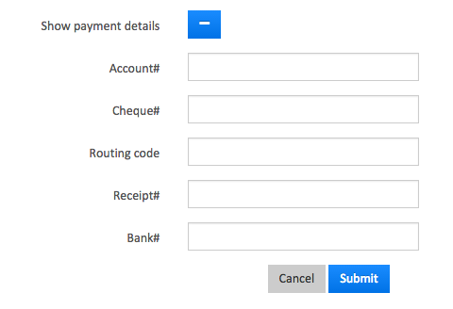
7. Make a deposit (continued)
If your organization uses “Show Payment Details”, click on the blue “+”
Fill in the Account#, Cheque#, Routing code, Receipt#, and Bank#

Slide 10
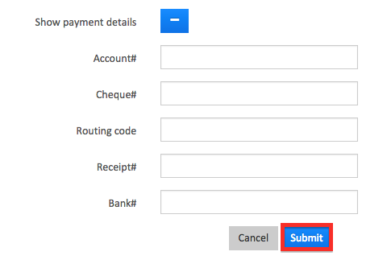
8. Make a deposit (continued)
Review the information on the screen and press “Submit” when you have made sure that everything is correct

Slide 11
Congratulations!
You have now created a savings account

