Slide 1
USER Setup

Slide 2
How to add new user or edit an existing one?
This guide will show you how to add a new user or edit an existing one with Mifos X System

Slide 3
Step One: Go to Users
You can go to Users by opening Admin tab and select Users.
This is how the user chart is looking:
There are 4 columns: First Name, Last Name, Email and Office.
Click on a user’s name to view his more information and edit it.
Tip: Use the filter to find the user you need faster.

Slide 4
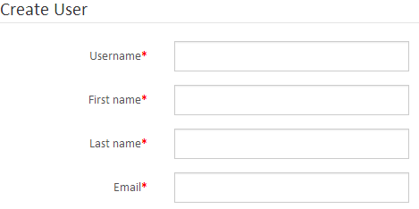
Step Two: Create a User
Click on the icon in the top-right corner of the Users screen in Admin tab
First you must fill all of these fields to start creating new user.

Slide 5
Step Two Continued
For passwords you have two options:
Auto generate password
Write one yourself, but first you have to uncheck Auto generate password box
After finishing password you have to select user’s home office:
Finally you have to give the user at least one role:
To select more than one hold the Ctrl key
After you have filled everything click the Submit button.

Slide 6
Step Three: Edit User
Just click on the user’s name in Users in Admin tab.
You have 3 buttons at your disposal to edit his profile:
Edit
Delete
Change Password

Slide 7
Step Three Continued
Click on the button at the top-right of the page
After you have went to the editing screen you can change:
Username
First name
Last name
Also you can change Staff which will report to this user by using the drop- down menu:
Here you can also Add or Remove user’s Roles:
Remember: To select more than one hold the Ctrl key
Click Submit button after changes

Slide 8
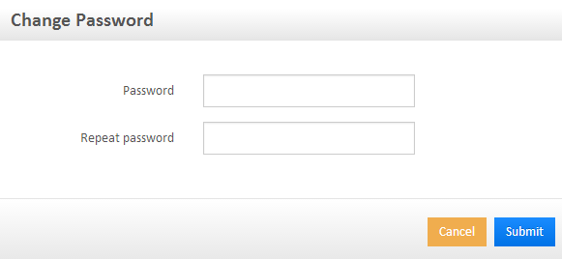
Step Three Continued
You can transfer user account from one office to another by using the drop-down menu
Navigate to Users in Admin tab select a user by clicking on his name.
After that click button at the top-right of the page.
This will appear as pop-up window in which you have to fill Password and Repeat password and after that click Submit.
Navigate to Users in Admin tab select a user by clicking on his name.
After that click button at the top-right of the page.
Click Confirm.

Slide 9
Questions?

Slide 10
Thank you for your attention!

