Slide 1
Waiving interest for a loan account

Slide 2
This guide will show you how to waive interest for a loan account using the Mifos X system.
To waive interest for a loan account, a Mifos user must be granted permission to do so.
The amount of interest to be waived can be specified when completing the transaction. The amount will default to interest amounts that are in arrears on the transaction date, if any, or the total interest payable on the loan if interest is not in arrears.
Before waiving interest, review the information on the loan account summary tab to confirm the amount of interest to be waived.

Slide 3
Step 1
Launch Mifos X and click Clients. Click Clients or Groups depending on whether you are waiving interest for a client or group loan account.

Slide 4
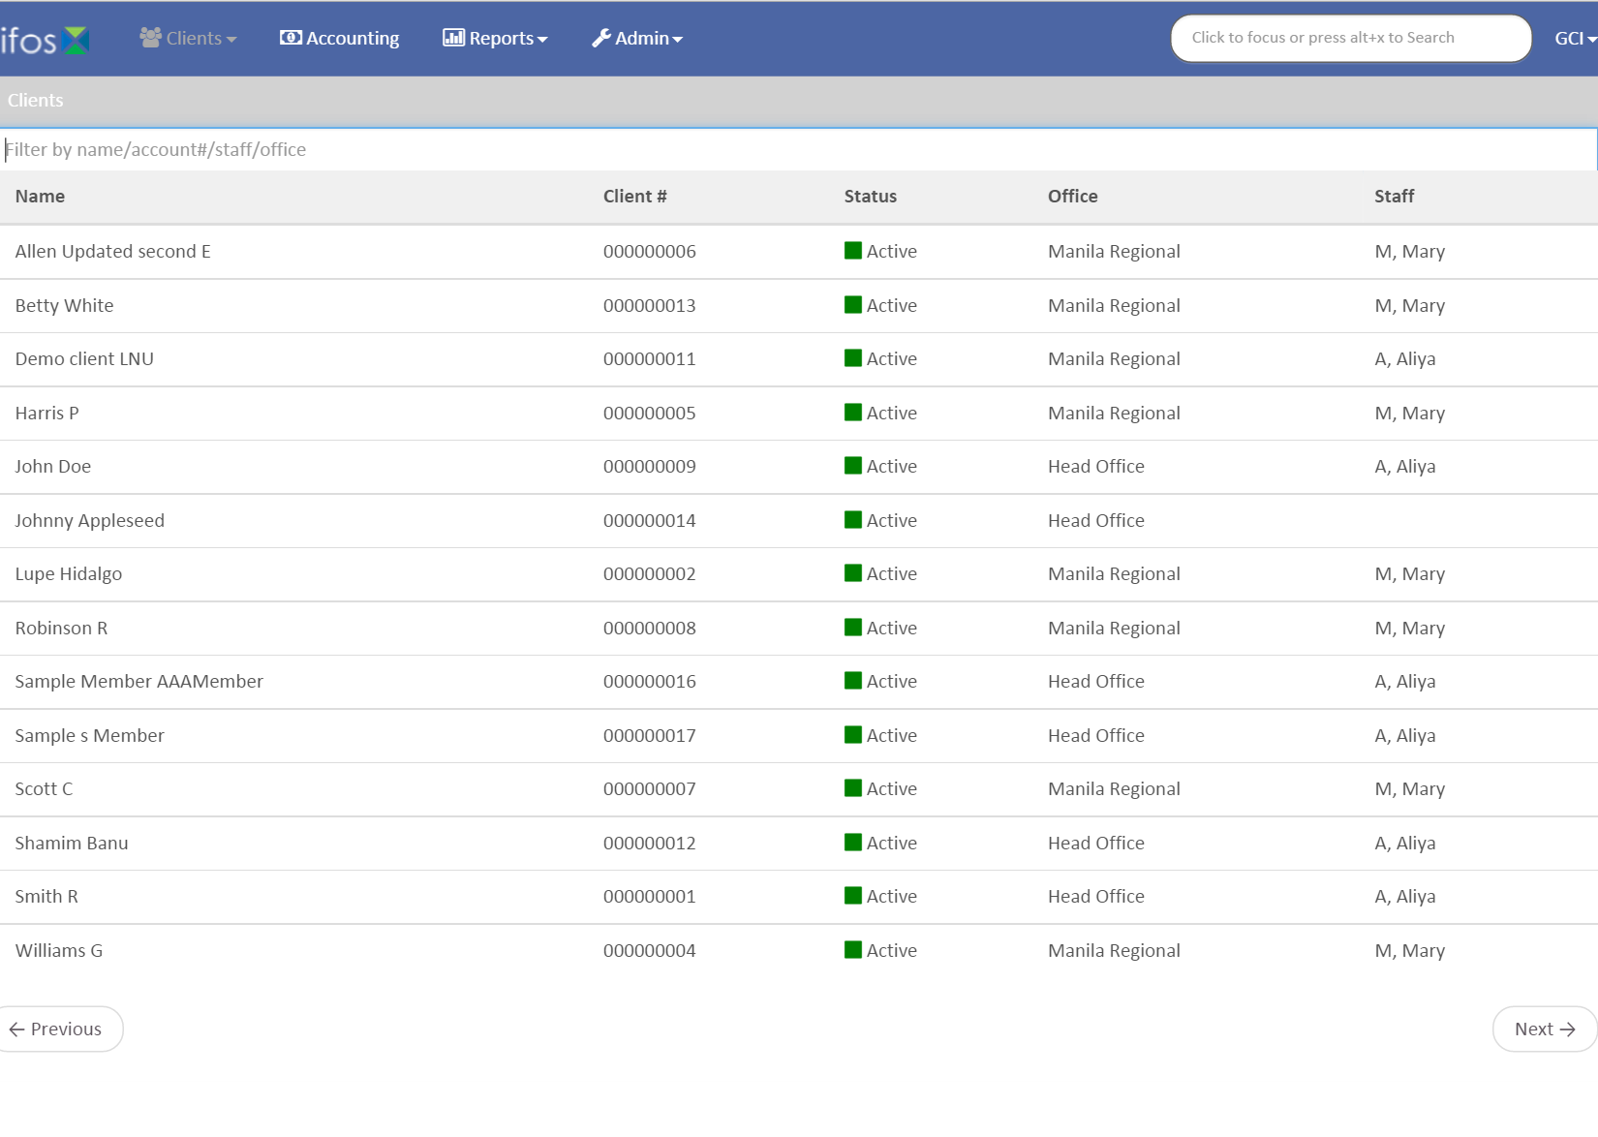
Step 2
Click on the client or group.

Slide 5
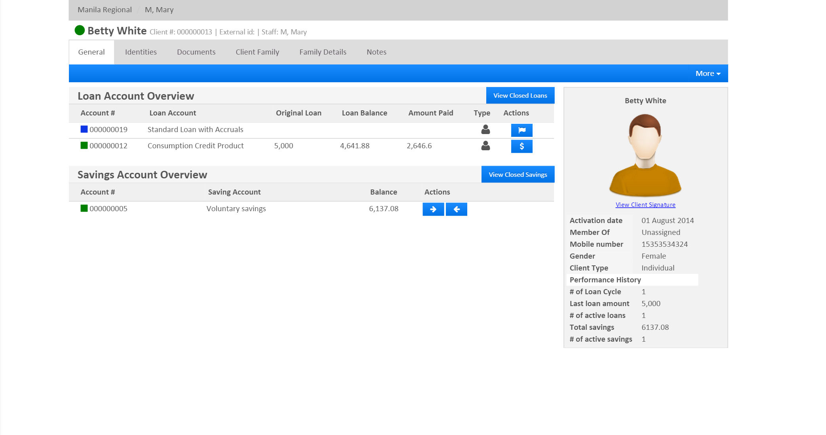
Step 3
Select the loan account for which interest is to be waived.

Slide 6
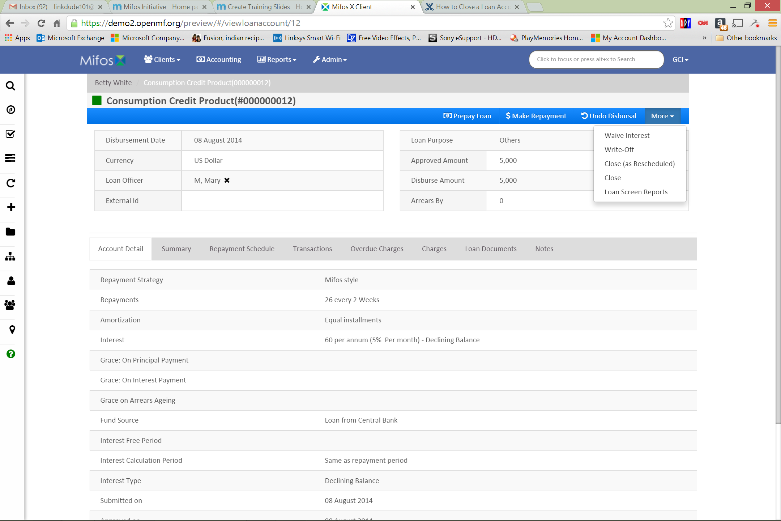
Step 4
Click Summary to review loan information. Click More, and then click Waive Interest.

Slide 7
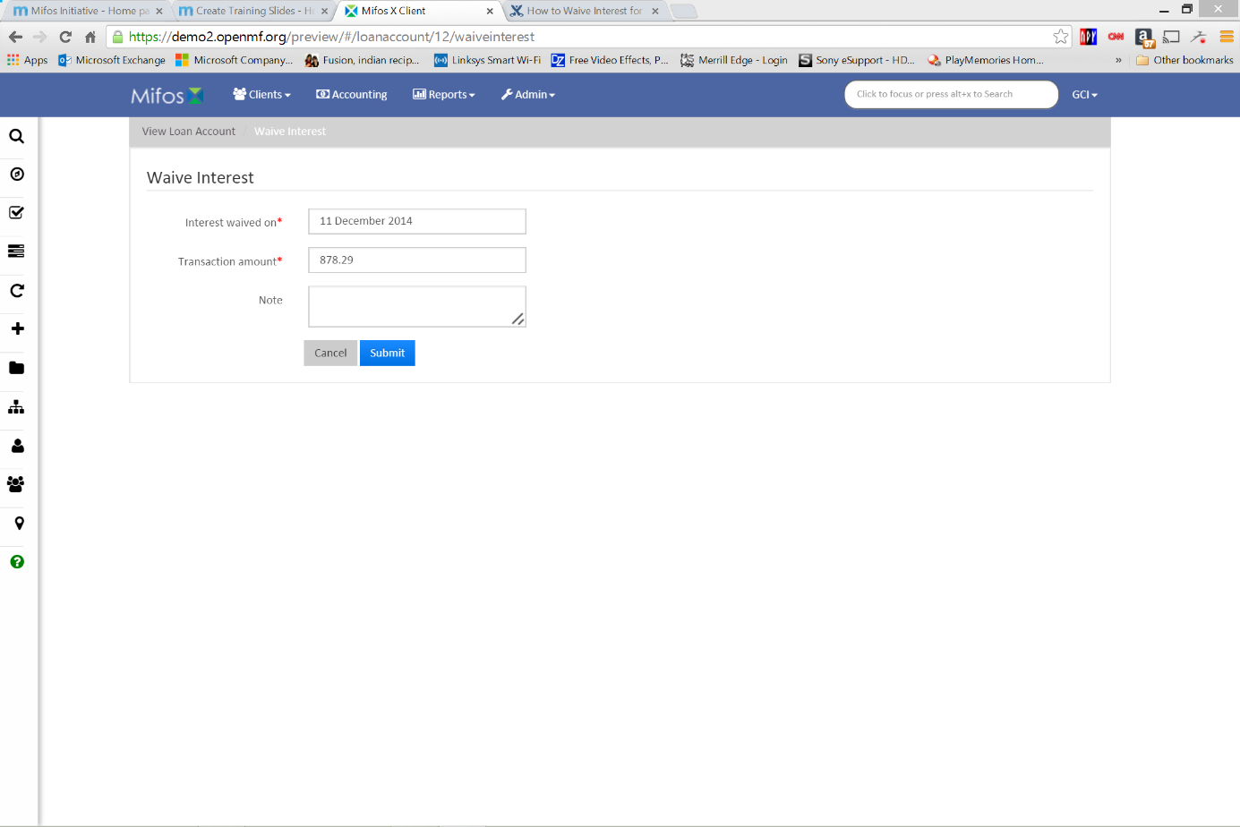
Step 5
Pick a date for Interest waived on. Enter a Transaction amount. Type a Note (optional). Click Submit and review the Summary to confirm that the amount has been waived.

Slide 8
Thanks for your attention, and good luck!

