Slide 1
Writing-off a loan account

Slide 2
This guide will show you how to write-off a loan account using Mifos X.
To write-off a loan account, a Mifos user must be granted permission to do so.

Slide 3
Step 1
Launch Mifos X and click Clients. If you want to write-off a client loan account, click Clients, and if you want to write-off a group loan account, click Groups.

Slide 4
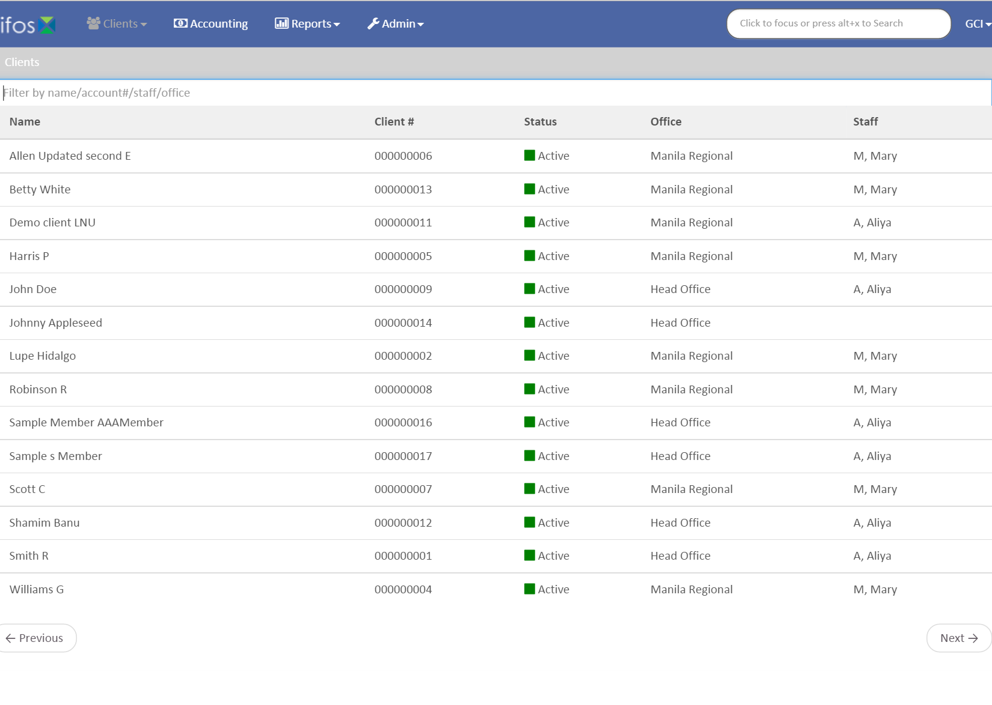
Step 2
Click on the client or group.

Slide 5
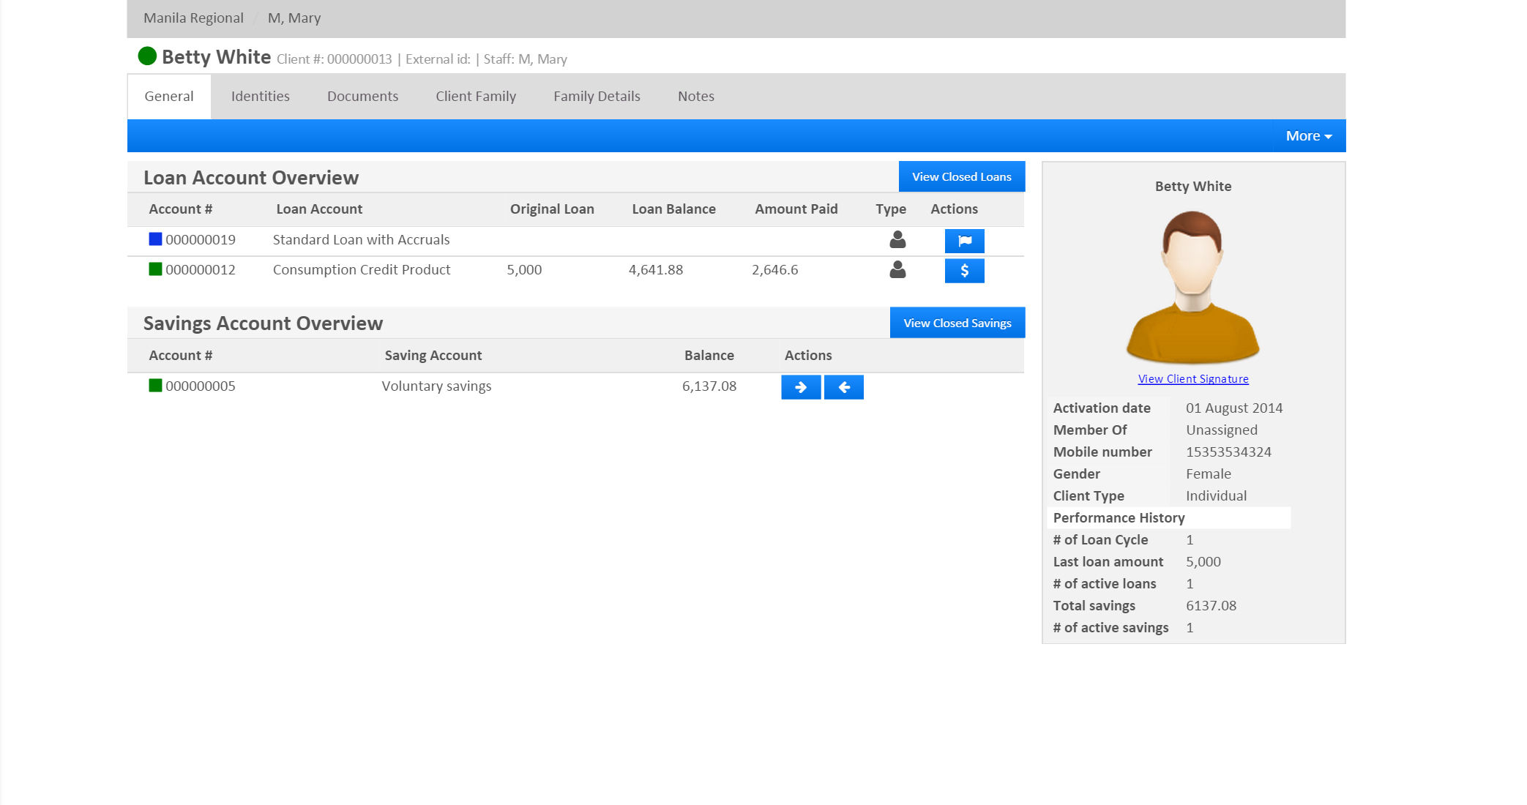
Step 3
Select the loan account to be written-off.

Slide 6
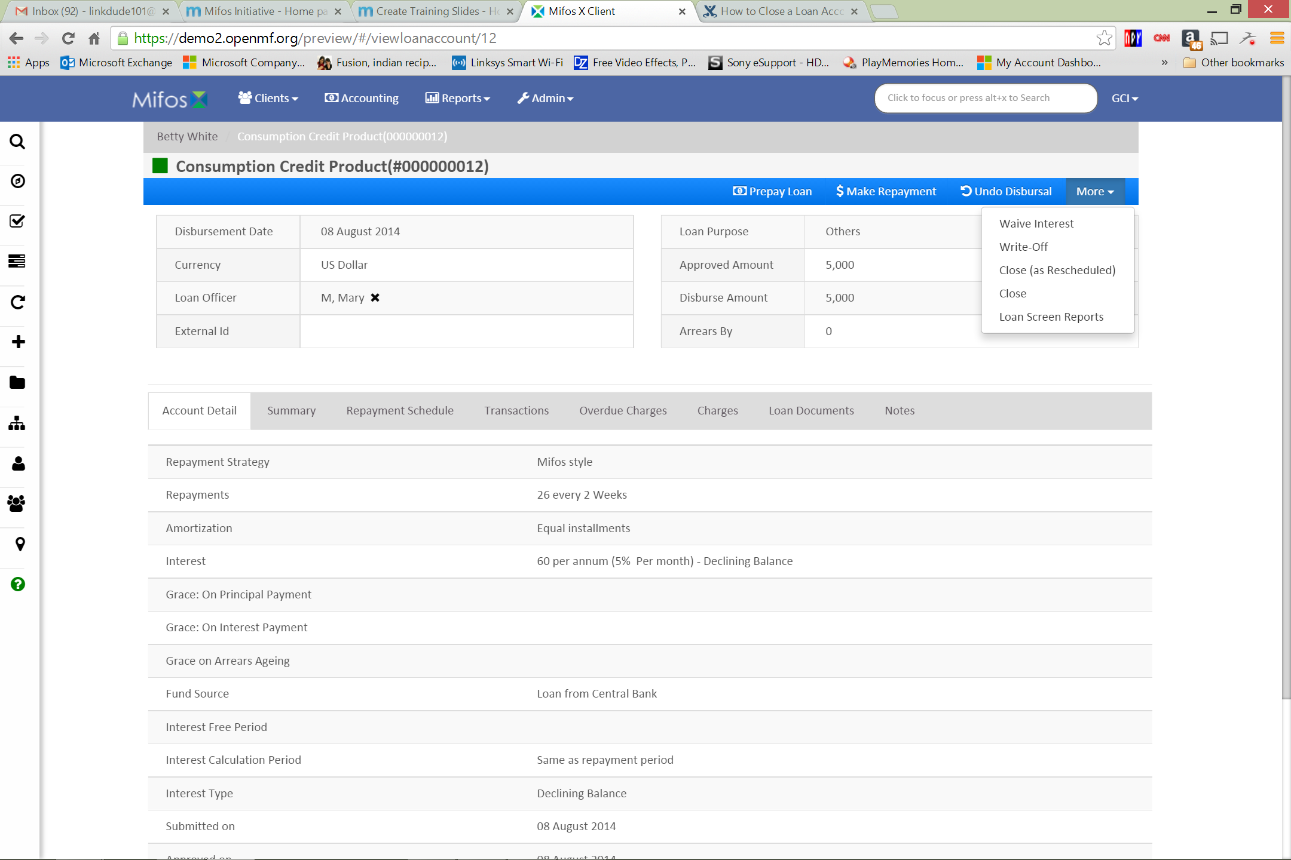
Step 4
Click More, and then click Write-off.

Slide 7
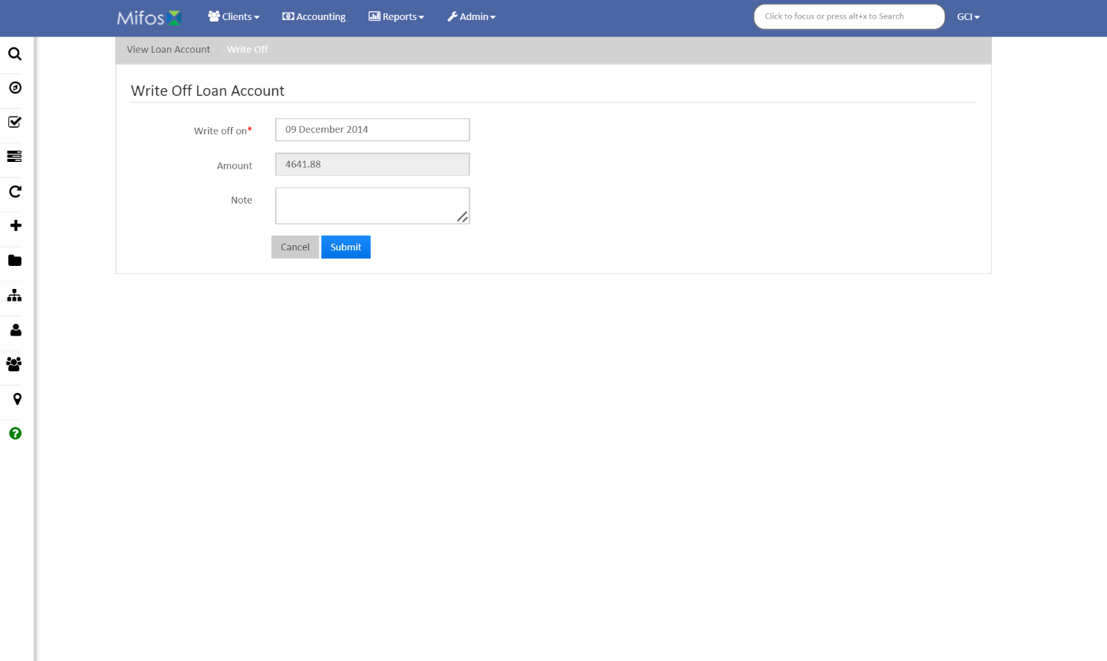
Step 5
Pick a date for Write off on, and enter a Note (optional). The Amount to be written-off will be displayed. Click Submit.

Slide 8
Thanks for your attention, and good luck!

