Slide 1
MIFOS TRAINING SLIDES

Slide 2
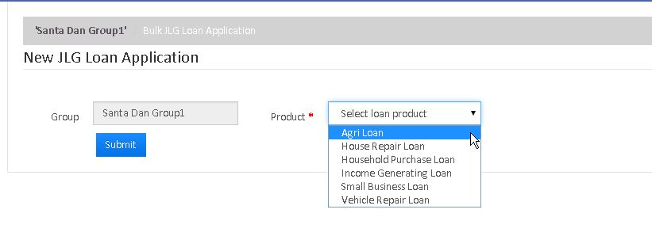
How to Process Bulk JLG Loan Application
Bulk Joint Liability Group (JLG) Loan Application enables you to process the JLG Loan for more than one Client in a single Group.
TO CREATE BULK JLG LOAN APPLICATION:
Go to specific Group and Click on 'Bulk JLG Loan Application' to see the following window.

Slide 3
2. Then Select the loan product and click on 'Submit' button to see the following hidden fields.
3. Using '>>' , add the clients of the group who are eligible for JLG Loan and then click on 'Submit' button to see JLG Loan Application as shown next.

Slide 4
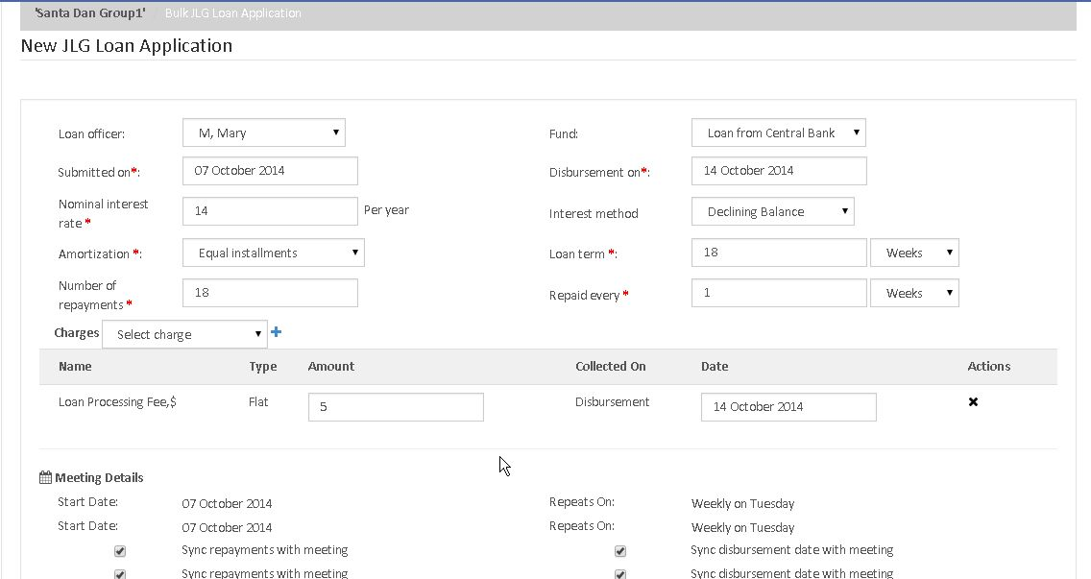

Slide 5
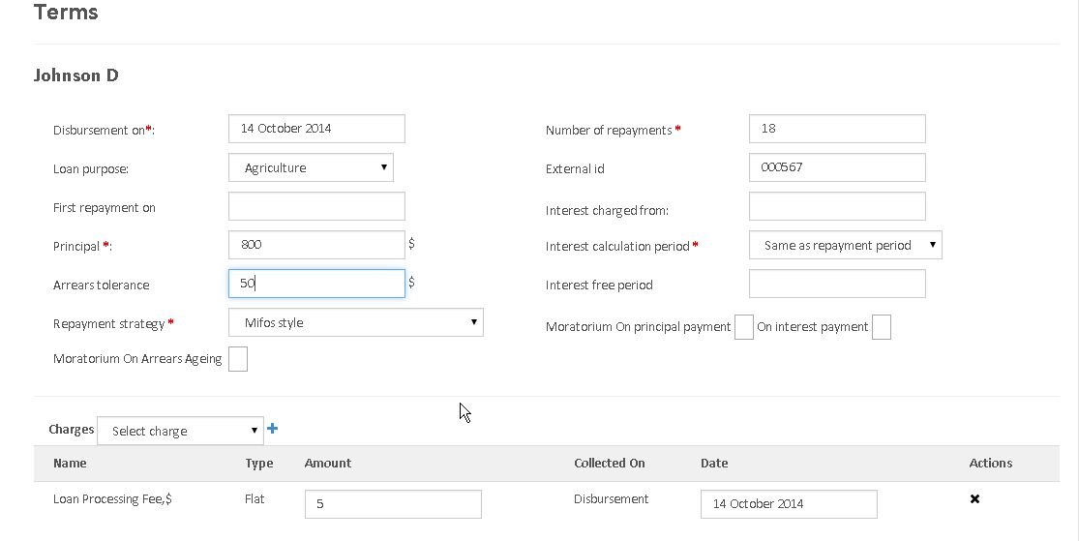
4. After this, on the same Loan Application, you can see the each Client's loan details.

Slide 6
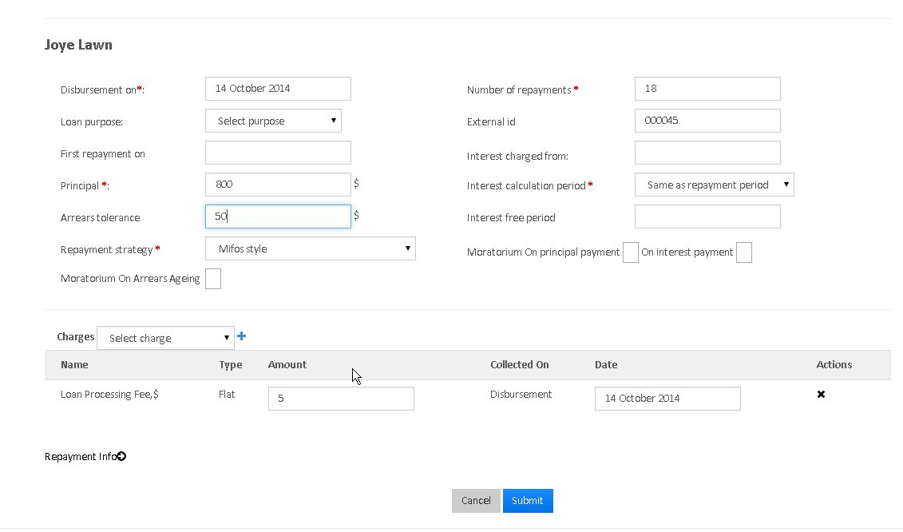
5. Finally, Click on 'Submit' button to create the JLG Loan Application.
6. The Application needs to Approved and activated with Specified date.

Slide 7
LOAN PRODUCT FIELDS
FIELD NAME | DESCRIPTION | EXAMPLE | VALIDATIONS
Details Section
Product name | The product name is a unique identifier for the lending product. The product name is used: In Product lists (depending on where the product list appears, it may contain a list of all loan products or a list of active loan products) As the Loan Account identifier in the Loan Account Overview section on the client General tab In the Name column in the list of loan products displayed when Loan Products is clicked on the Products page | Home Building Loan A | Required field Alphanumeric
Short name | The short name is a unique identifier for the lending product. The short name is used: In the Short name column in the list of loan products displayed when Loan Products is clicked on the Products page On the Collection Sheet, to identify the loan product a loan account is based on | BldA | Required field Alphanumeric

Slide 8
FIELD NAME | DESCRIPTION | EXAMPLE | VALIDATIONS
Description | The description is used to provide additional information regarding the purpose and characteristics of the loan product. | Home Building Loan A is available for new construction only | Alphanumeric
Fund | Loan products may be assigned to a fund set up by your financial institution. If available, the fund field can be used for tracking and reporting on groups of loans. If your financial institution has set up funds, the Fund list will be populated and you will be able to select a fund. |  | May be left blank or select from list.

Slide 9
FIELD NAME | DESCRIPTION | EXAMPLE | VALIDATIONS (IF APPLICABLE)
Start date | The date that the loan product will be active and available to clients. If blank, the loan product will be active as soon as it is created. Select the date from the calendar popup. | 01 Jan 2013 | Date dd /mm/ yyyy
Close date | The date that the loan product will become inactive and unavailable to clients. If blank, the load product will never become inactive. Select the date from the calendar popup. | 31 Dec 2020 | Date dd /mm/ yyyy

Slide 10
FIELD NAME | DESCRIPTION | EXAMPLE | VALIDATIONS (IF APPLICABLE)
Include borrower loan counter | Check this checkbox to include a loan counter for a borrower Uncheck this checkbox to not include a loan counter for a borrower .
Currency Section
Currency | The currency in which the loan will be disbursed. Currencies are set up by your financial institution. Select the loan product's currency from the Currency list. |  | Required field

Slide 11
FIELD NAME | DESCRIPTION | EXAMPLE | VALIDATIONS
Decimal places | The number of decimal places to be used to track and report on loans. | 2 | Required field Numeric
Currency in multiples of |  | 0 | Required field Numeric
Terms Section
Terms vary based on Loan Cycle | Leave this checkbox unchecked if the terms do not vary based on the Loan Cycle . Check this checkbox if terms vary based on the Loan Cycle. See additional fields for additional information required for this type of loan product.

Slide 12
FIELD NAME | DESCRIPTION | EXAMPLE | VALIDATIONS
Principal: Minimum Default Maximum | These fields are used to define the minimum, default, and maximum principal allowed for the loan product. When a client applies for a loan account, the loan account application will be populated with the default principal amount. The lending officer may modify the default within the minimum to maximum range. Using the example values (see column to the right), a new loan account application for this loan product would default to a principal amount of 100 (in the selected currency). The lending officer may modify the principal as low as 25 and as high as 250. | Minimum: 25 Default: 100 Maximum: 250 | Required fields Numeric whole numbers
Number of repayments: Minimum Default Maximum | These fields are used to define the minimum, default, and maximum number of repayments allowed for the loan product. When a client applies for a loan account, the loan account application will be populated with the default number of repayments. The lending officer may modify the default within the minimum to maximum range. Using the example values (see column to the right), a new loan account application for this loan product would default to 12 repayments. The lending officer may modify the number of repayments as low as 6 and as high as 60. | Minimum: 6 Default: 12 Maximum: 60 | Required fields Numeric whole numbers

Slide 13
FIELD NAME | DESCRIPTION | EXAMPLE | VALIDATIONS
Nominal interest rate: Minimum Default Maximum Period | These fields are used to define the minimum, default, maximum, and period for the nominal interest rate allowed for the loan product. The minimum, default, and maximum nominal interest rates are expressed as percentages. The period value is selected from the choices in the list (Per Month, Per Year). The period value is not modifiable on individual loan accounts. When a client applies for a loan account, the loan account application will be populated with the nominal interest rate. The lending officer may modify the default within the minimum to maximum range. Using the example values (see column to the right), a new loan account application for this loan product would default to a nominal interest rate of 1.5. The lending officer may modify the nominal interest rate as low as 1.25 and as high as 2.0. In this example, the nominal interest rate will be applied monthly. | Minimum: 1.25 Default: 1.5 Maximum: 2.0 Period: Per Month | Required fields Numeric with decimals

Slide 14
FIELD NAME | DESCRIPTION | EXAMPLE | VALIDATIONS
Repaid every | These fields are input to calculating the repayment schedule for a loan account and are used to determine when payments are due. Enter a number into the first field and then select the frequency from the list (Days, Weeks, Months). Using the example values (see column to the right), a new loan account application for this product would be initially set for repayments every 2 weeks. The lending officer may change the payment timing during the loan application process. | 2 Weeks | Required fields Numeric and select from list
Setting Section
Amortization | The Amortization value is input to calculating the repayment amounts for repayment of the loan. Select Equal installments or Equal principal payments from theAmortization list. If Equal installments is selected all repayment amounts will be equal but the interest, fees, penalties, and principal amounts will vary with each repayment. If Equal principal payments is selected, the repayments amounts will vary depending upon the interest, fees, and penalty amounts in the repayment and the principal amount will be the same for all repayments. |  | Required field

Slide 15
FIELD NAME | DESCRIPTION | EXAMPLE | VALIDATIONS
Interest method | The Interest method value is input to calculating the payments amount for repayment of the loan. Select Flat or Declining balance. |  | Required field
Interest calculation period | Daily - Will Calculate the interest on DAILY basis ex: Month of February has 28days and it will calculate interest for 28days, SAME AS REPAYMENT PERIOD- it calculates for the month,that is, 30days.
Arrears tolerance | With 'Arrears tolerance' you can specify a tolerance range and if the loan is behind (in arrears) but within the tolerance range it won't be classified as 'in arrears' and part of the portfolio at risk. | If 'Arrears Tolerance is $ 100 then upto that amount is not considered as arrears.

Slide 16
FIELD NAME | DESCRIPTION | EXAMPLE | VALIDATIONS
Repayment strategy | Repayments have up to four components: Principal Interest Fees Penalties The repayment strategy determines the sequence in which each of the components is paid. Mifos Style Replicates the same payment order of our previous legacy mifos software. Payment order: Overdue and due penalties Overdue and due fees Overdue and due interest Overdue and due principal Early payment: Any payment that pays off an installment that occurs before the due date of the installment. There is no incentive/advantage to making an early payment as theres no decrease in cost of the loan. On time payment: Any payment that pays off an installment that occurs exactly on the due date of the installment.

Slide 17
FIELD NAME | DESCRIPTION | EXAMPLE | VALIDATIONS
 | Late payment: Any payment that pays off an installment that occurs after the due date of the installment. There is no penalization for late payment. The total cost of the loan does not automatically increase, no penalties are automatically applied to the loan. Interest Principal Penalties Fees Order The key aspect of this strategy is the payment order. Payment order: Overdue and due interest Overdue and due principal Overdue and due penalties Overdue and due fees Early payment: Any payment that pays off an installment that occurs before the due date of the installment. There is no incentive/advantage to making an early payment as theres no decrease in cost of the loan. On time payment: Any payment that pays off an installment that occurs exactly on the due date of the installment. Late payment: Any payment that pays off an installment that occurs after the due date of the installment. There is no penalization for late payment. The total cost of the loan does not automatically increase, no penalties are automatically applied to the loan.

Slide 18
FIELD NAME | DESCRIPTION | EXAMPLE | VALIDATIONS
 | RBI (India) Per RBI regulations, all interest must be paid (both current and overdue) before principal is paid. For example taking a loan with two installments due (one current and one overdue) of 220 each (200 principal + 20 interest) - A partial payment of 40 results in payment been broken up as 20 interest on installment #1 (200 principal remaining) and 20 payment to interest on installment #2 (200 principal remaining) Payment order: Overdue and due interest Overdue and due principal Overdue and due penalties Overdue and due fees Early payment: Any payment that pays off an installment that occurs before the due date of the installment. There is no incentive/advantage to making an early payment as theres no decrease in cost of the loan. On time payment: Any payment that pays off an installment that occurs exactly on the due date of the installment. Late payment: Any payment that pays off an installment that occurs after the due date of the installment. There is no penalization for late payment. The total cost of the loan does not automatically increase, no penalties are automatically applied to the loan.

Slide 19
FIELD NAME | DESCRIPTION | EXAMPLE | VALIDATIONS
 | Early Payment Strategy This strategy works similar to the Interest Principal Penalties Fees Order for on-time and late payments, i.e Payment order: Overdue and due interest Overdue and due principal Overdue and due penalties Overdue and due fees Early payment: Any payment that pays off an installment that occurs before the due date of the installment. There is no incentive/advantage to making an early payment as theres no decrease in cost of the loan. However, early payments are allocated only towards principal payments of future installments. Interest and fees/penalties of future installments are not paid and may be waived manually if required On time payment: Any payment that pays off an installment that occurs exactly on the due date of the installment. Late payment: Any payment that pays off an installment that occurs after the due date of the installment. There is no penalization for late payment. The total cost of the loan does not automatically increase, no penalties are automatically applied to the loan.

Slide 20
FIELD NAME | DESCRIPTION | EXAMPLE | VALIDATIONS
Interest free period | If the Interest Free Period is '4' and the client's Repayment Frequency is every week, then for the first four weeks the client need not to pay interest, he has to pay principle due for that week only.
Moratorium On principal payment On interest payment | Suppose, If Morotorium On Principle Payment is '6' and the client's Repayment Frequency is every month, then for the first six months, the client has to pay Interest only and after six months the client starts paying principle amount too. On Interest Payment is '6' and the client's Repayment Frequency is every month, then for the first six months, the client has to pay Principle only and after six months the client starts paying Interest amount too.

Slide 21
FIELD NAME | DESCRIPTION | EXAMPLE | VALIDATIONS
Number of days a loan may be overdue before moving into arrears | A loan is in arrears once the number of days entered into this field is exceeded. If this field is blank, the loan will be in arrears the day after a scheduled payment is missed. If 5 is specified, as in the example value, the loan will be in arrears on the 5th (or 6th?) day after a scheduled payment is missed. | 5
Maximum number of days a loan may be overdue before becoming a NPA (non performing asset) | A loan is a NPA once the number of days entered into this field is exceeded. If this field is blank, the loan will be an NPA the after a scheduled payment is missed. If 35 is specified, as in the example value, the loan will be an NPA on the 35th (or 36th) day after a scheduled payment is missed. | 35

Slide 22
FIELD NAME | DESCRIPTION | EXAMPLE | VALIDATIONS
Recalculate Interest | Please check the box if you want to recalculate interest for each period based on outstanding for that month/week. Once you check it.
Tranche Details Section
Is Multi Disburse Loan | Leave this checkbox unchecked if the loan is a single disburse loan. Check this checkbox if the loan is a multi disburse loan. See additional fields for additional information required for this type of loan.

Slide 23
FIELD NAME | DESCRIPTION | EXAMPLE | VALIDATIONS
Charges Section
Charges | Select a charge from the Charges list and click Add. If more charges apply to the loan product, select additional charges and click Add for each.
Overdue Charges | Select an overdue charge from the Overdue Charges list and click Add. If more overdue charges apply to the loan product, select additional overdue charges and click Add for each.
Accounting Section
Accounting | Select one from: None Cash Accrual (periodic) Accrual (up front If Cash, Accrual (periodic), or Accrual (up front) is selected, see additional fields.

Slide 24
THANK YOU FOR ATTENTION

