Slide 1
TRACK LOAN PERFORMANCE

Slide 2
How to Track Loan Performance
This guide will show you how to track loan performance in the Mifos X client.

Slide 3
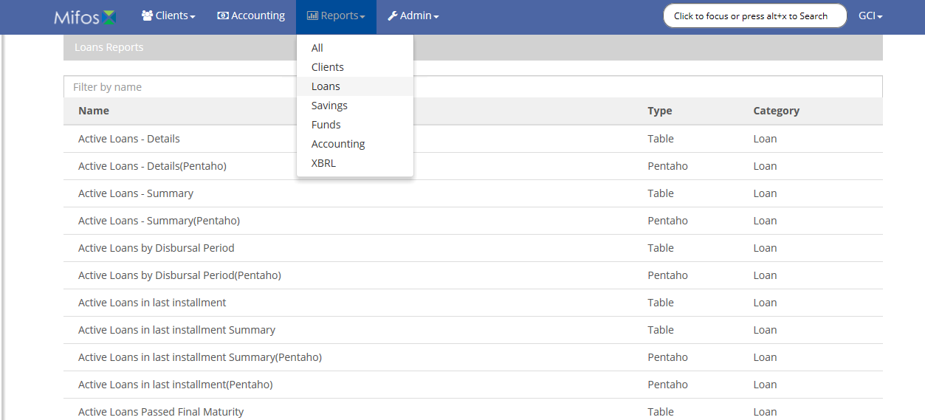
Step 1: Go to Loan Reports
Go to Loan Reports by clicking the “Reports” button and selecting “Loans” from the dropdown list.

Slide 4
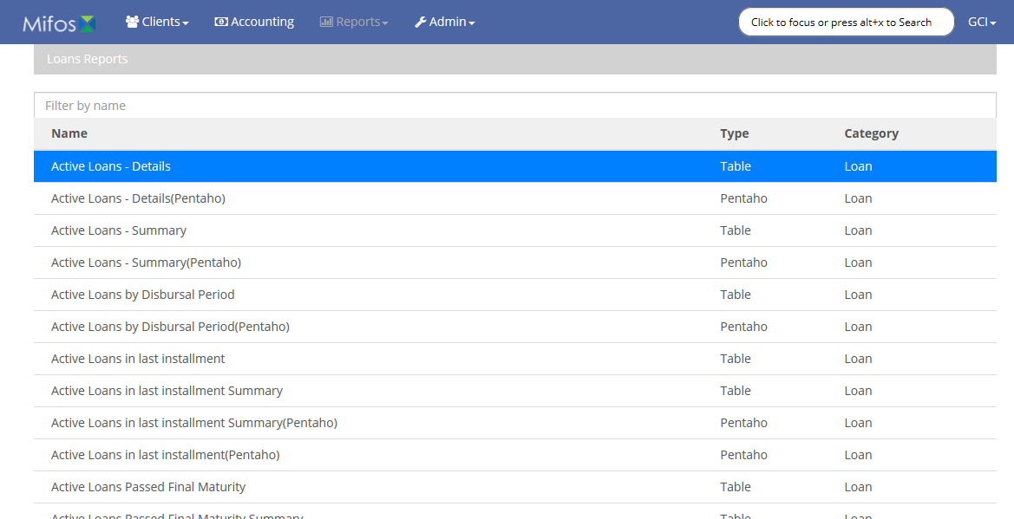
Step 2: Click Active Loans
On the loan reports page, click the row marked: “Active Loans - Details”

Slide 5
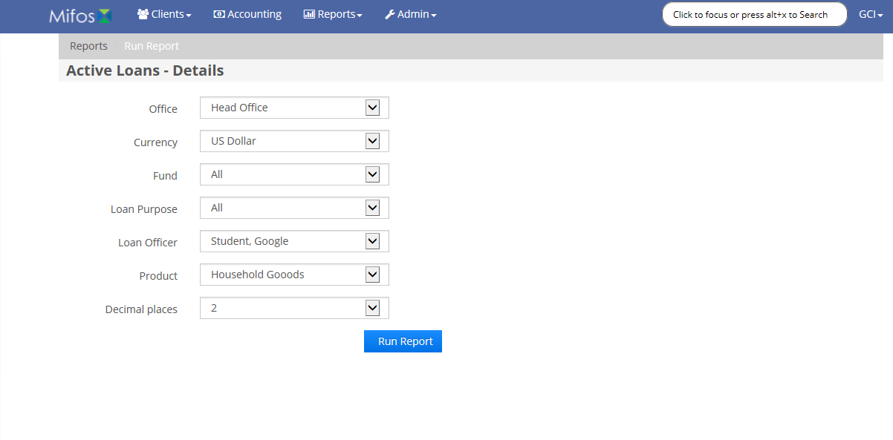
Step 3: Select Options
Select the office, currency, fund, purpose, officer, product, and desired number of decimal places to filter the loans you receive a report on. To get all loans, simply select: All
After selecting your desired options, click the “Run Report” button.

Slide 6
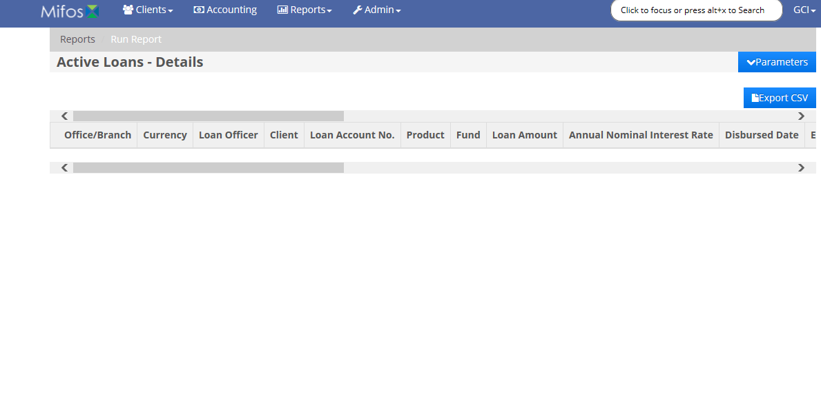
Step 4: Receive Report
A report will be presented to you with the details of all active loans.

Slide 7
Thank you for your attention
If you have any questions or concerns, please visit the Mifos documentation, located at tinyurl.com/MifosDocs

