Slide 1
Mifos X capabilities Overview
The One True Open Platform for Financial Inclusion

Slide 2
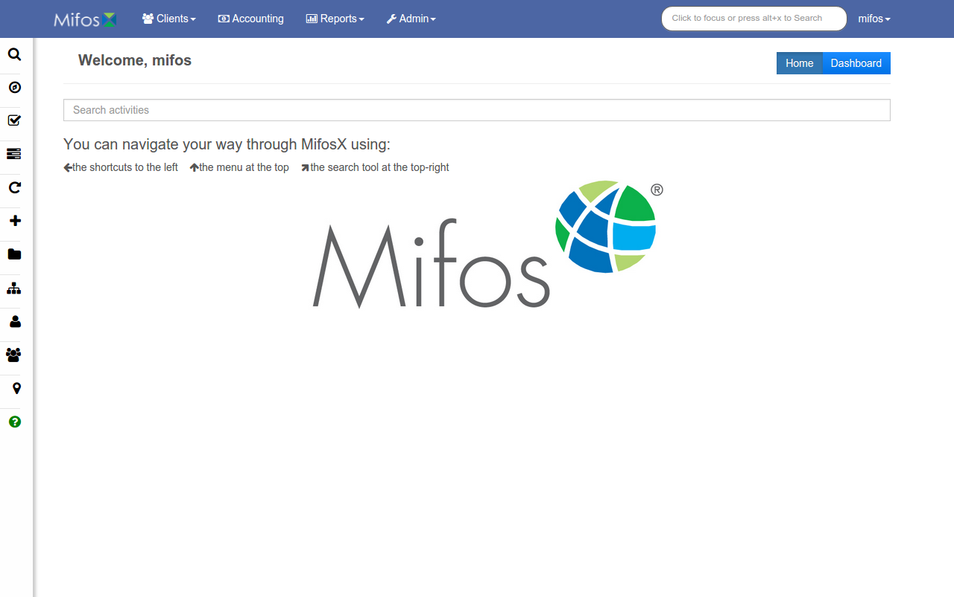
Welcome Screen
Menu
Shortcuts
Search

Slide 3
Client Management
Keep track of client/group/center activity, details, and loan performance.

Slide 4
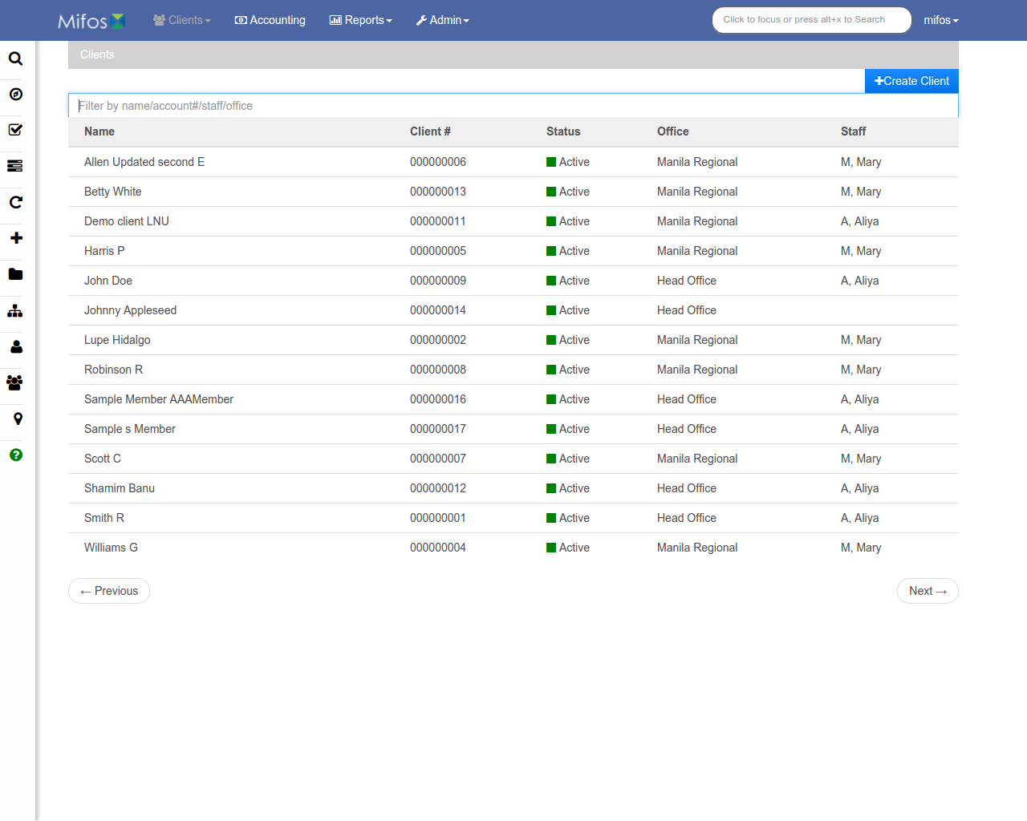
Client List
Filters
Create a new client
Client list

Slide 5
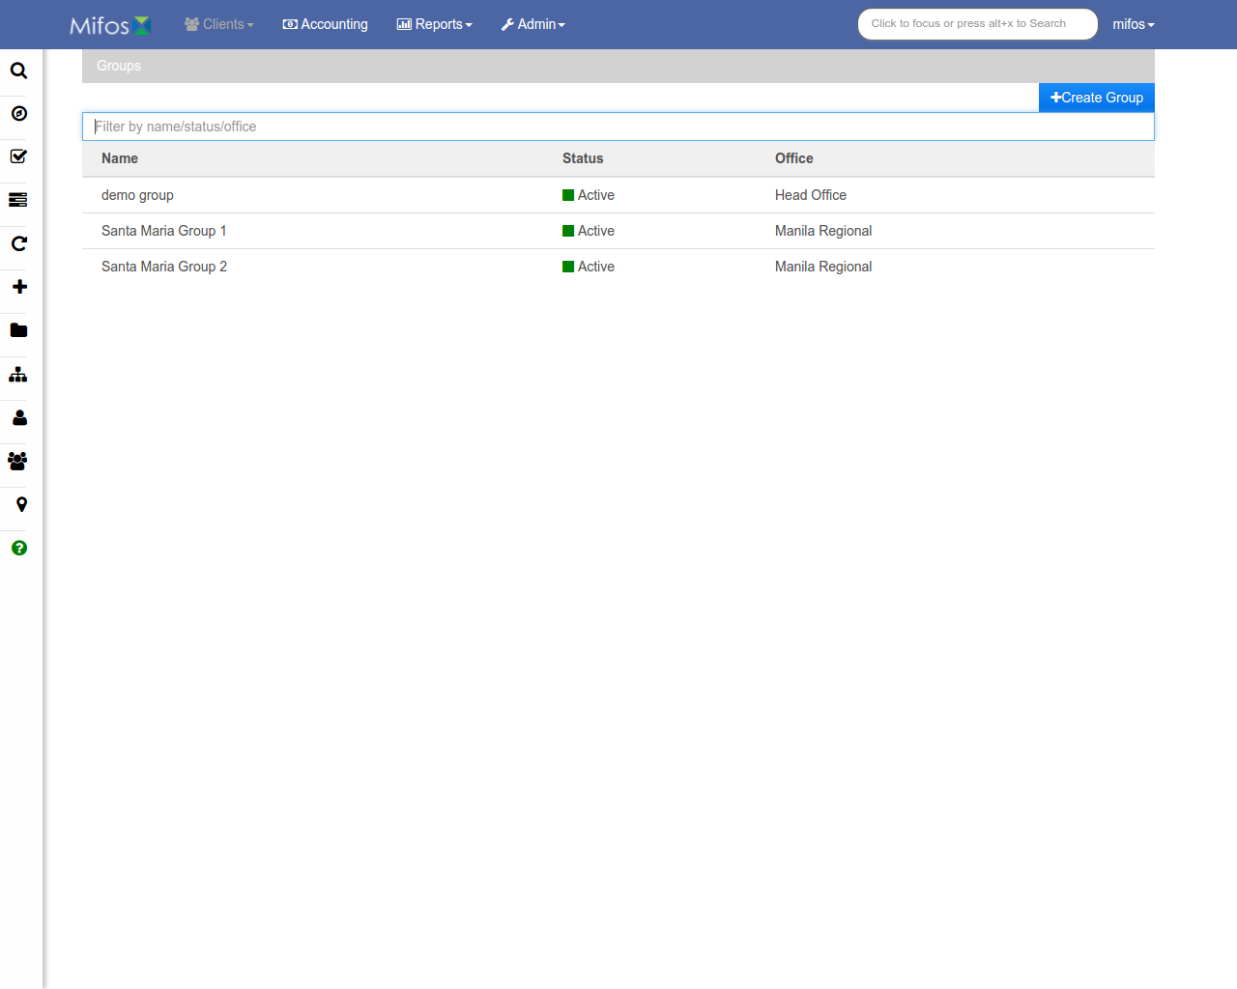
Group List
Filters
Create a new group
Group list

Slide 6
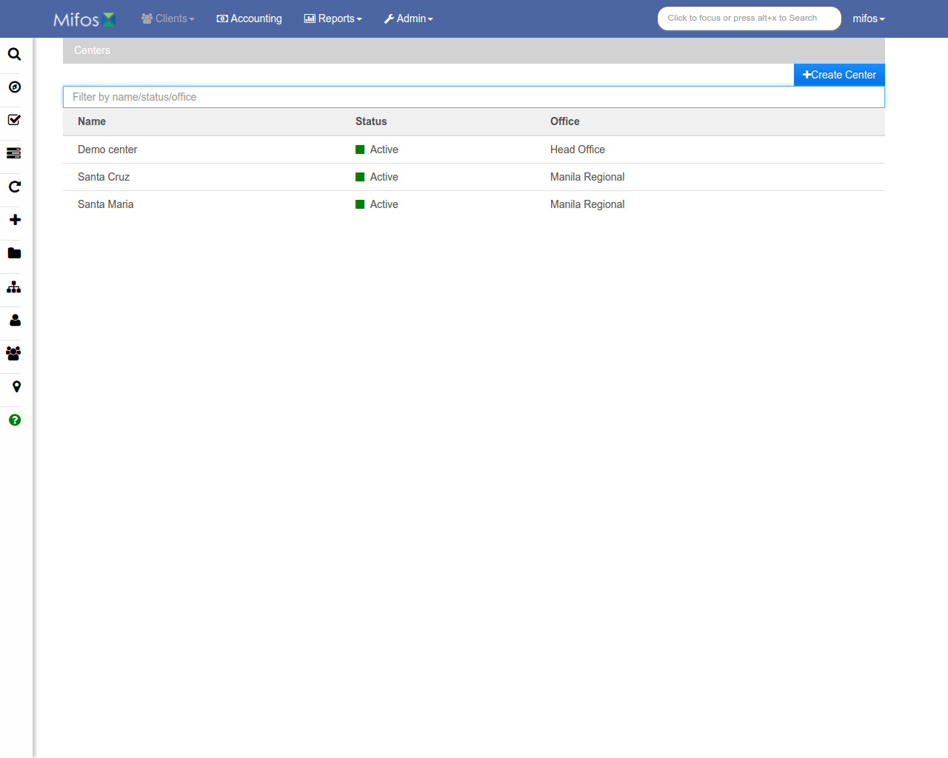
Center List
Filters
Create a new center
Center list

Slide 7
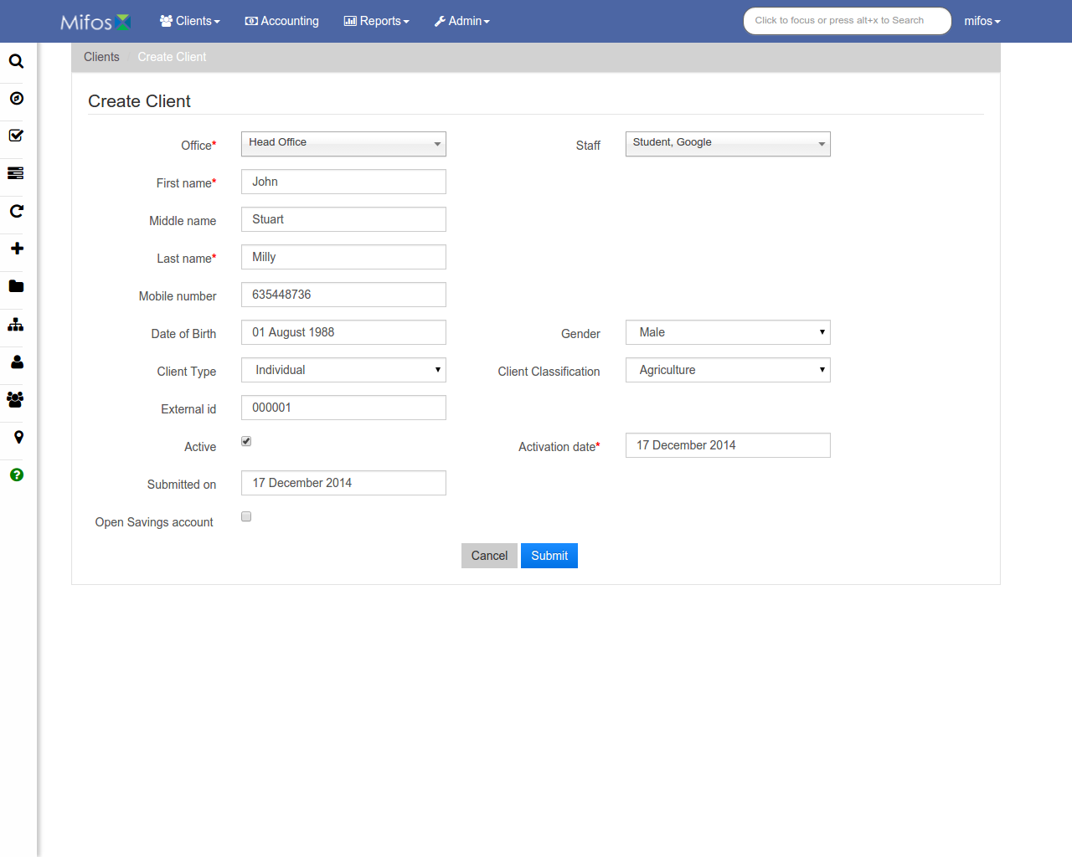
Create Client
Client information
Submit when done

Slide 8
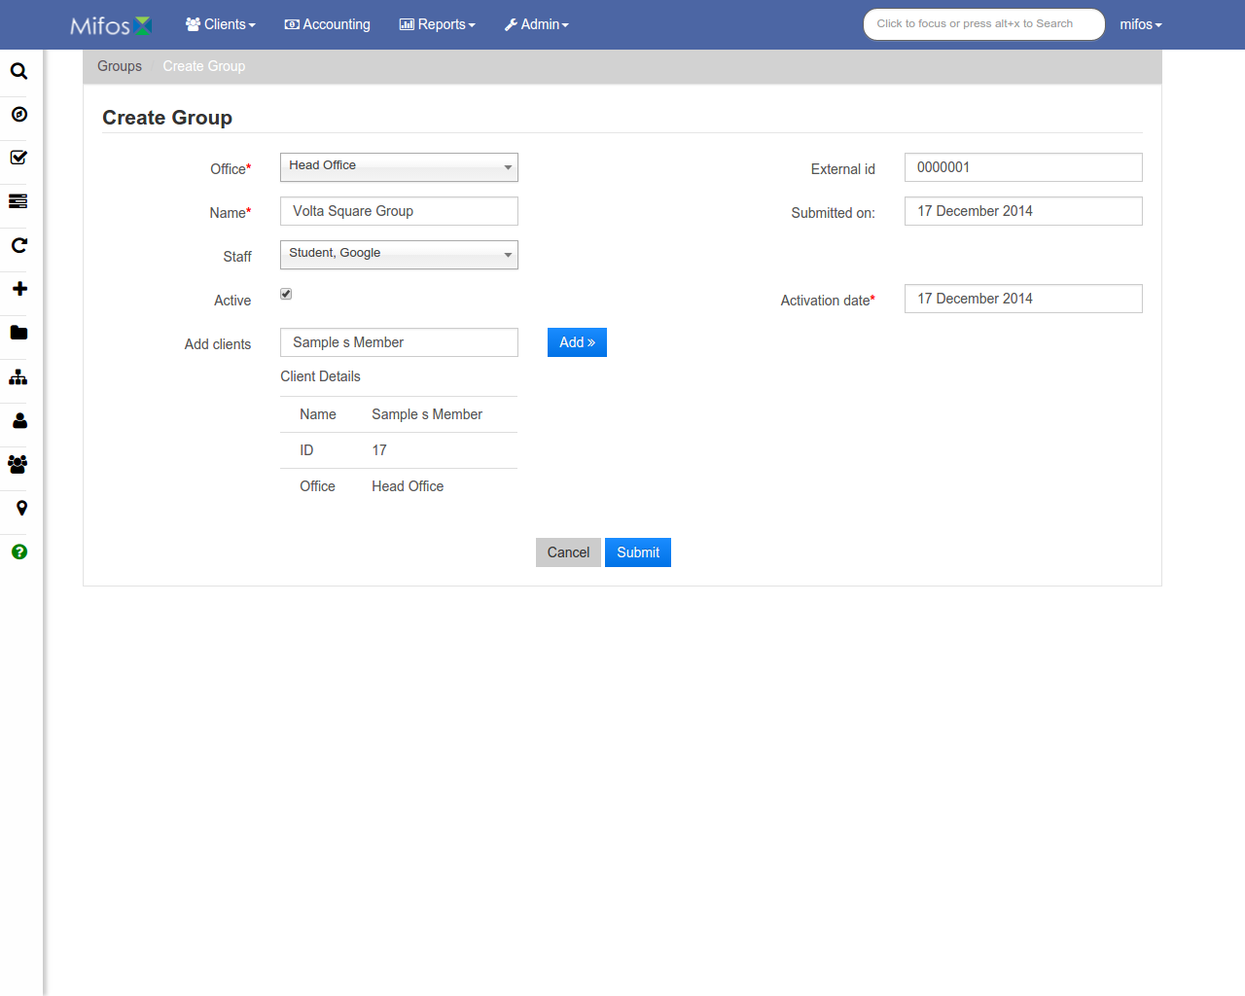
Create Group
Group information
Submit when done

Slide 9
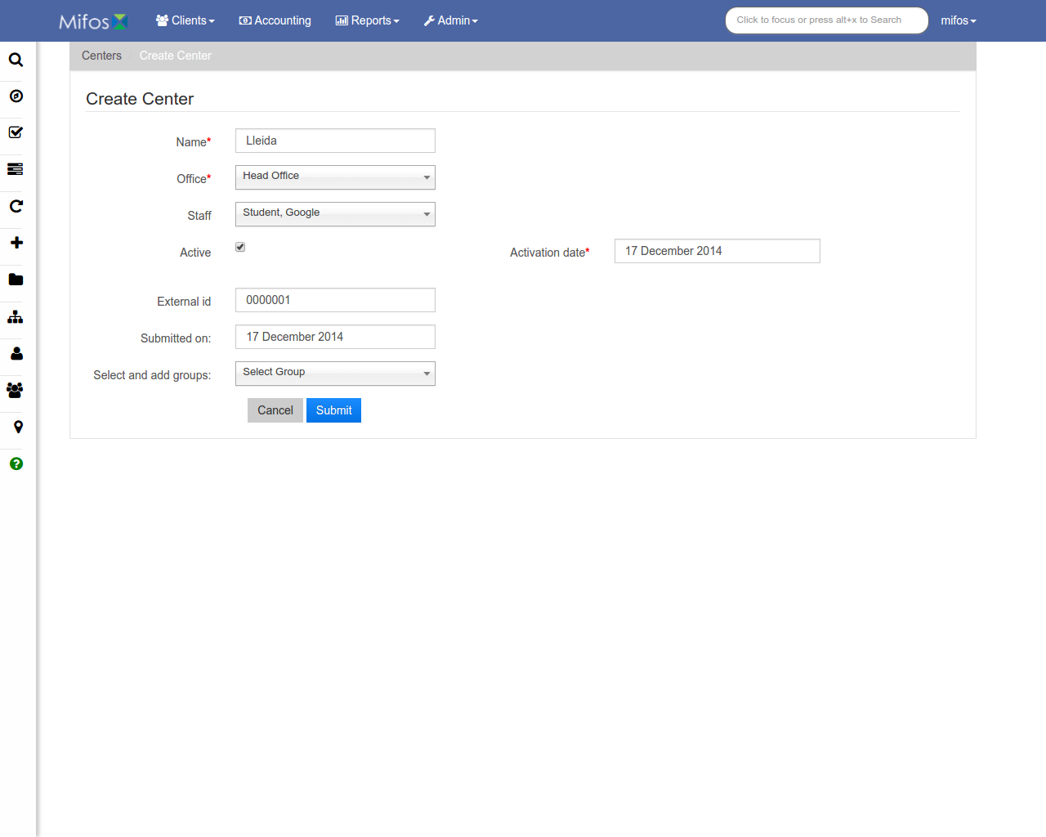
Create Center
Center information
Submit when done

Slide 10
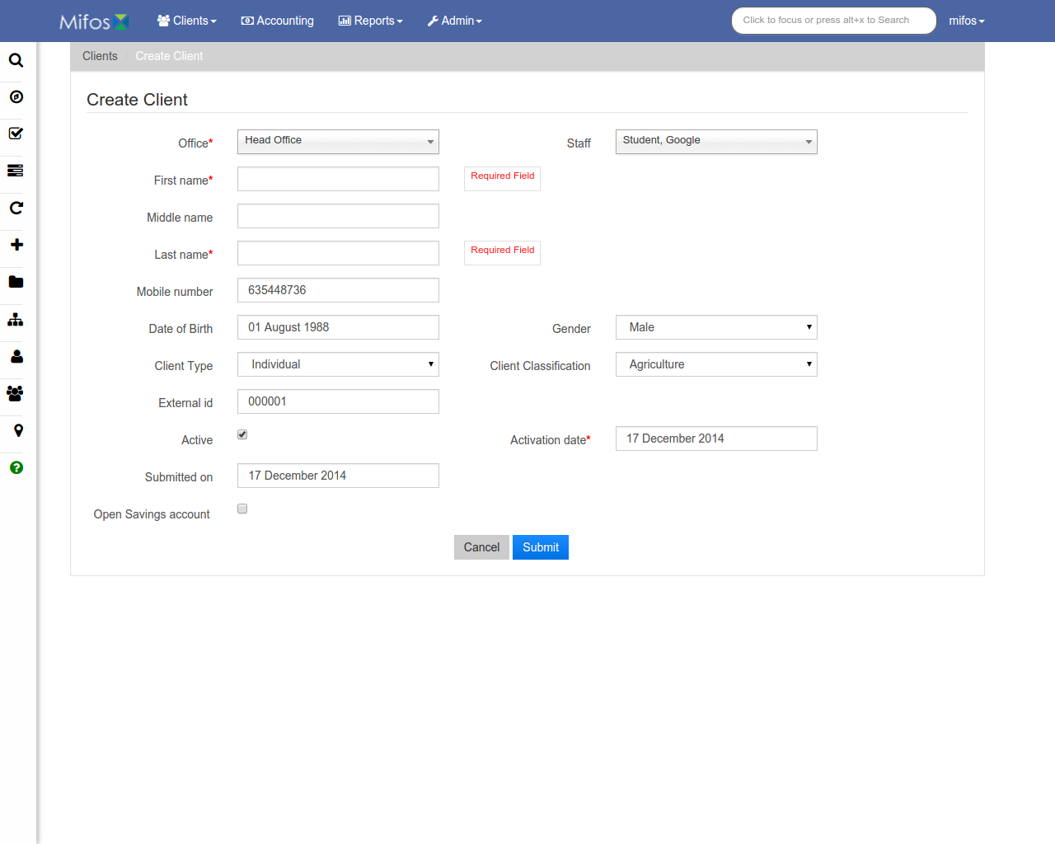
Error Messages
Error messages will show up in a red font
Center information

Slide 11
Accounting Functions
Manage frequent postings, journal entries, closing entries, accounting rules, and accruals, and view a list of accounts.

Slide 12
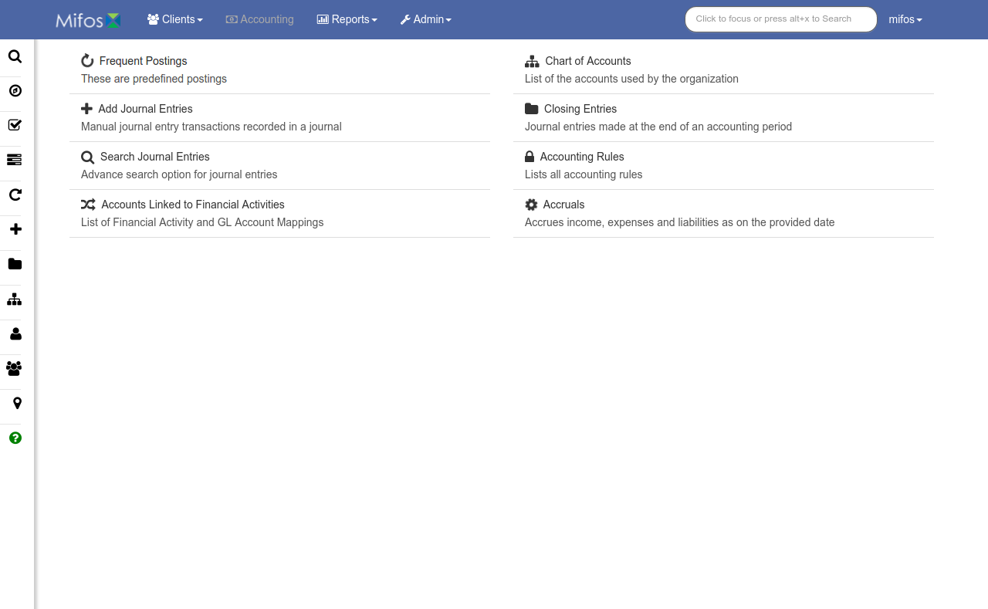
Accounting Main Page
Accounting functions

Slide 13
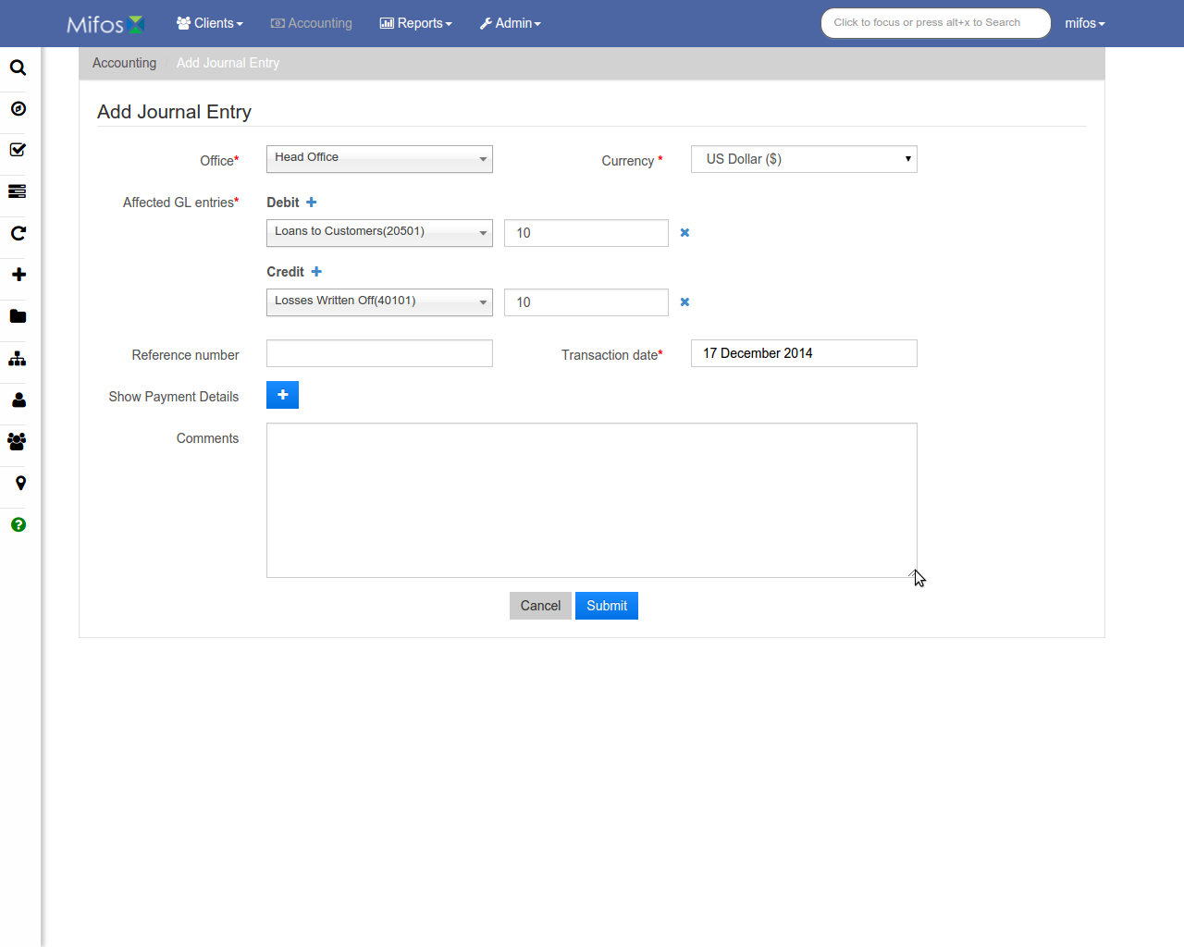
Add Journal Entry
Entry info
Submit when done

Slide 14
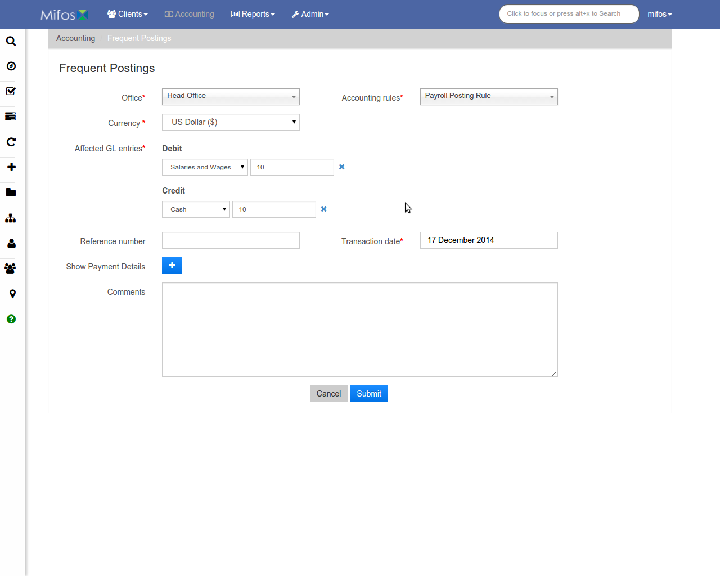
Frequent Postings
Posting info
Submit when done

Slide 15
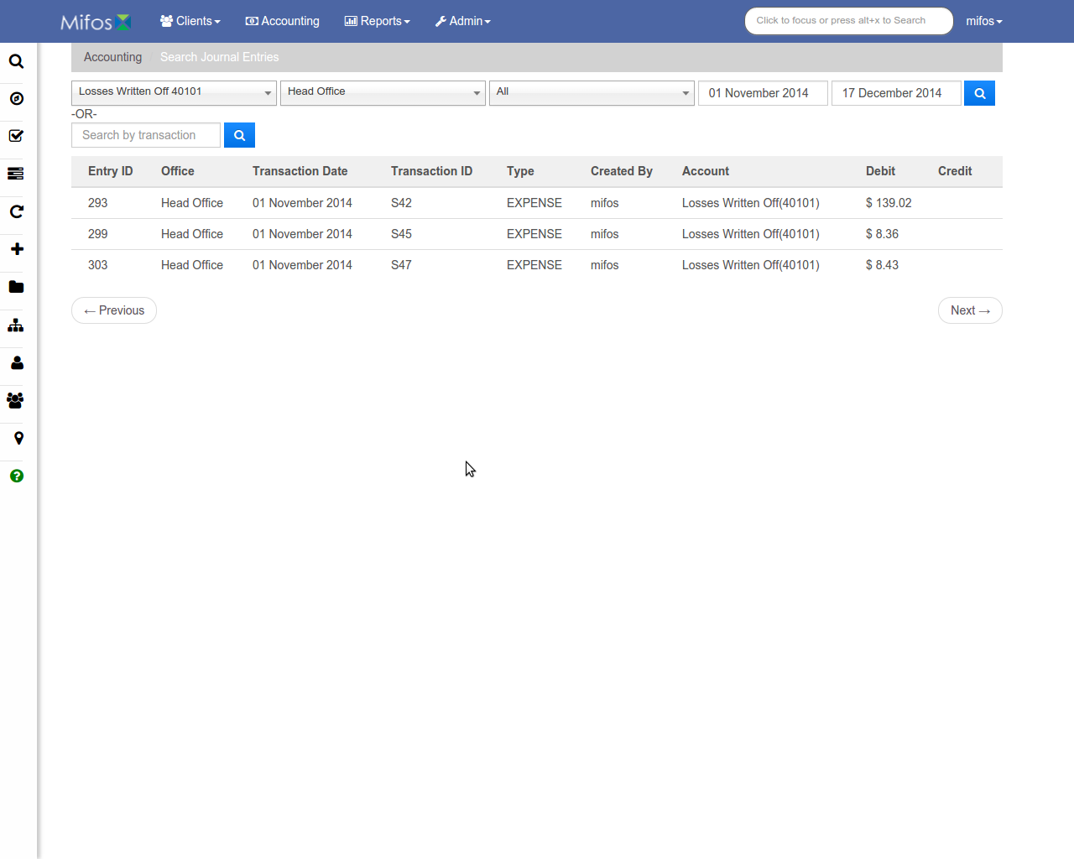
Search Journal Entries
Filters
Search by transaction
Journal entry list

Slide 16
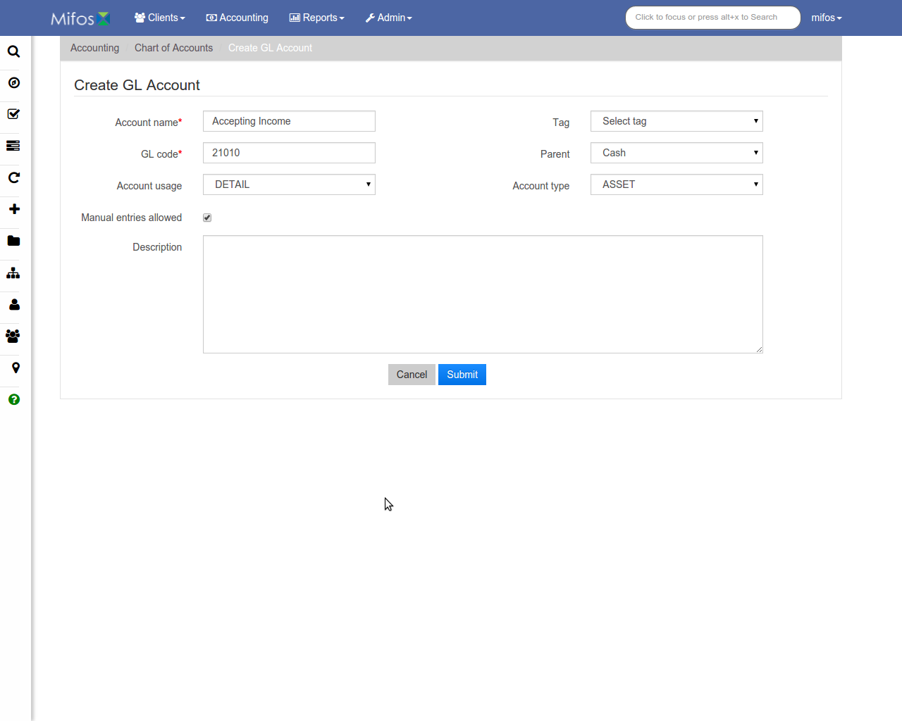
Create GL Account
GL Account Info
Submit when done

Slide 17
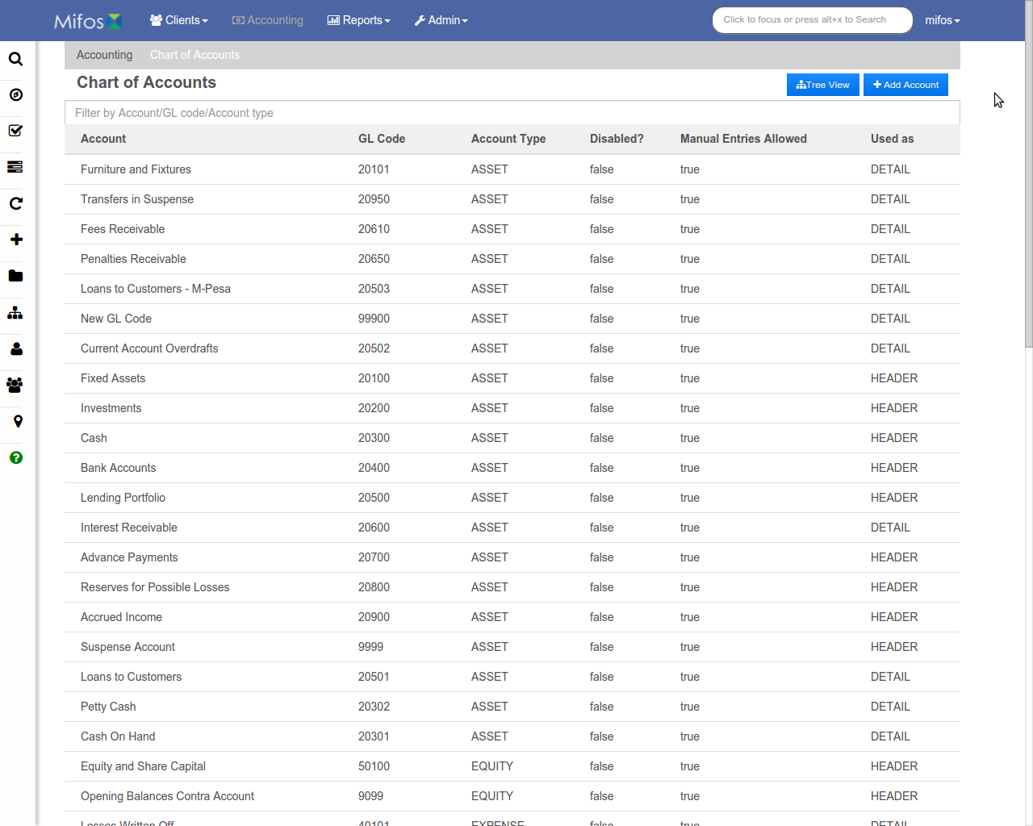
Chart of Accounts
Add an account
Switch to tree view
Filter results
Account info

Slide 18
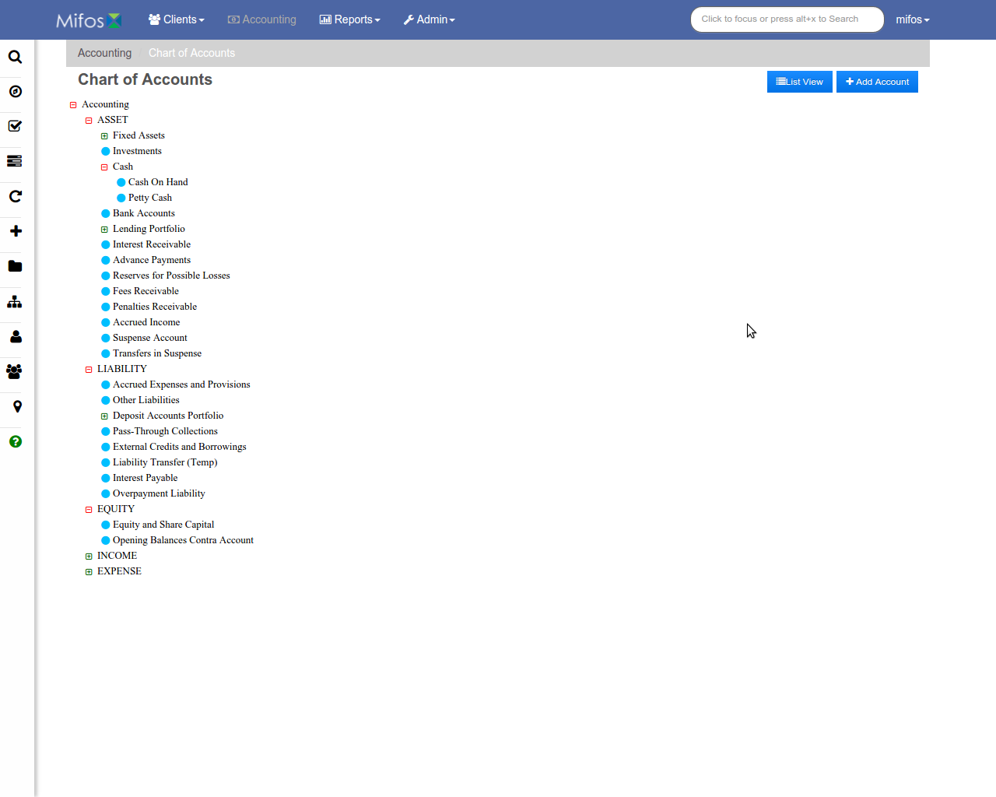
Chart of Accounts (Tree View)
Add an account
Switch to list view
Account tree

Slide 19
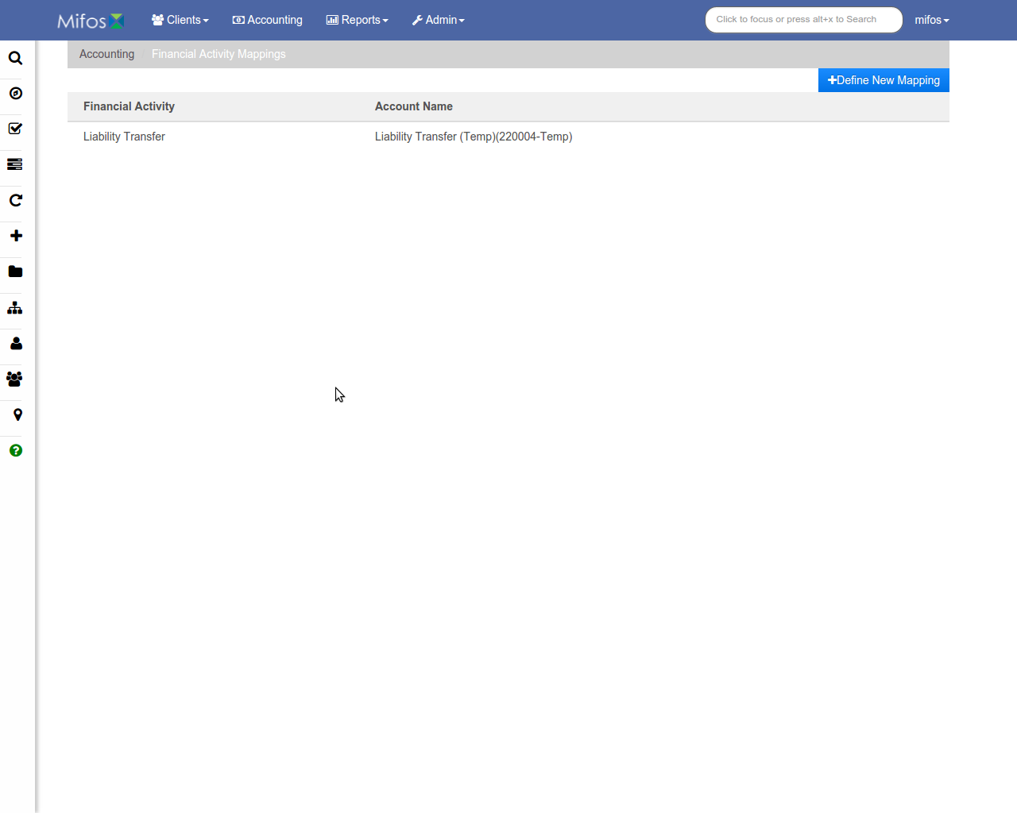
Financial Activity Mappings
New mapping
List of mappings

Slide 20
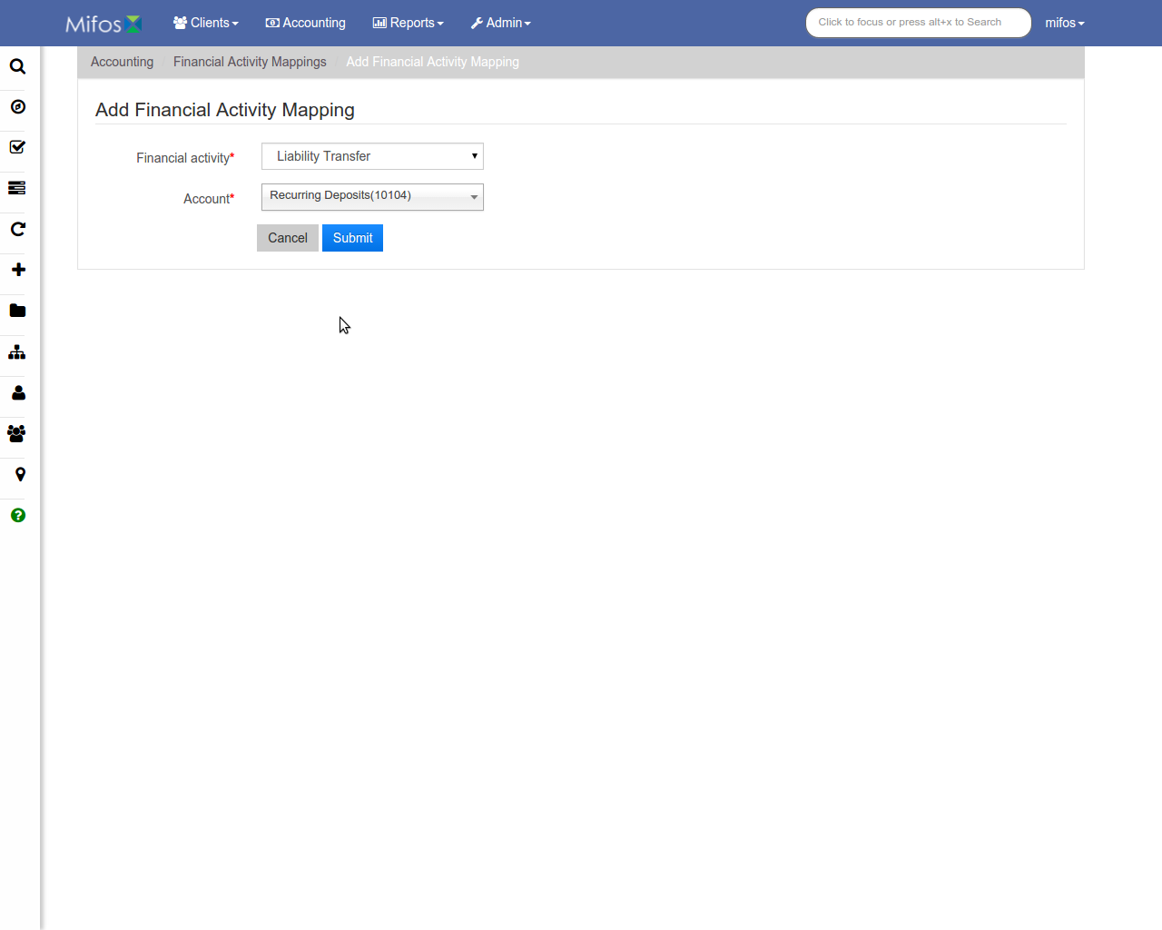
Add Financial Activity Mapping
Mapping info
Submit when done

Slide 21
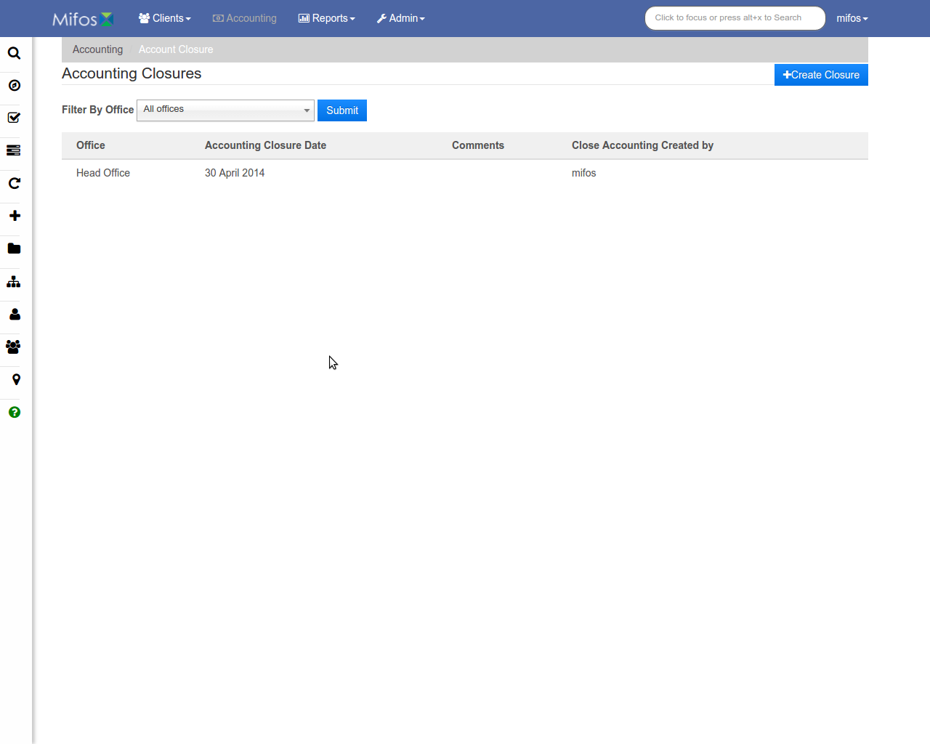
Accounting Closures
Create new closure
Filter results
List of closures

Slide 22
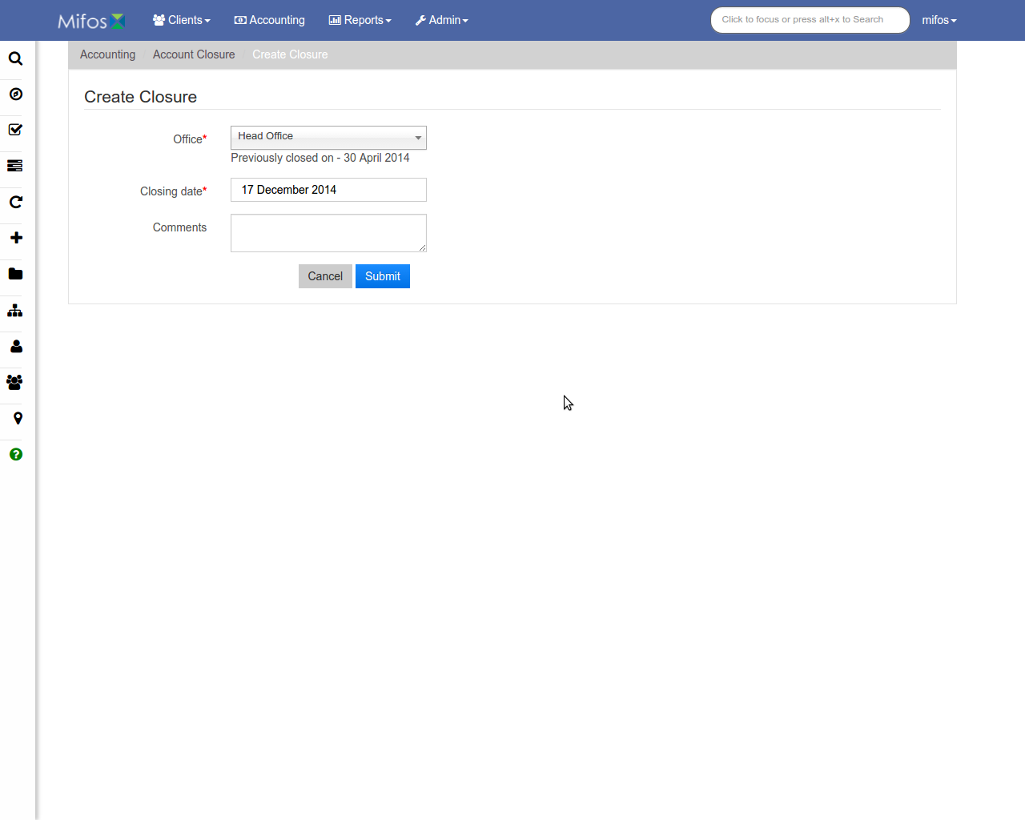
Create Closure
Closure info
Submit when done

Slide 23
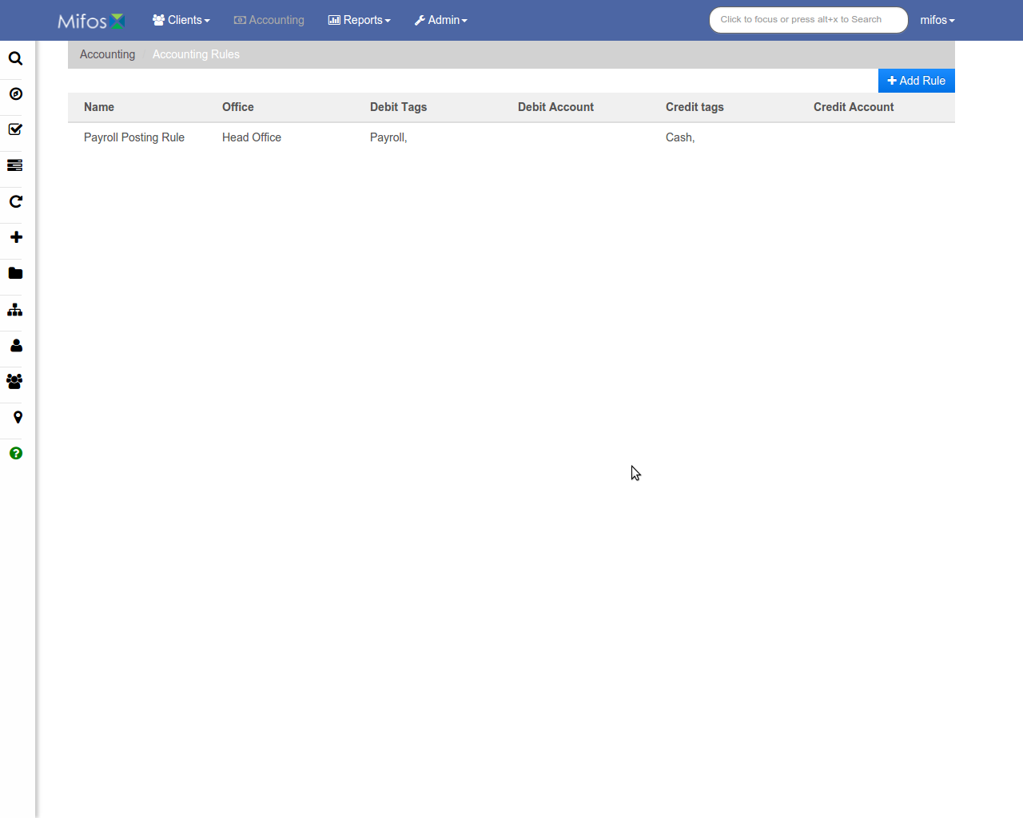
Accounting Rules
Add new rule
List of rules

Slide 24
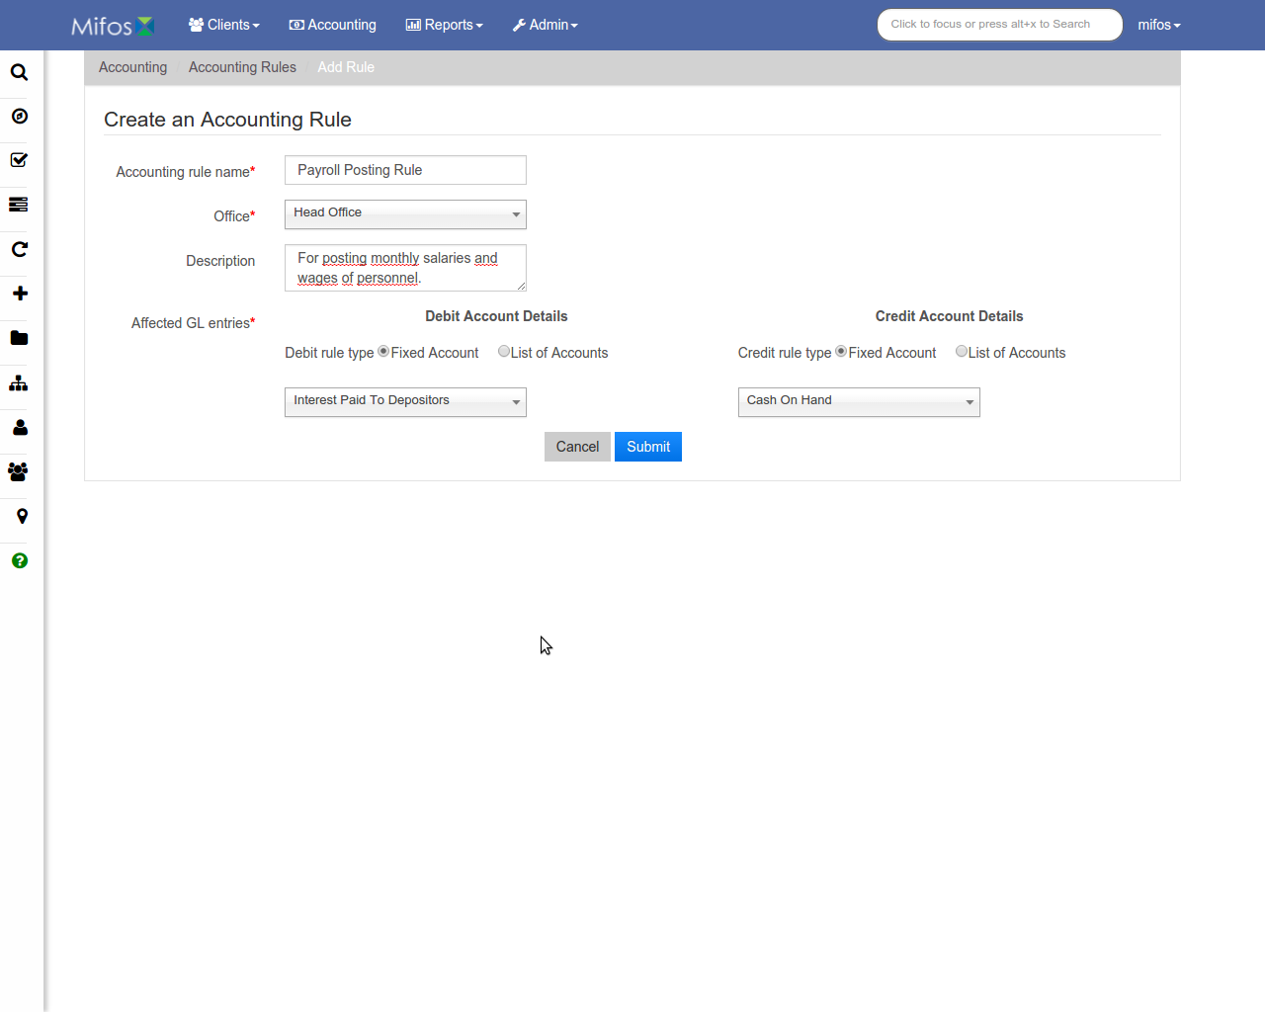
Create Accounting Rule
Rule info
Submit when done

Slide 25
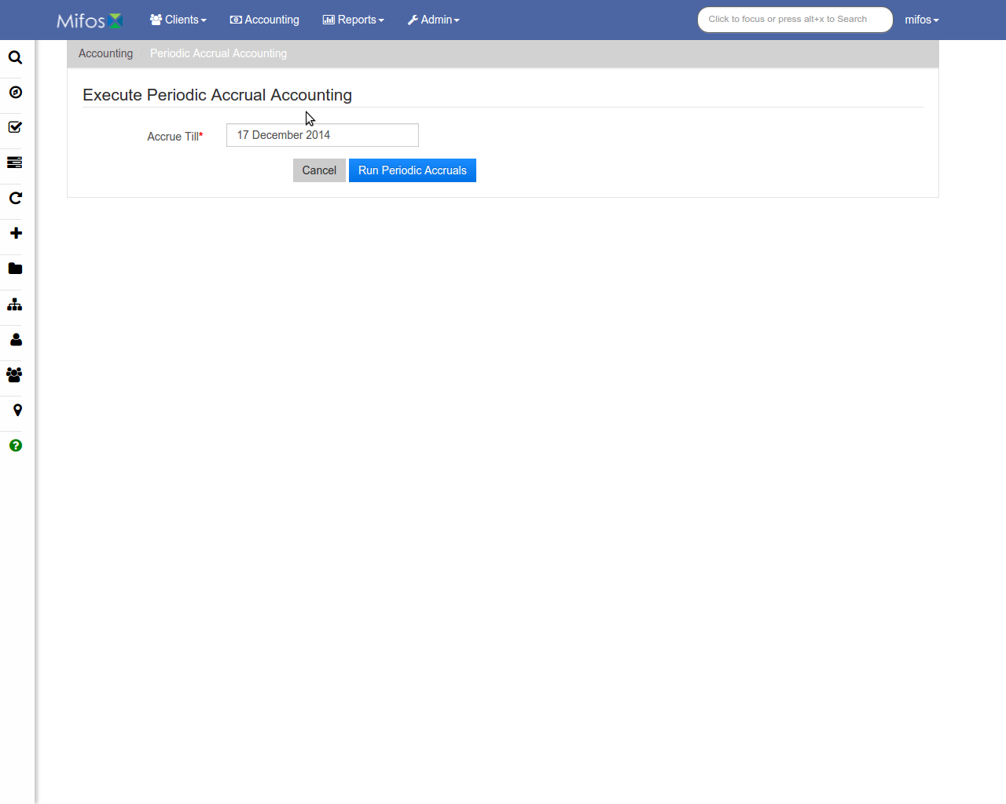
Execute Periodic Accrual Accounting
Enter accrual end date
Run accrual

Slide 26
Reports
Manage clients, funds, accounting, loans, savings, and XBRL reports.

Slide 27
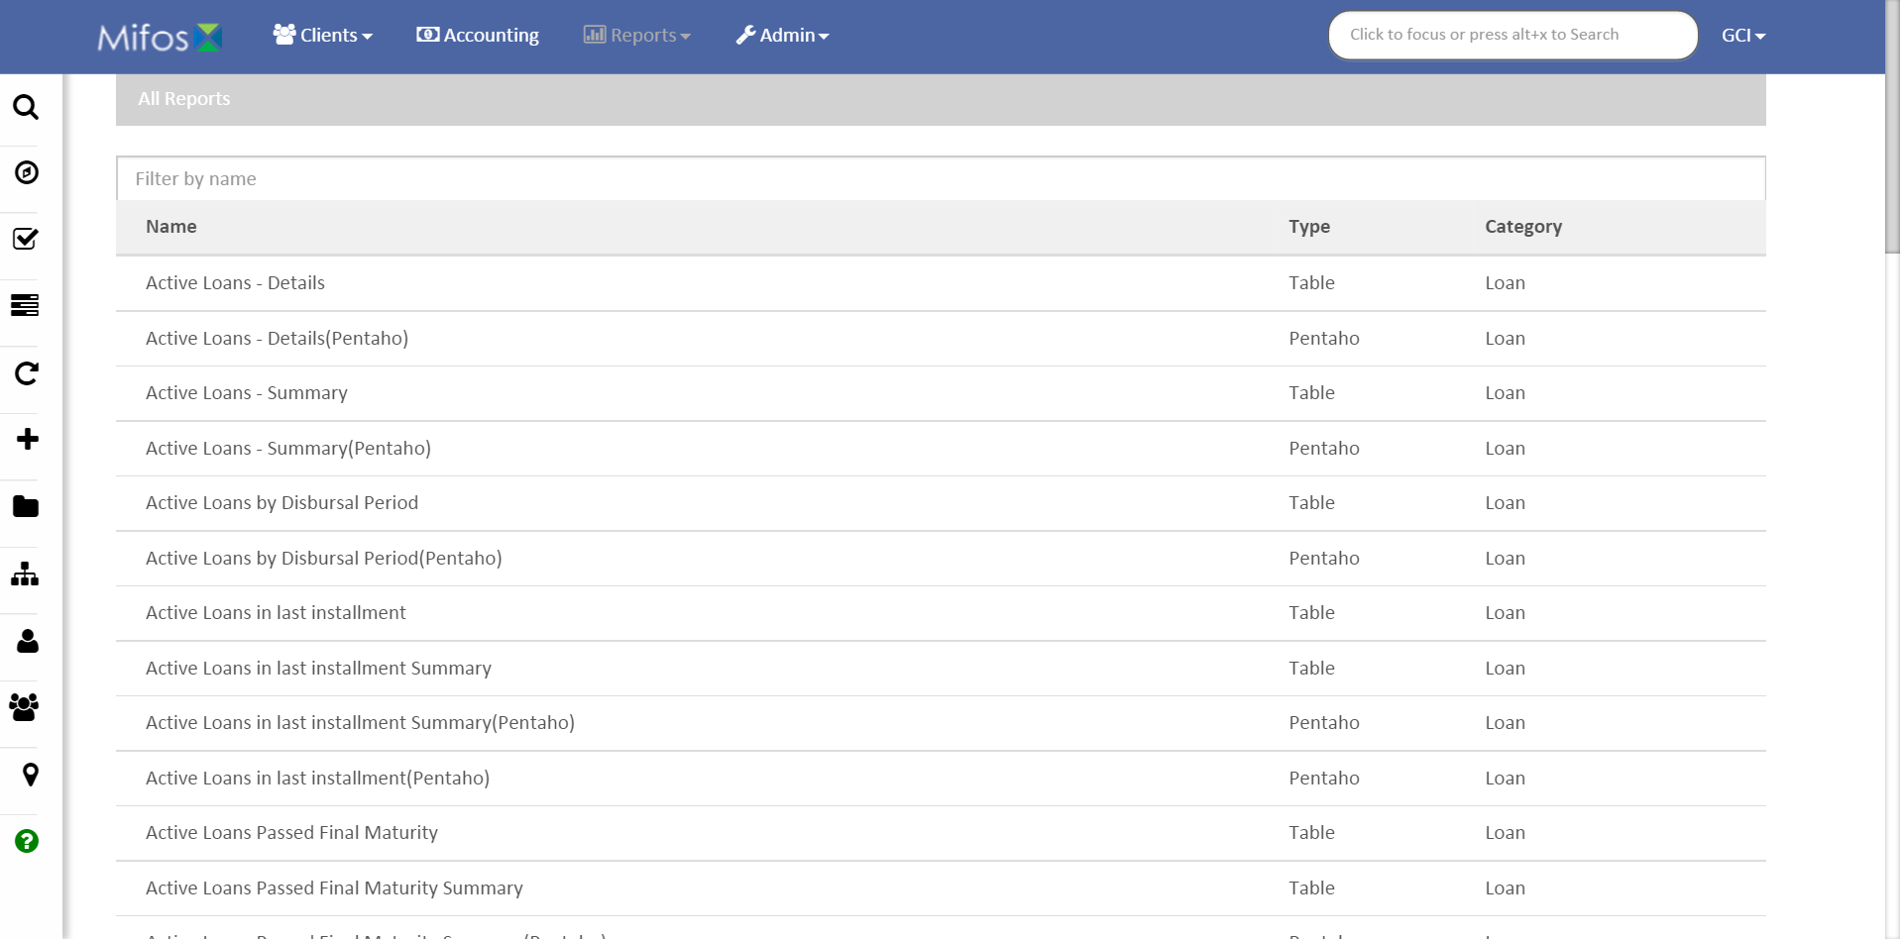
All Reports
Filter results
List of reports with type and category

Slide 28
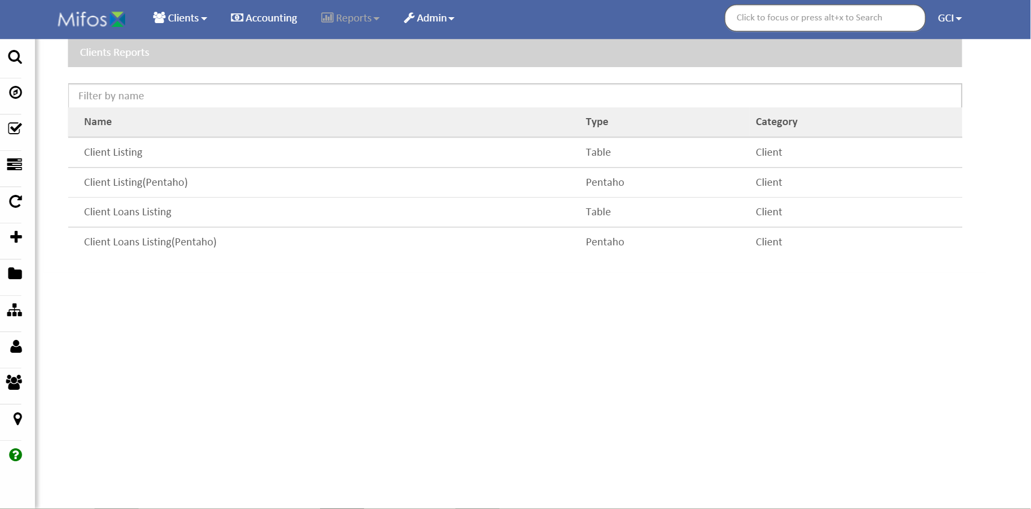
Clients Reports
Filter results
List of reports with type

Slide 29
Funds Reports
Filter results
List of reports with type

Slide 30
Accounting Reports
Filter results
List of reports with type

Slide 31
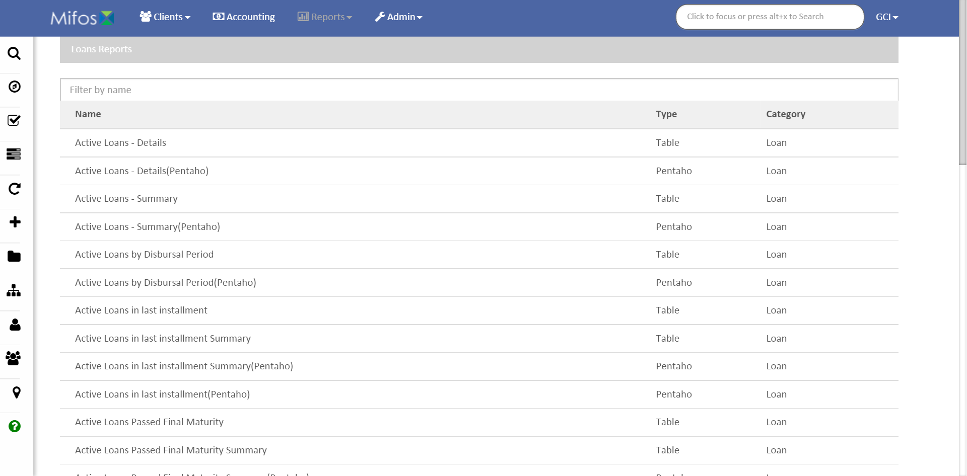
Loans Reports
Filter results
List of reports with type

Slide 32
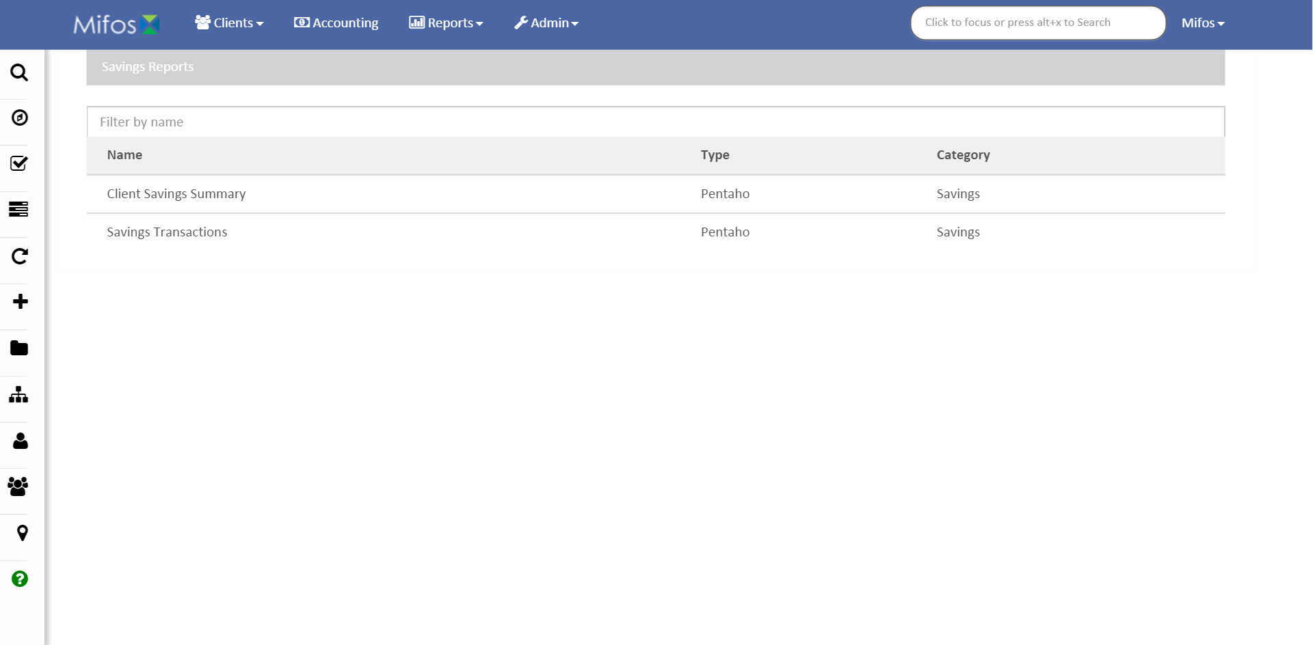
Savings Reports
Filter results
List of reports with type

Slide 33
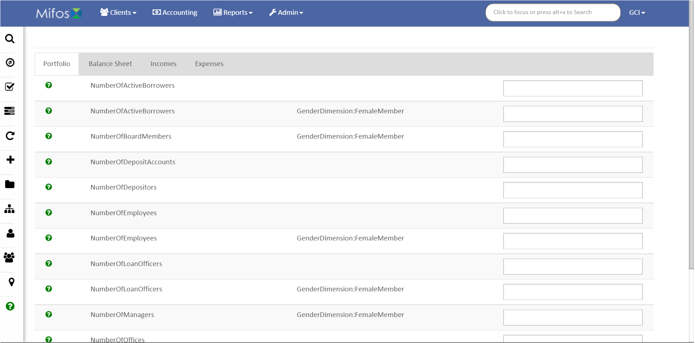
XBRL Reports
Report type
List of reports

Slide 34
Admin Functions
Manage users, organization, system, products, and templates.

Slide 35
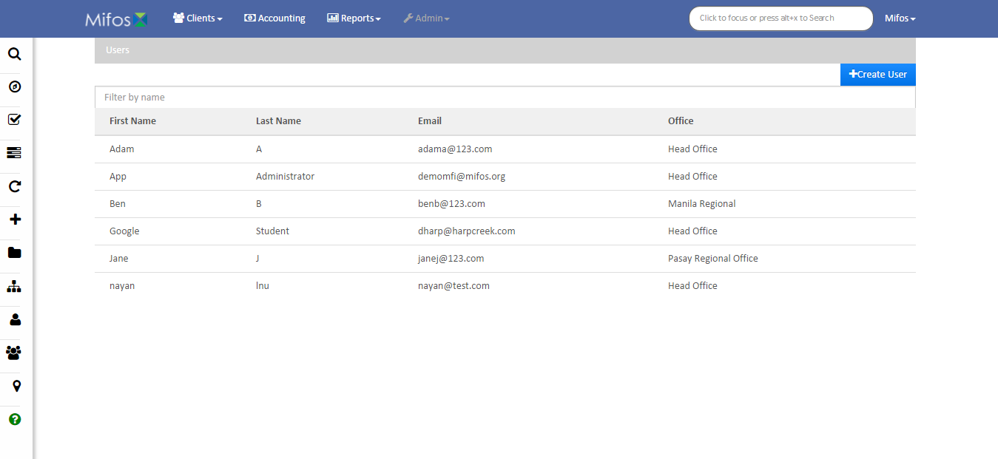
Users
Filter results
Create new user
List of users with email and office

Slide 36
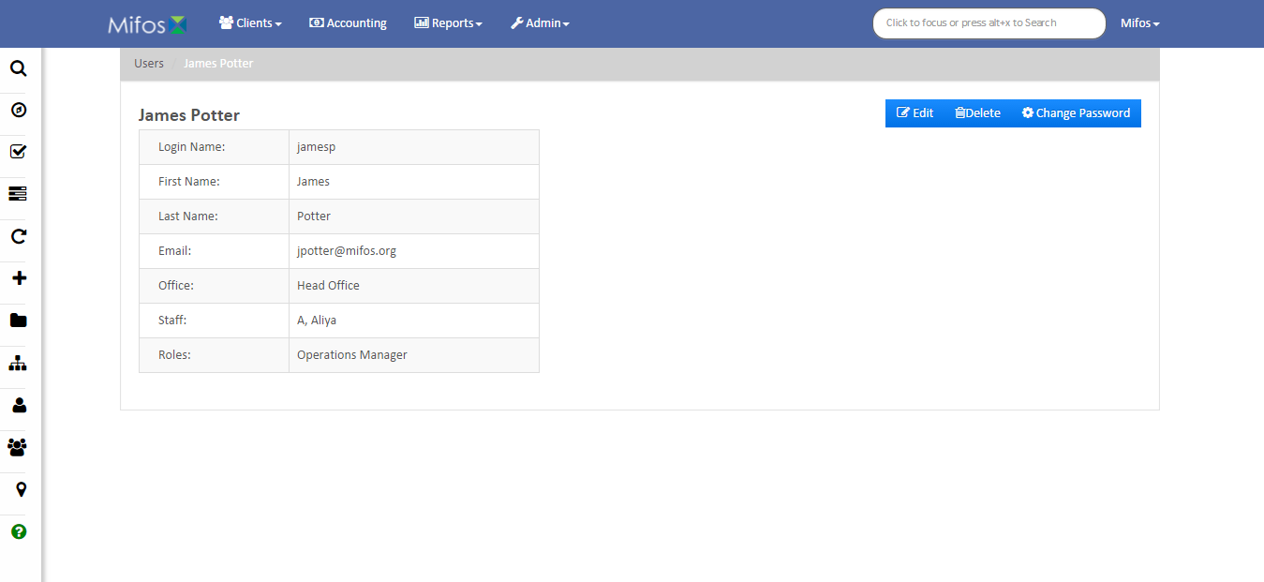
User Example
Edit, delete, or change user password
User info

Slide 37
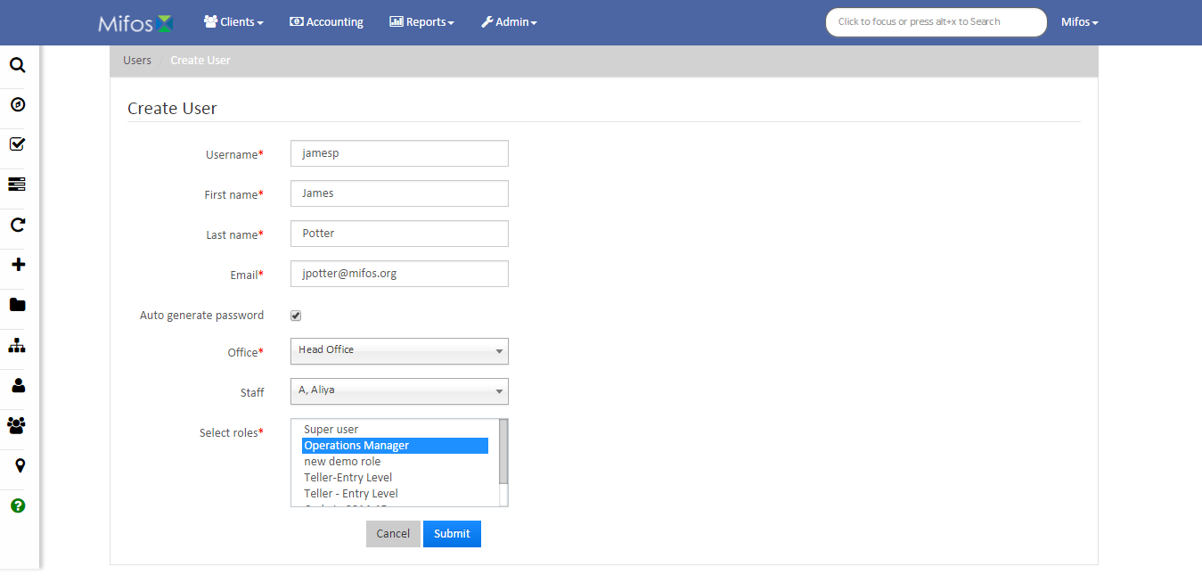
Create User
User info
Submit when done

Slide 38
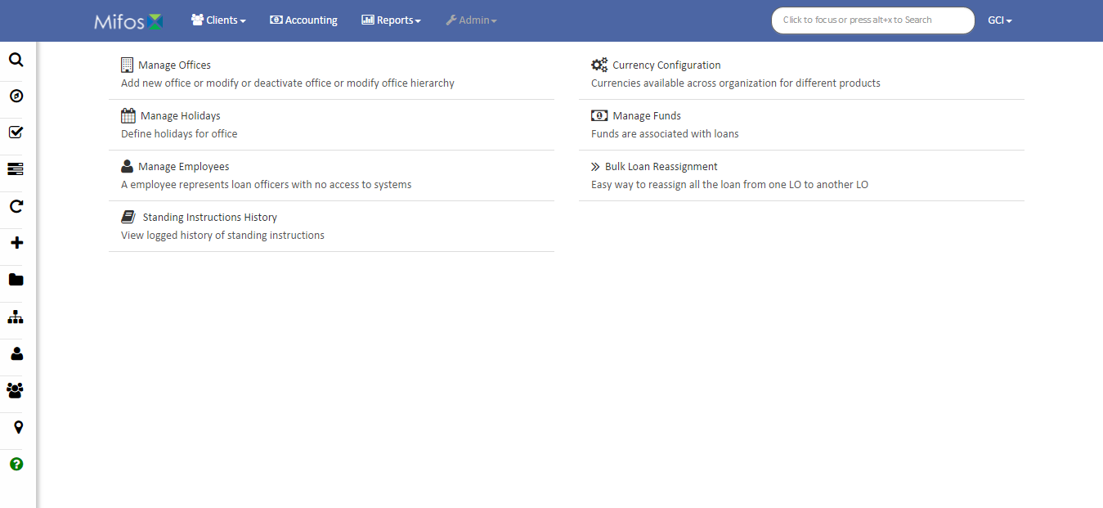
Organization
Organization functions

Slide 39
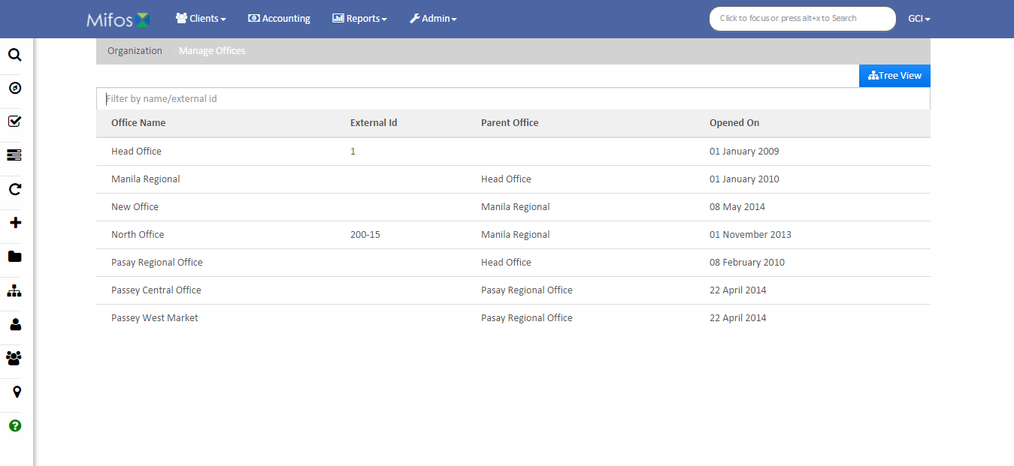
Manage Offices
Filter results
Switch to tree view
List of offices with parent office and opening date

Slide 40
Manage Holidays
Select office
Filter results
List of holidays with dates and status

Slide 41
Manage Employees
Filter results
List of employees with role, office and status

Slide 42
Standing Instructions History
Initialize search when done
Search info

Slide 43
Currency Configuration
List of currencies and codes

Slide 44
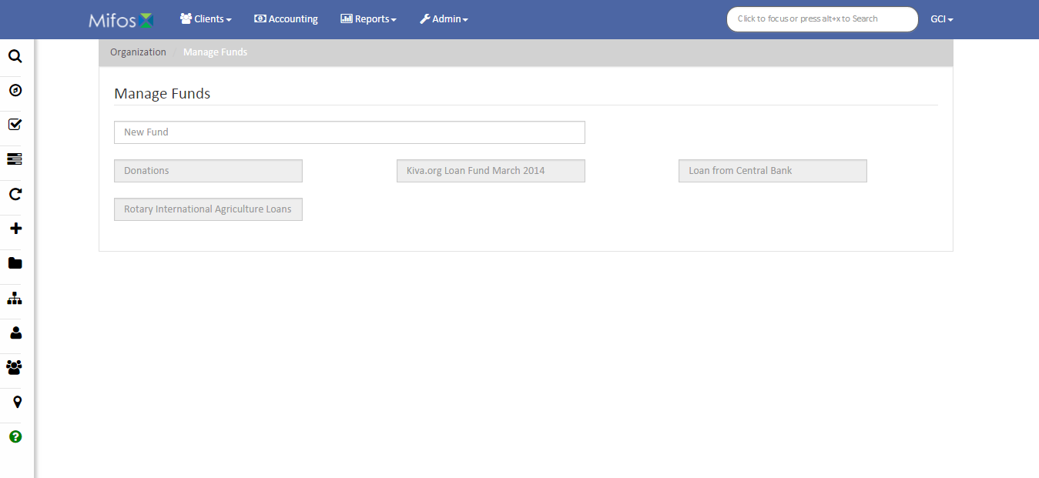
Manage Funds
New fund info

Slide 45
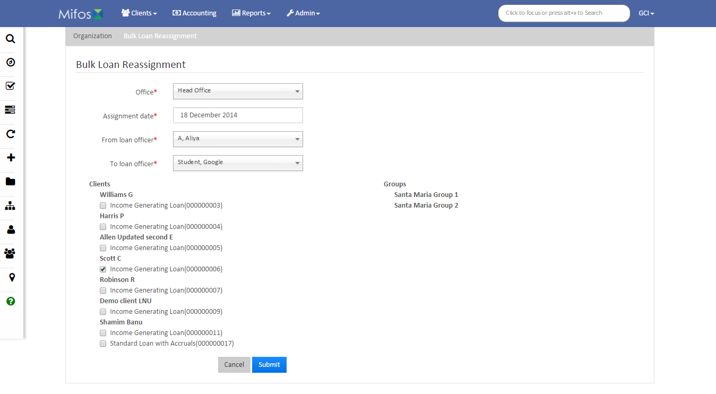
Bulk Loan Reassignment
Bulk loan info with groups and clients
Submit when done

Slide 46
System
System functions

Slide 47
Manage Data Tables
Filter results
List of data tables with associations

Slide 48
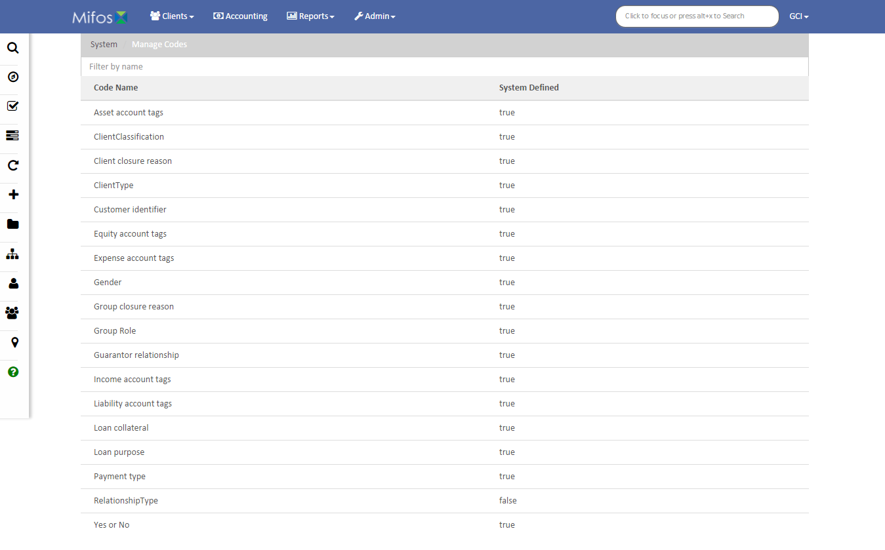
Manage Codes
Filter results
List of codes and whether they are system defined

Slide 49
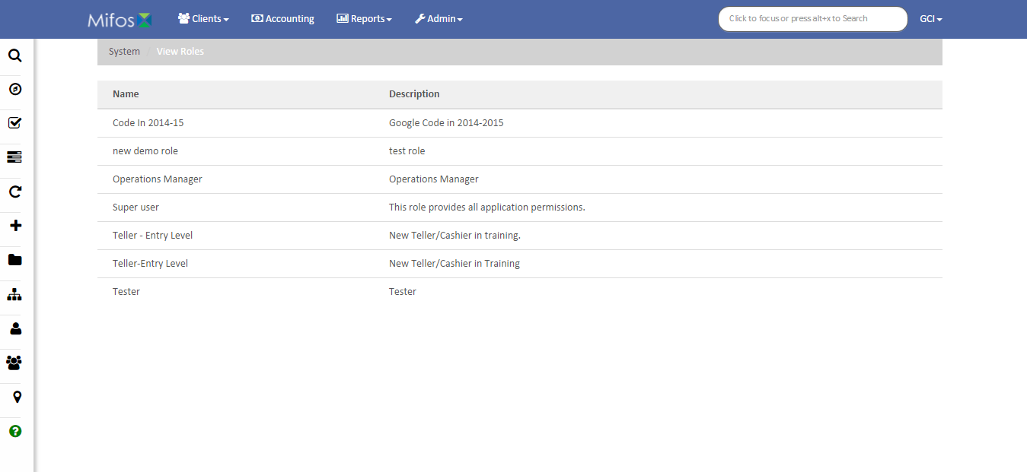
Manage Roles and Permissions
List of roles with descriptions

Slide 50
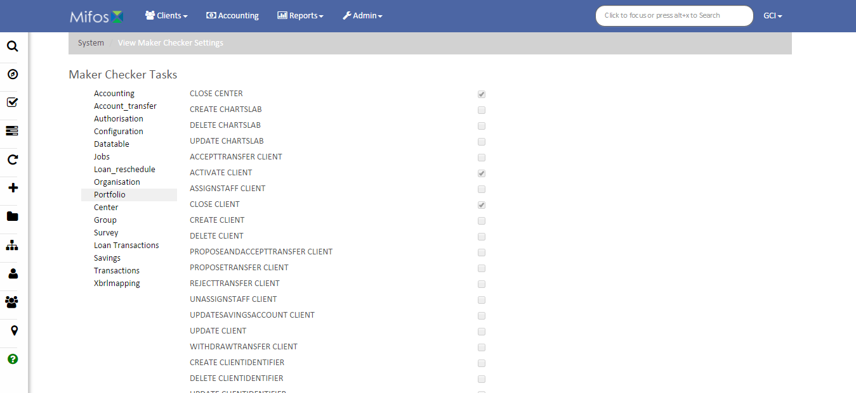
Configure Maker Checker Tasks
List of tasks with status
Task type

Slide 51
Manage Hooks
Filter results
List of hooks with status

Slide 52
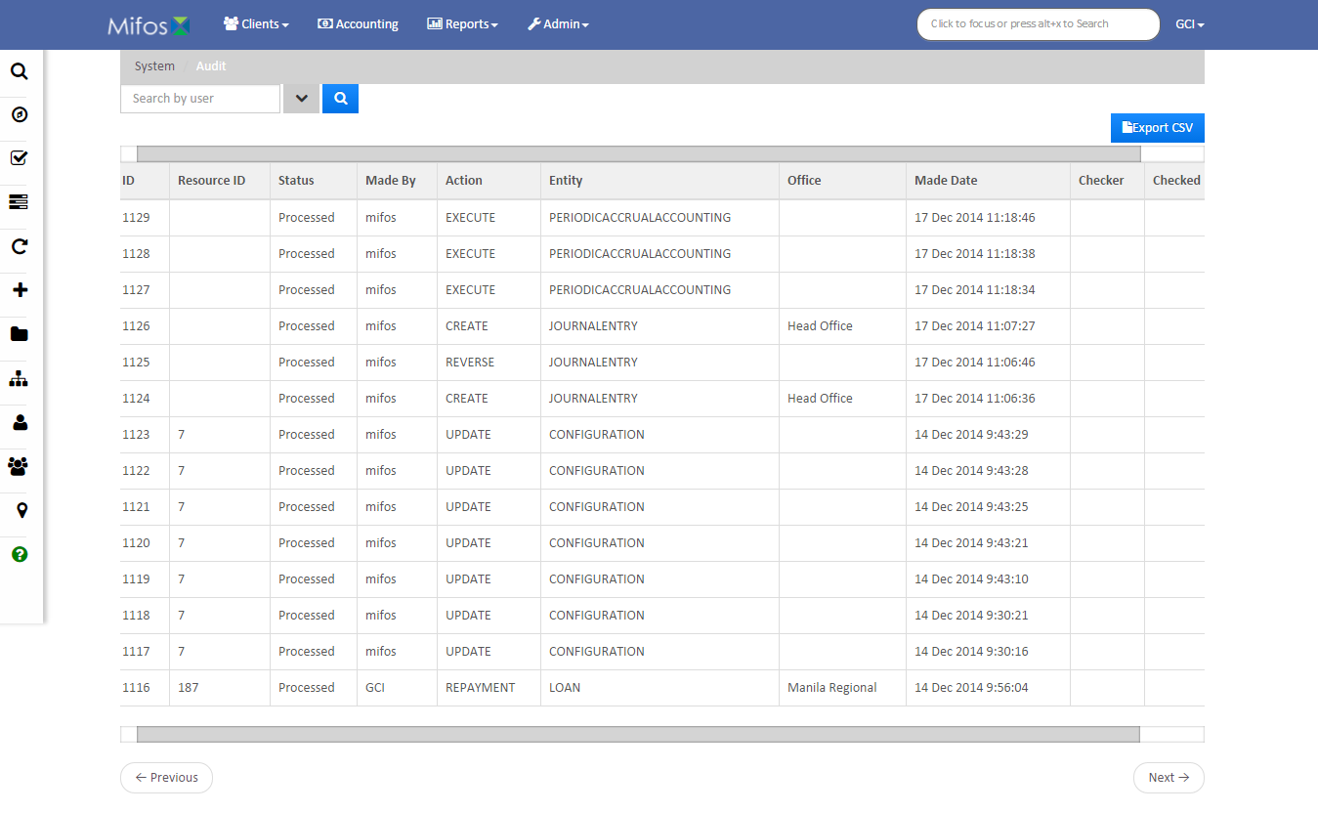
Audit Trails
Search by user
Export CSV
List of audits

Slide 53
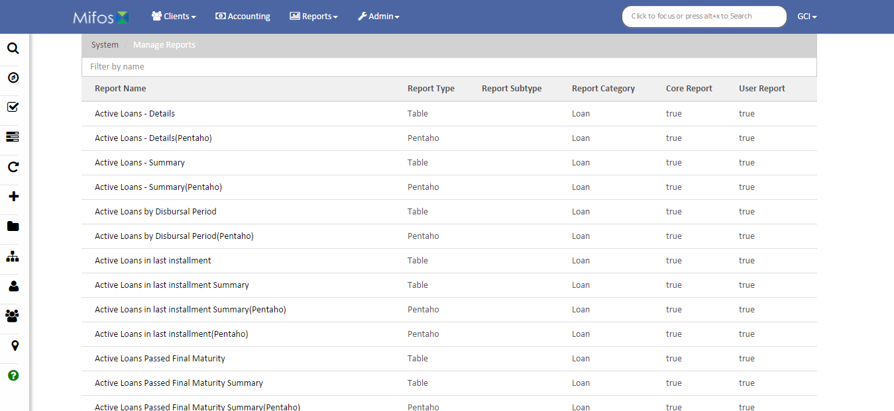
Manage Reports
Filter results
List of reports with type, subtype, category, and status

Slide 54
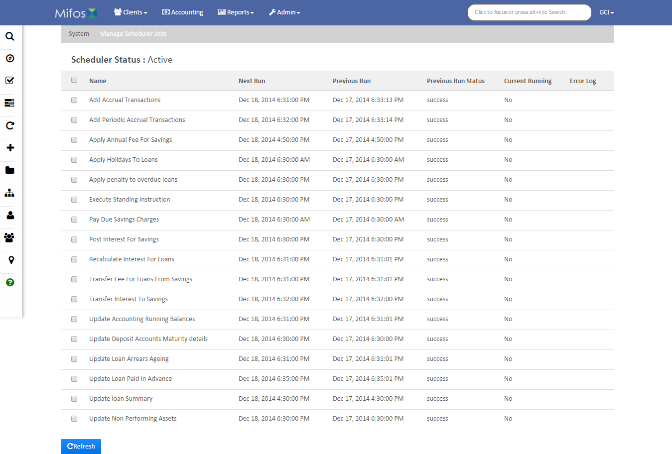
Manage Scheduler Jobs
List of jobs with status
Refresh

Slide 55
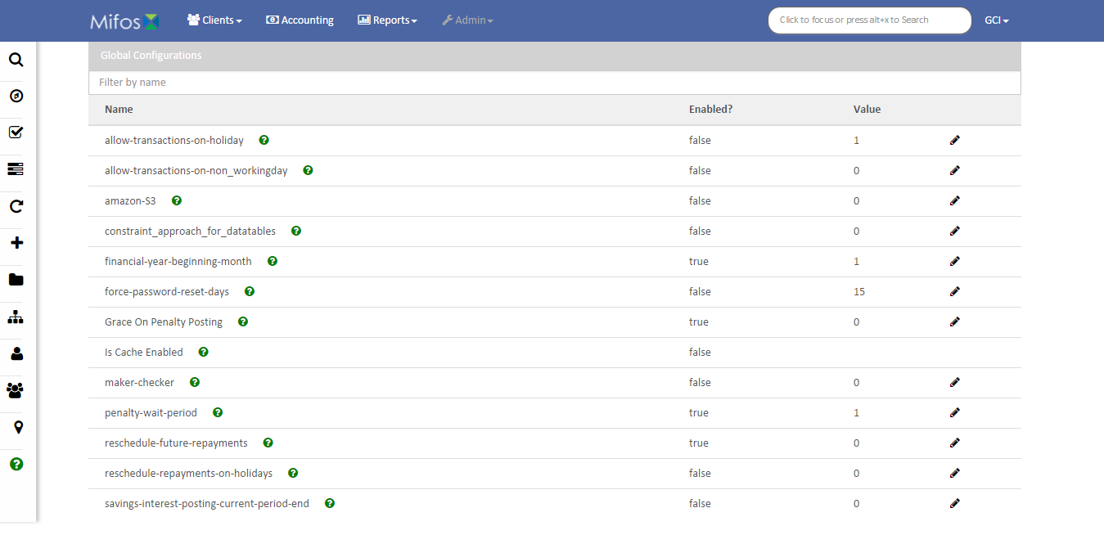
Global Configurations
Filter results
List of configurations with status and value

Slide 56
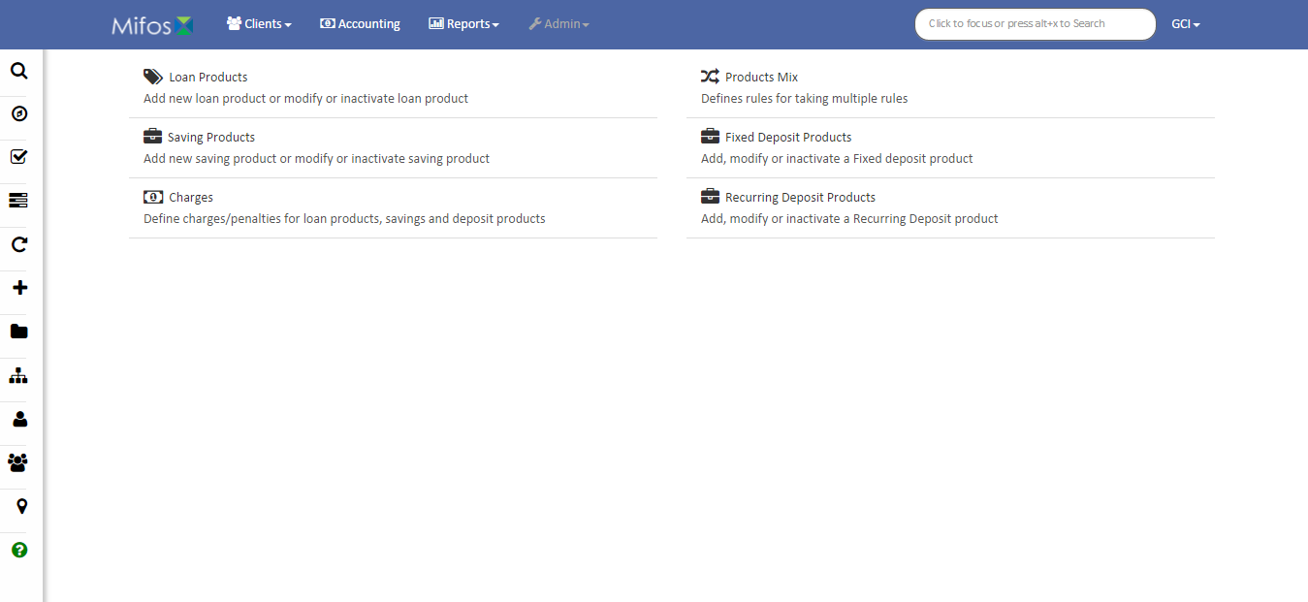
Products
Product functions

Slide 57
Loan Products
Filter results
List of products with short name, expiry date, and status

Slide 58
Saving Products
Filter results
List of products with short name

Slide 59
Charges
Filter results
List of products with application, penalty, and status

Slide 60
Products Mix
List of products

Slide 61
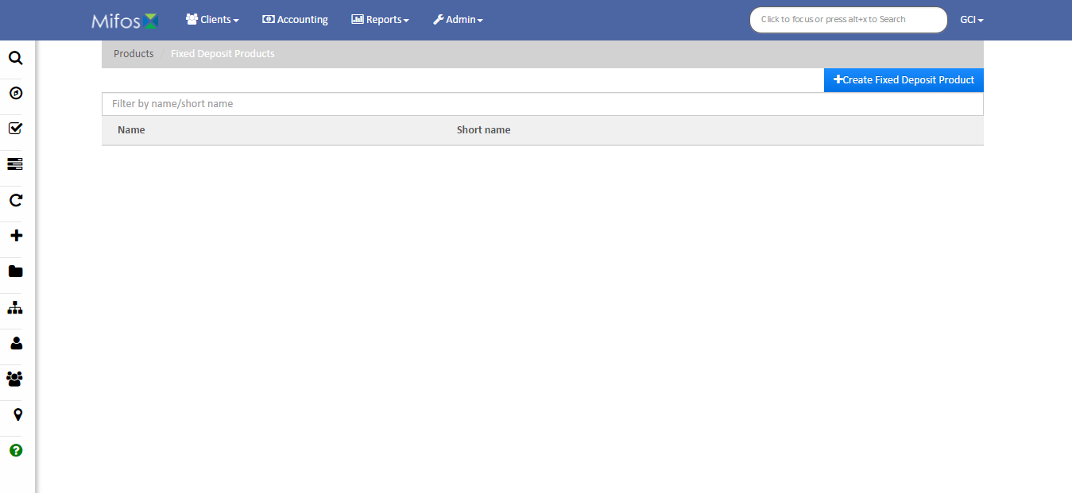
Fixed Deposit Products
Filter results
Create fixed deposit product
List of products

Slide 62
Recurring Deposit Products
Filter results
Create recurring deposit product
List of products

Slide 63
Templates
Filter results
List of templates

Slide 64
Thanks for your attention, and good luck!

