Slide 1
Training slides for teller training

Slide 2
Clients Tab
This is the Clients tab which has 3 different options:
Clients
Groups
Centers
Groups and Centers work similarly to Clients.

Slide 3
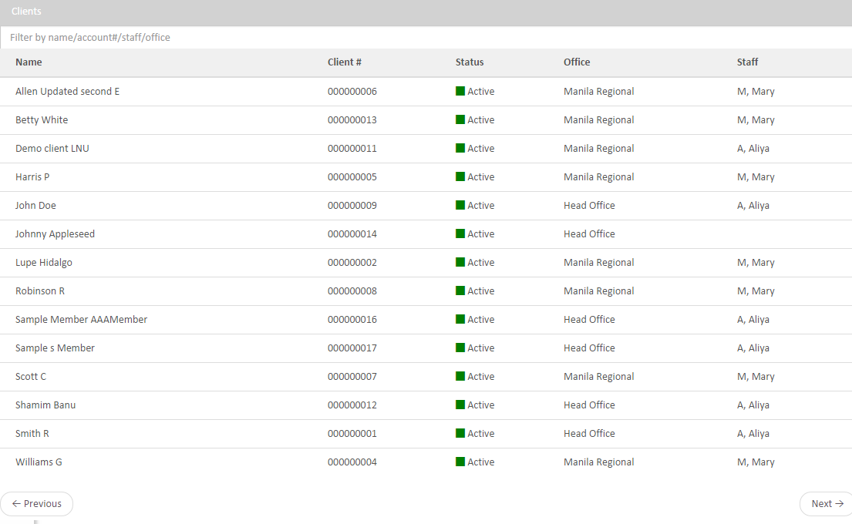
How does it work?
After you select Clients by clicking on the tab’s content box you get to this screen.
Then you can use the filter on the top to find the client you want faster click on the client to get his information.

Slide 4
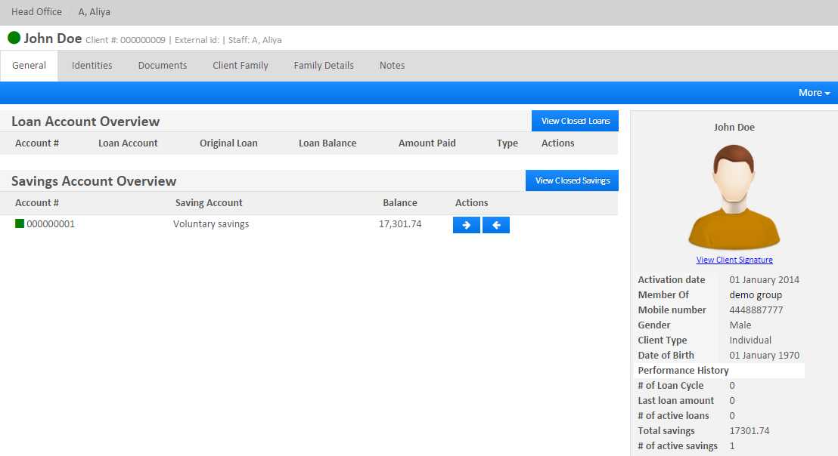
Client Overview
This is the screen you get to after selecting the client.
Here you can get all the information your organization has for this client.

Slide 5
Accounting Section
In this section the user can choose between five different features:
Search Journal Entries
Accounts Linked to Financial Activities
Chart of Accounts
Closing Entries
Accounting Rules

Slide 6
Search Journal Entries
After selecting this option you will get to the following screen.
From here you can use a lot of different filters to adjust what you are searching in the Journal, but also you can use transaction search e.g. S2.
This is the screen you get to after using the search option and pick from the list by clicking on the journal you want to view.

Slide 7
Accounts Linked to Financial Activities
After selecting this option you will get to the following screen.
From here you can select an element from the list by clicking on it.
After selecting the element you are given the following screen which will give you view of this Financial Activity Mapping.

Slide 8
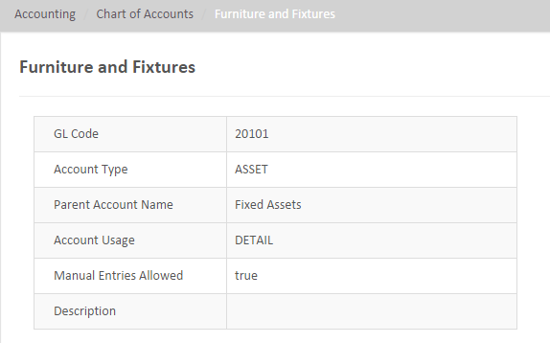
Chart of Accounts
After selecting this option you will get to the following screen.
You can use the filter on the top to find the account you need more easier and after that click on it to get to the following screen.

Slide 9
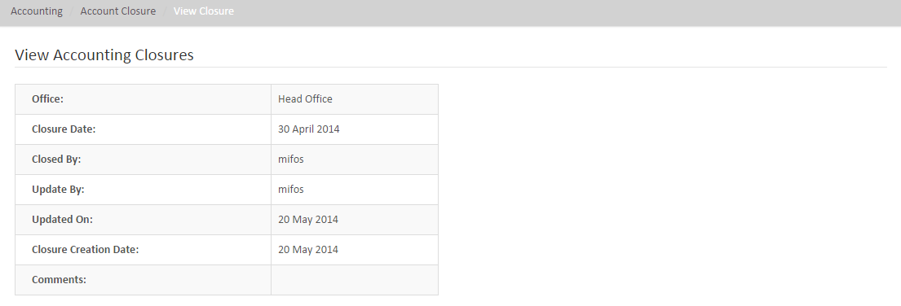
Closing Entries
After selecting this option you will get to the following screen.
Use the Office filter the find the element you need faster and after clicking on the element you needed you will View Accounting Closures.

Slide 10
Accounting Rules
After selecting this option you will get to the following screen.
From here you can click on an Accounting Rule to view it on the following screen.

Slide 11
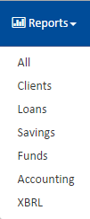
Reports Tab
All of the options from this tab have similar way of working, they give you report for the chosen element and option.
It contains 6 options:
Clients
Loans
Savings
Funds
Accounting
XBRL

Slide 12
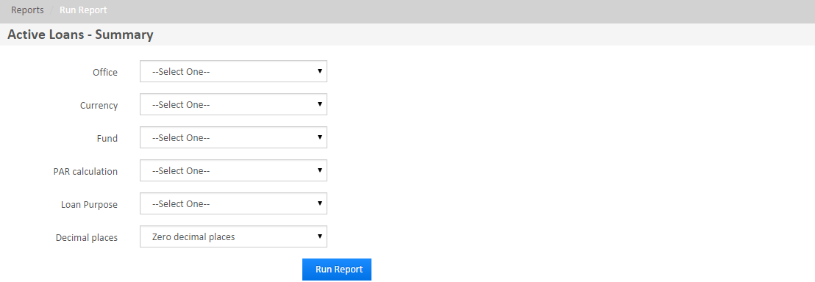
Loans
After selecting this option you will get to the following screen.
From here you choose the element you need and click on it to get to the following screen.
Use the filters to create the report you need.

Slide 13
Admin tab
This is the Admin tab which contains 5 options:
Users
Organization
System
Products
Templates

Slide 14
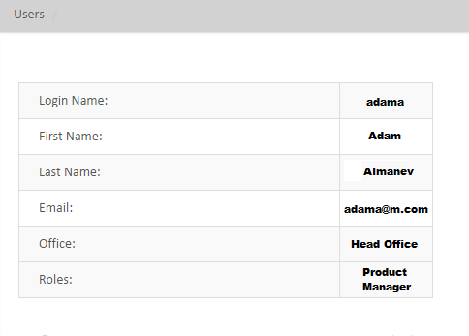
Users
After selecting this option you will get to the following screen.
Use the filter to find the user you need easier and after that click on the user to get to the following screen

Slide 15
Organization
These are all the features of the Admin’s Organization option.

Slide 16
System
These are all the features of the Admin’s System option.

Slide 17
Products
These are all the features of the Admin’s Products option.

Slide 18
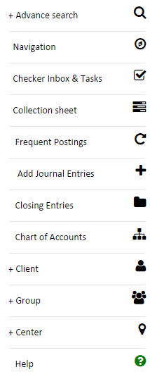
Navigations
This is the quick tab which contains a lot
of useful options. You can find it on the
left side of the screen.

Slide 19
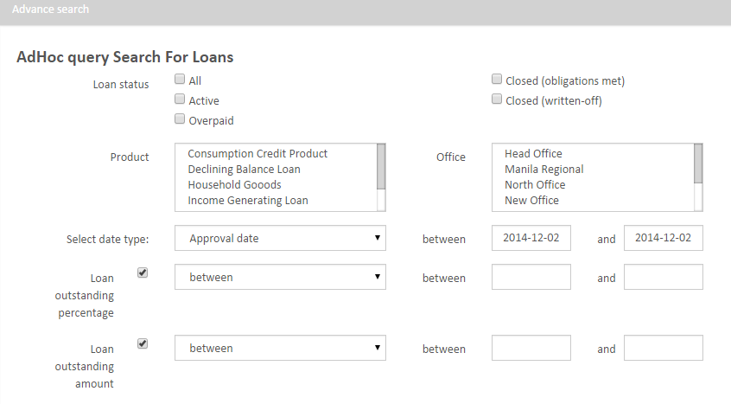
Advance Search
This is the advance search screen which contains a lot of different filters to help you find the needed Loan Journal.

Slide 20
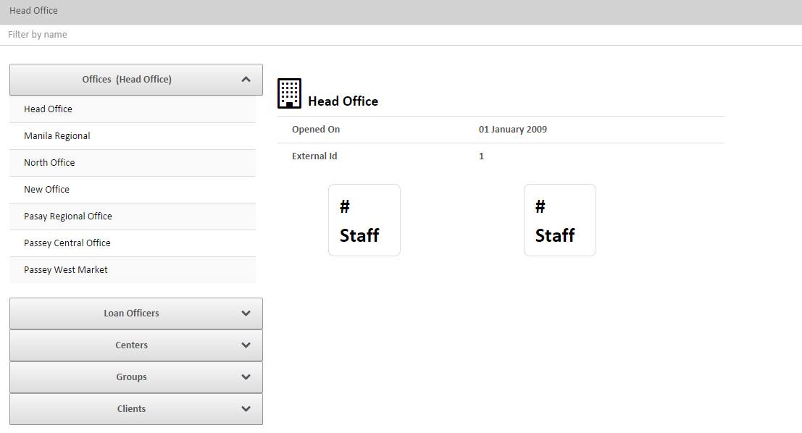
Navigation
This is the Navigation screen which gives you information about Offices, Loan Officers, Centers, Groups and Clients, also it has useful name filter.

Slide 21
Checker Inbox & Tasks
Here you can Approve Clients, Check Inbox, and approve or disburse loans.

Slide 22
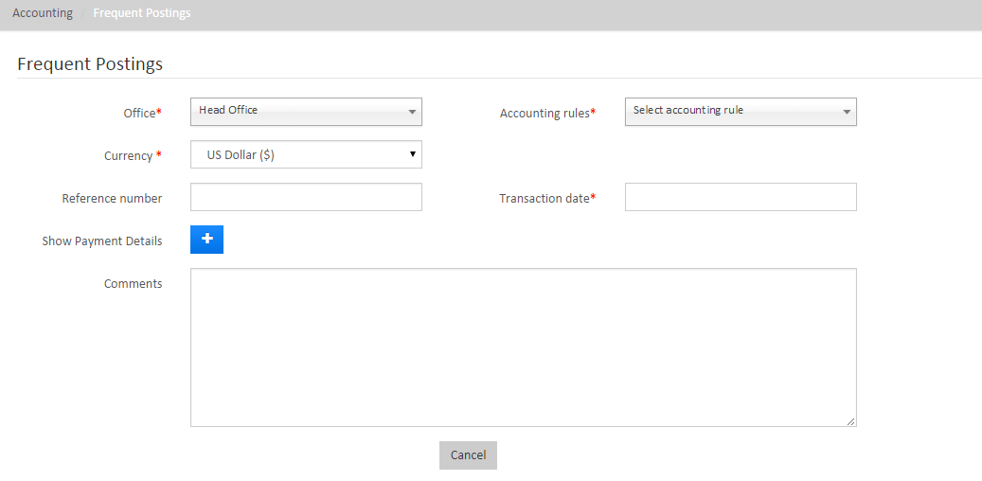
Frequent Postings
This is the screen of Frequent Postings option.

Slide 23
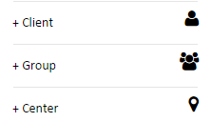
Adding Functions
These three functions add:
Client
Group
Center
Just by clicking on them and filling the needed information.

Slide 24
Questions?

Slide 25
Thank you for your attention!

