Slide 1
Teller Cash Management in Mifos X December 10, 2014
Binny Gopinath Sreevas binny@confluxtechnologies.com

Slide 2
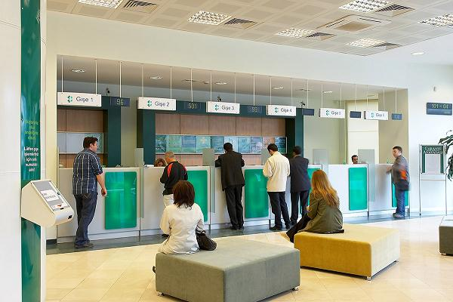
Tellers
Used by institutions where Cash transactions (loan disbursements, repayments, savings deposits and withdrawals) are done at designated desks (or Tellers) at Branche
Need to constantly monitor the cash position at each teller
Teller Desk
Cashier behind the Teller (can be a different person on each day)

Slide 3
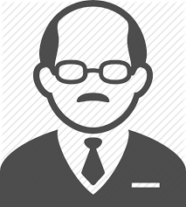
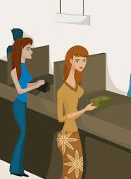
Typical teller cash life-cycle
Allocate Cash
Cashier
Main Cash Vault
Settle Cash
Branch Manager /
Accountant
Loan Repayments,
Deposits
Loan Disbursements,
Withdrawals
Clients
Allocation / Settlement of cash can happen:
at beginning-of-day
intra-day
at end-of-day

Slide 4
Teller Management
Create Tellers at Branches
Allocate Staff as Cashiers for each Teller for different dates
Day Beginning
Allocate Cash from Main Cash Vault to Cashier
Intra-Day
Do Transactions (Cash In / Cash Out)
Allocate Additional Cash to Cashier from Main Cash Vault
Settle Excess Cash with Cashier to Main Cash Vault
Day End
Settle Cash by Cashier to Main Cash Vault

Slide 5
Teller Management – Pending Tasks
Designating GL codes as Main Cash Vault and Teller Cash
Accounting entries for Cash Allocation and Settlement
Automatically selecting a Payment Type for Cashier transactions
UI improvements
Viewing/filtering of Allocated Staff as Cashiers for each Teller for different dates
Pagination of Views

