Slide 1
Variable installment loans

Slide 2
Before proceeding, make sure that…
You are logged in

Slide 3
What are variable installment loans?
Sometimes, there is a need to tailor loan repayments to suit the cash flow patterns of the borrower. This is particularly true for products of agricultural loans where client cash flows can be quite volatile.
This creates a need for Financial Institutions to customize loan products to allow for more flexibility with the installment schedule.
For more information, see:
https://cwiki.apache.org/confluence/display/FINERACT/Variable+Installment+Loans

Slide 4
Setting up a variable installment loan
First, you must configure variable installment loans at the loan product level.
Then, you can create a loan account under that product with variable installments.
Lastly, you can edit an installment plan for a loan account.

Slide 5
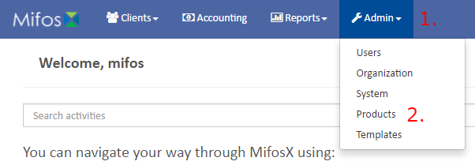
1. Configuring a variable installment loan
From the main screen, click on Admin at the top, then Products from the drop down list. This will launch the Products menu.
Click on the Loan Products at the top left corner.

Slide 6
1. Configuring a variable installment loan
Then click on the blue Create Loan Product button in the top right corner.
Fill out the necessary fields for a Loan Product. See here for more details:
https://mifosforge.jira.com/wiki/display/docs/Loan+Products

Slide 7
1. Configuring a variable installment loan
Scroll down to the Settings subsection. Check the “Is Variable Installments Allowed?” box. This will cause two boxes to appear.
First, fill in the Minimum Gap Between Installments in days.
Then, fill in the Maximum Gap Between Installments in days.

Slide 8
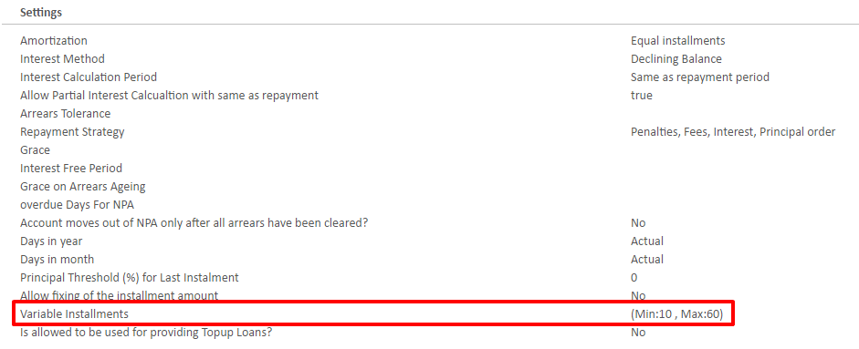
1. Configuring a variable installment loan
Submit the loan product.
Once it is created, it will take you a summary page of the new loan product. You can ensure variable installment loans are enabled by looking under the settings section.

Slide 9
2. Creating the loan account
First, search for the desired client on the global search. Once the client is found, click the general tab.
Then, on the client page, click the blue New Loan button.

Slide 10
2. Creating the loan account
Select the loan product to base the loan account. Use the product you created in step 1 that has variable installment loans enabled.
Complete the necessary loan account fields and submit. For more details, see:
https://mifosforge.jira.com/wiki/display/docs/Loan+Account+Fields

Slide 11
2. Creating the loan account
The loan account will be created with a status of Pending Approval.

Slide 12
3. Changing the Installment Plan
There are two ways to change an installment plan. However, the first step (next slide) will be the same.
a. Manually
b. Using a Pattern

Slide 13
3. Changing the Installment Plan
Go to loan account that has just been created.
Click on the More tab on the right, then click Edit Repayment Schedule from the dropdown.

Slide 14
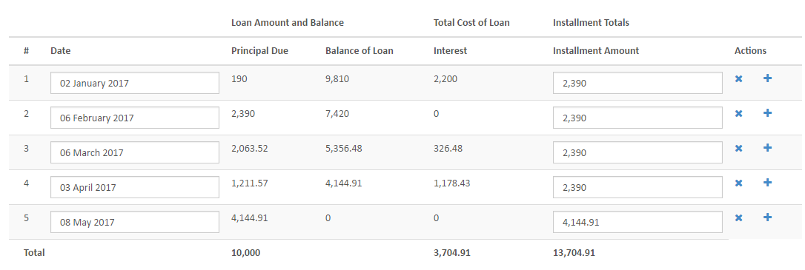
3. Changing the Installment Plan
This will take you to the current loan installment plan, which will look similar to this:

Slide 15
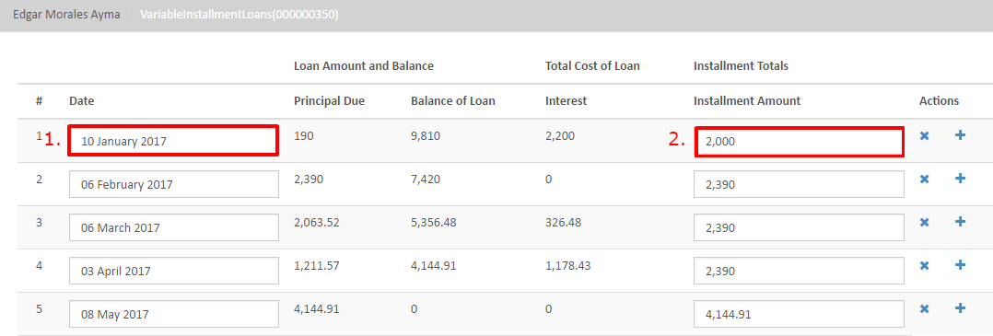
3a. Manually updating installment plan
You can manually change what you need, such as the date and/or amount of an installment.
Here, I have changed:
1. The date from 02 January to 10 January
2. The amount from 2390 to 2000

Slide 16
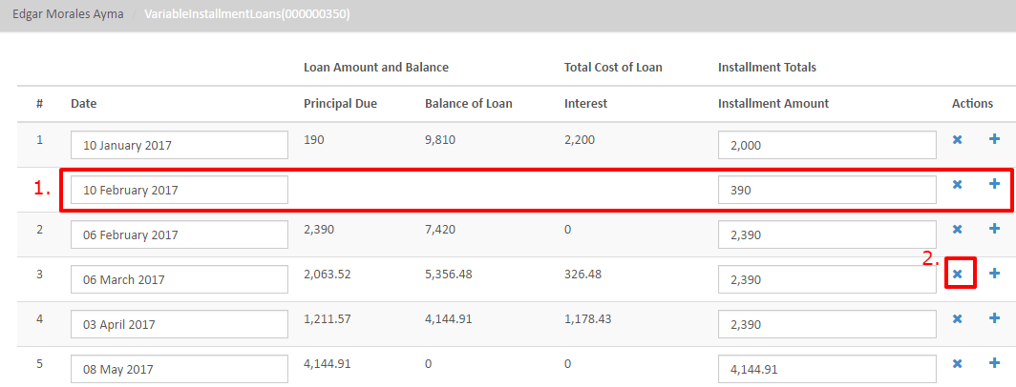
3a. Manually updating installment plan
In addition, you can add or remove an installment.
First, to add an installment, click on the “+” button on the right side and fill out the details.
Second, to remove an installment, click on the “x” button on the right side of the installment.

Slide 17
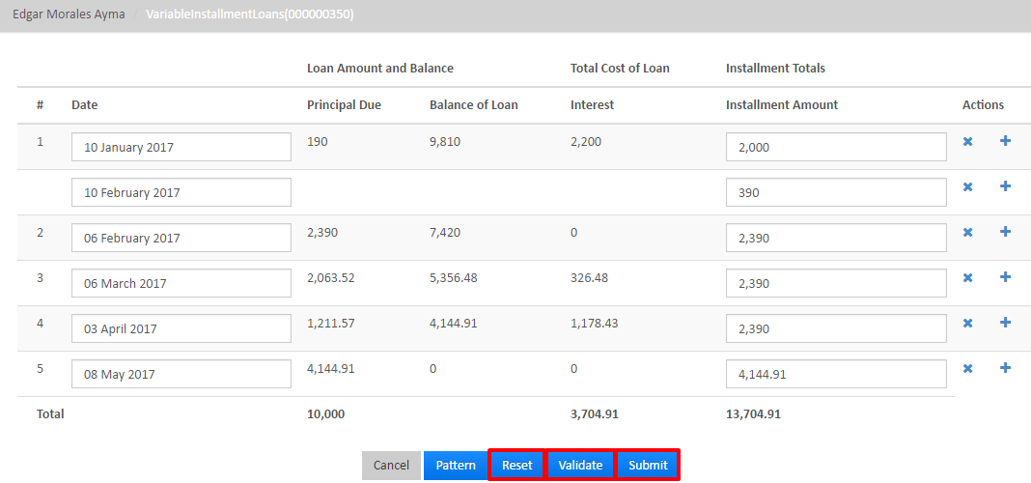
3a. Manually updating installment plan
If you need to revert your changes, click the “Reset” button to reset values to the normal installment schedule.
If you are satisfied with your changes, click on the “Validate” button to validate the details.
Once these are validated, you can click on the submit button.

Slide 18
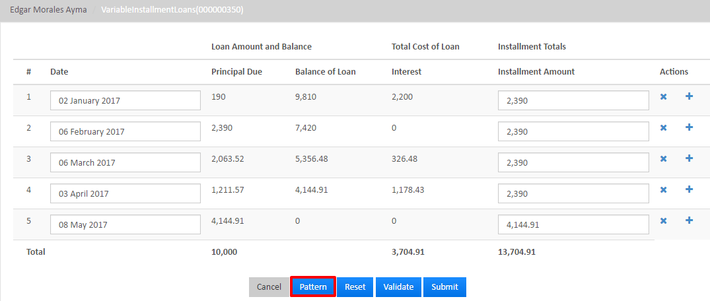
3b. Applying pattern to installment plan
In order to create a pattern, navigate to the “Edit Repayment Schedule.” (See previous slide)
Then, click on the blue pattern button at the bottom.

Slide 19
3b. Applying pattern to installment plan
This should cause a dialog to popup.
Then, you can fill in the desired pattern:
1. From date – Provide the starting date
In this example, January 2.
2. To date – Provide the end date
In this example, May 8.
3. Increase month by – Provide increase by month
In this example, None.
4. Day of the month – Provide day of the month
In this example, the 5th.
5. Installment amount – Provide the installment amount
In this example, 1000.

Slide 20
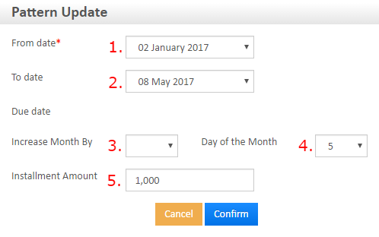
3b. Applying pattern to installment plan
The filled out dialog may look something like this.
Note: The numbers match the described inputs in the previous slide.

Slide 21
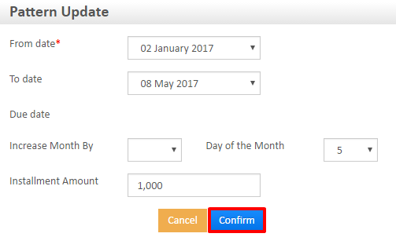
3b. Applying pattern to installment plan
When you are finished, click the blue “Confirm” button at the bottom of the dialog.

Slide 22
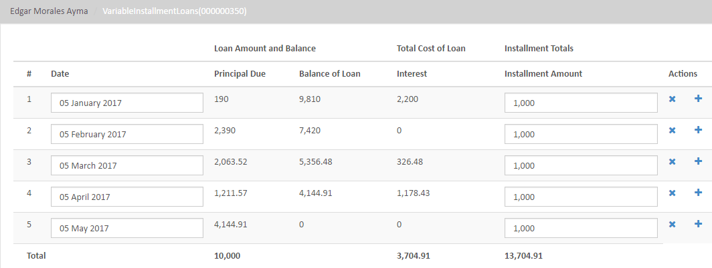
3b. Applying pattern to installment plan
Once it is confirmed, it will take you to the installment plan. You can view the created pattern and its effect on the installment plan. An example is shown below.

Slide 23
Congratulations!
You have configured a variable installment loan at the product level, created a loan account with variable installments, and edited the installment plan!

